Slide 1
RETAINWORKS
IEP Training
May 16, 2024

Slide 2
Introductions
Leanne Garner
&
Kelly Collins

Slide 3
Objectives
Be able to explain what an IEP is, why it’s important, what’s in it for the workforce coordinator, the client, nurse navigators, employers, etc.
Be able to identify the components of an IEP and what goes into each section.
KANSASWORKS IEP creation, documentation, uploads
KANSASWORKS Review Trends
Best Practices
Where do we go from here?

Slide 4


The Good, The Bad and the Ugly of IEP’s

Slide 5

I.E.P.
Individualized Employment Plan
(Is it just busy work???)
Provides a framework for all team members to work within
Maps out goals and action steps to get there
Establishes important timelines / due dates
Defines roles and responsibilities of team members
Shows the value of services provided

Slide 6
But first…The Intake Interview
Introductions - Explain why you are here, and what your value is to the client
Have a Conversation
Participants are likely struggling physically, mentally and financially…
- How do you show empathy?
Important questions:
How are you feeling?
How is your life different?
How is work different?
Notes:
Survey Responses – so much happening in participant’s life – chaos, confusion, overwhelmed by questions
Everyone comes to us with a piggy bank, however, we don’t know how much is in it. Before we take out, we may need to make some deposits, we don’t want to leave them with a negative balance.
Take the time to see the BIG Picture.
–Are there more things going on? Broken foot – may be depressed, etc.

Slide 7
IEP Requirements
In consultation with the claimant, a written Individual Employment Plan (IEP) matched to the claimant’s needs based on information gathered during the Initial Assessment is developed.
The IEP must, at a minimum, include:
    a specific employment goal;
    a list of challenges or barriers to employment specific to the claimant;
    detailed step-by-step activities the claimant will perform and or participate in to achieve his/her employment goals;
    timelines to start and complete each activity;
    specific dates for staff follow-up to evaluate each activity, provide additional assistance, and make adjustments, if necessary; and
    the next scheduled contact date with staff (when appropriate).
Notes:
REDCAP / RETAINWORKS Manual

Slide 8
IEP Components
Occupational Assessment and Career Research
Justification for Employment Goal
Justification for Vocational Goal
Job Seeker Strengths
Plan for Overcoming Barriers
Assistive Technology Needs for Achieving Goals
Job Seeker Responsibilities and Agency Responsibilities
Required Supportive Services During Active Participation
Economic Need Statement and Planning
Required Services During Active Participation
Post Employment Needs
Job Seeker Involvement Statement
Job Seeker Progress Review
Additional Notes
Notes:
It is important to note that the IEP is going to look different depending on whether the client is Stay at Work, Return to Work, or Future Employment.

Slide 9
Occupational Assessment and Career Research
Provide a summary of the clients’ employment situation, career goals and include what you know about the labor market forecast for this field.
What job does the client currently do or want to do? (S) (R) (F)
Does the client have previous skills / experience in this field? (S) (R) (F)
How much do they want to work, Full-time / Part-time? (S) (R) (F)
Current wage, or wage / salary needed (S) (R) (F)
Have any career related assessments been utilized: Interest Profiler, Work Values Profiler, Skills Tests, etc. (R) (F)
Provide Onet median wage for area and projected outlook (S) (R) (F) www.onetonline.org
Notes:
Labor market information (Onet) is important for all clients.
We can provide them with some insight as to the future of their career choice.
This is another way that we provide value to the customer and establish that we are the workforce experts.
Even if they are stay at work / return to work they may decide to look for other opportunities down the line, and they will turn to us for assistance.
If undecided as to what they like to do, providing onet data on a couple different career interests so they can make an informed choice.

Slide 10
Justification for Employment Goal
Explain why this goal is a good fit for this client.
Identify previous skills, years of experience, industry knowledge and/or educational requirements that the client has that are relevant. (R) (F)
Does this field meet the client’s salary need? (S) (R) (F)
If the client has medical restrictions or limitations, how will the employer accommodate? (S) (R)
Are these restrictions / limitations reasonable for the proposed career field? (F)
If not working, are there current openings in the area? Specific employers to target? (F)
Notes:
This can be especially difficult to write when the client doesn’t really know what they want to do.
Sometimes I find I need to have multiple conversations before we can both agree on a goal.
Sometimes you may have to delicately introduce here what challenges they might face

Slide 11

Justification for Vocational Goal:
May not apply to (S) and (R)
If the client needs education, training or certification, explain why this is necessary and a good investment for this client. (R) (F)
Estimate of how long will it take to complete? (R) (F)
How will client support themselves during? (R) (F)
This Photo by Unknown Author is licensed under CC BY
Notes:
Most need to work some while going to school to meet needs.

Slide 12

Job Seeker Strengths:
Identify what client & team see as the individual’s strengths in the workplace. (S) (R) (F)
May include experience, education, soft skills, transferrable skills, etc. (S) (R) (F)
Notes:
This is my favorite part of the IEP – every client needs their strengths identified and recognized.
Many clients struggle with this or they think about their personal attributes that don’t always relate to work.
Help them see themselves as others see them… They / We are so much more than what is seen on the surface.

Slide 13

Plan for Overcoming Identified Barriers:
Identify barriers to employment, how they will be addressed and who will be responsible. (S) (R) (F)
Specify direct services provided by coordinator, nurse navigator, workforce staff, medical provider, and employer
Include referrals to community resources, handouts provided, workshops to attend, accommodations, etc.
What is expected of the client?
S.M.A.R.T. – Are the goals Specific, Measurable, Achievable, Relevant and Time-Bound?
Notes:
I always ask the clients what challenges or barriers do they think they may face?
Usually I find that I have to acknowledge other things that need to be addressed.
In the WFC, I learned early, that the quicker I can identify a client’s barriers and address them properly, the quicker they will have success!
-Client will work with WFC staff to develop a custom resume by _______ and notify workforce coordinator when complete.
-Client will attend ______ workshop on _____________.
-WFC staff will discuss how to deal with convictions on applications and in interviews. Staff will provide 3R’s Conviction Speech handout.
- WFC staff provided article “Strategies for Addressing Ageism”.

Slide 14
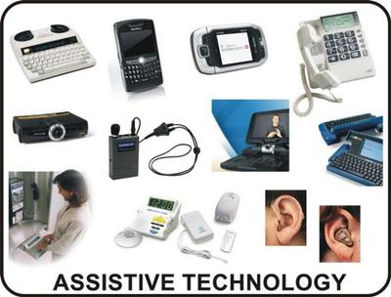
Assistive Technology Needs for Achieving Goals:
May not apply
What technology is needed?
Why will it be beneficial?
How might it be acquired?
Is there any training that will be needed for the client or employer?
Include information about workplace assessments and accommodations that support this plan.
This Photo by Unknown Author is licensed under CC BY-SA
Notes:
Ice Machine, Sit/stand desk, etc.
If unsure of what technology is needed, mention the need and contact ATK by a specific date.
Ex: Client needs assistive technology to help with ________. Workforce Coordinator will contact ATK on client’s behalf by ______ in order to explore what options might be available. WFC coordinator will coordinate ATK services with client to explore / test out equipment and options for funding.

Slide 15
Job Seeker Responsibilities and Agency Responsibilities
Client must be in compliance with the program requirements for the Nurse Navigators and Workforce Coordinator, in order to request Supportive Services. Failure to comply could result in denial of Supportive Services. Supportive Service requests can take two to three weeks to process, once all documentation has been received by the participant.
Client and Workforce Center Coordinator will touch base every 30 days to see how progress is coming along as well as see if there is any other assistance that client is needing within RETAINWORKS.
Client must participate in the services described in this plan including on-going communication with RETAINWORKS staff about changes to employment, living situation, and supportive services. This plan can be updated with the consent of all parties.
Notes:
Every IEP I have written has some form of responsibilities that were required to be included.
This is the minimum that probably needs to be in this section.
In the plans I reviewed most of them had this text all in one paragraph. I was overwhelmed, just looking it. I have broken it out into 3 separate responsibilities.
Be specific as to what the client does and what you will do. Who do these statements focus on? What is the Agency responsible for?
Shouldn’t there be a balance between them?
Touchbase – Note who is responsible for this – both.

Slide 16

Economic Need Statement and Planning
Detail any public assistance received or that may be needed.
Specify supportive services that will be needed and how often?
This Photo by Unknown Author is licensed under CC BY
Notes:
This is the Show Me The Money portion of the training!

Slide 17

Required Supportive Services During Active Participation
Customer has been informed that the following supportive services may be made available as needed and so long as customer meets set criteria and provides documentation as requested and required:
Transportation assistance, childcare assistance, employment related expenses and subsistence.
Medical accommodations for customer to return to or retain employment are also available with proper documentation from a medical provider. The customer’s need for supportive services will be supported at any point during their active participation in the RETAIN Program.
(Specify what supportive services will be required and what documentation is needed.)
This Photo by Unknown Author is licensed under CC BY-NC
Notes:
This is another one where I recommend breaking the points up in order to be clear. These first ones are just spelling out what may be available.
Then provide what you think the client is going to need.
John needs bus passes in order to attend medical and workforce appointments. He may request these once a month

Slide 18

Post-Employment Needs
Client will participate in a 2-week, 4 week, and 8 week check-ins with the Nurse Navigator after returning to work.
Customer will follow providers guidance and attend all appointments during the return-to-work process.
Notes:
Client and WFC Coordinator will make contact at least once a month.

Slide 19
Job Seeker Involvement Statement
Client understands that is a research grant and all calls and appointments need to be kept in order for this grant to successful. If client is unable to make an appointment, then advanced notice and a call to the Coordinator and / or Navigator is necessary to reschedule.
This plan has been developed jointly with my Workforce Coordinator. By my signature below I certify that the information contained herein is accurate and true to the best of my knowledge, and I understand the expectations and my responsibilities in successfully completing this plan of action.
Notes:
This is another copy /paste section.
However I have added statements indicating the client is eager, motivated and goal focused to accomplish his/her goals. (Bank Deposit!)

Slide 20
Job Seeker Progress Review
Summary of progress towards goals, barriers encountered, resources provided, referrals made.
Client will submit _______ to document _______.
Next contact date / time / method ________________________________
Notes:
Use this section to document follow up appts.
You also could Schedule a service in KW, Keys testing, resume using KW Add a Service (not quick entry) with an estimated completion date, only complete when verified complete

Slide 21

Additional Notes
Nurse Navigator will follow up with Return-to-Work plan and Activity Prescription.
Nurse Navigator & Program Coordinator Contact Information
Customer will receive the following incentives upon completion of:
Notes:
Some thoughts of things you might want to include here:

Slide 22
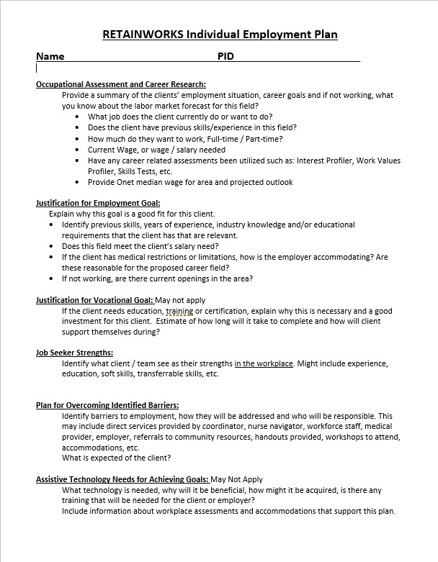
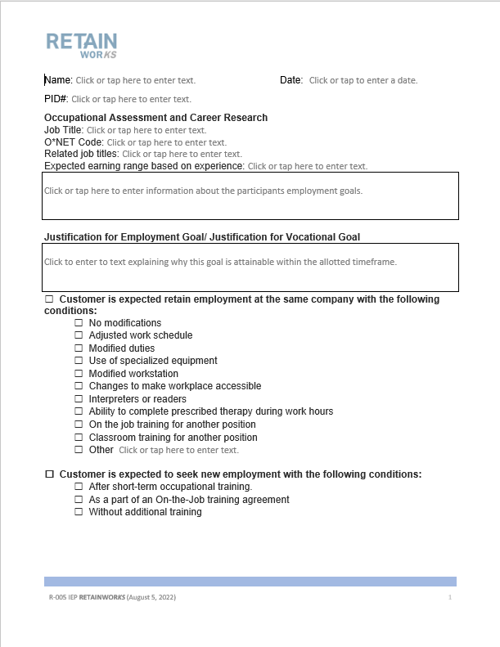
KANSASWORKS IEP Creation
Templates
KANSASWORKS Template
RETAINWORKS Template Form
Notes:
Typically KW IEP Templates for other programs have a sample statement that can be modified with fill in the blank fields.
Since SW, RTW, FE are so different, I have created a document that has the tips presented in this training.

Slide 23
KANSASWORKS Template Process
Open KW Template in Word
Complete appropriate sections
Save!
KW - Create IEP
Copy / Paste from template into KW Fields
Save / Print as PDF / Sign
Enter IEP Service
Upload signed IEP
Notes:
Enter IEP – Pathway will be shown on a future slide
Upload IEP Pathway will be shown on a future slide.

Slide 24
RETAINWORKS Template Process
Open RETAINWORKS Template in Word
Complete appropriate sections
Save!
Print / Sign
Enter IEP Service
Upload signed IEP

Slide 25
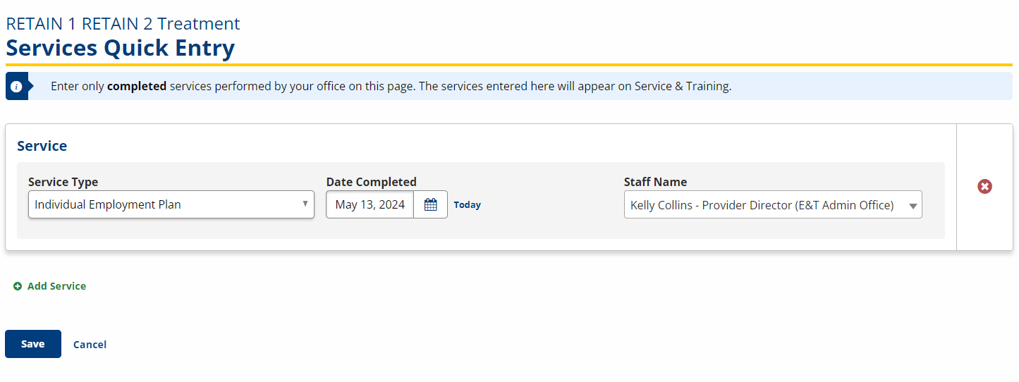
IEP Documentation
Notes:
Here is your pathway for service documentation.
IF you wanted to create a scheduled service, you would click Add Service with estimated completion date and no completion date. If you need help, Leanne or I can would be happy to walk you through any of these tasks.

Slide 26
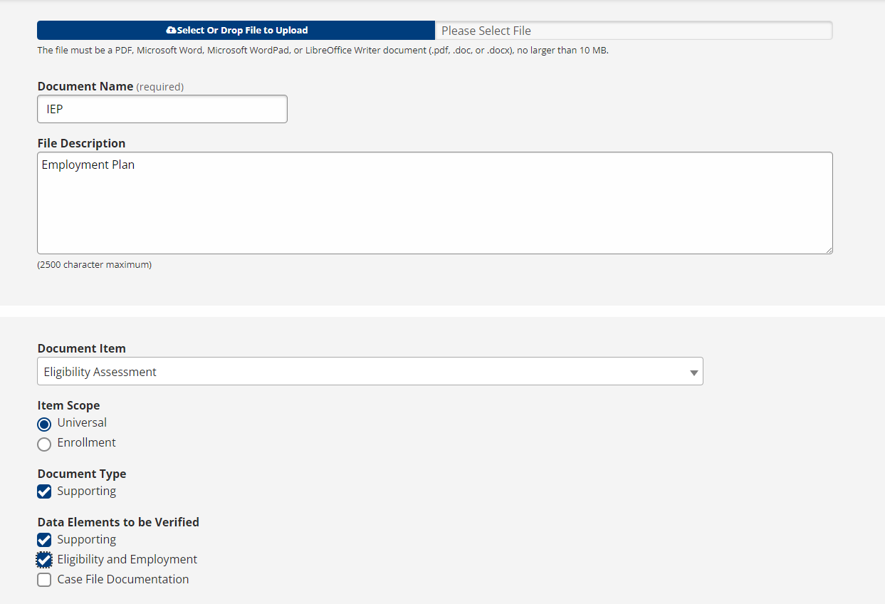
KW Upload
Notes:
Universal documents can be viewed by anyone with KW Staff account.
Enrollment documents can only be viewed by KW staff with enrollment permissions.
Since multiple staff need to be able to access, this is why we need to use Universal.

Slide 27
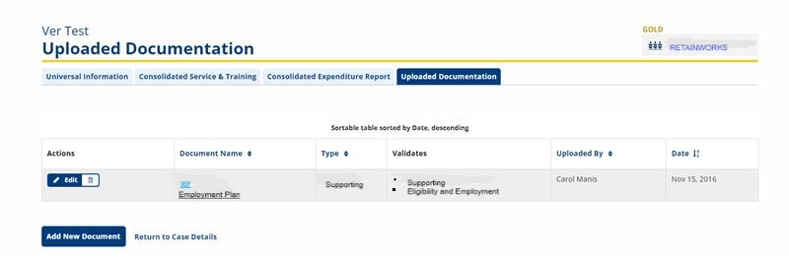
Completed Upload

Slide 28
When Should You Update an IEP
?
Notes:
Setbacks, goal change, change in path – VR, WIOA

Slide 29
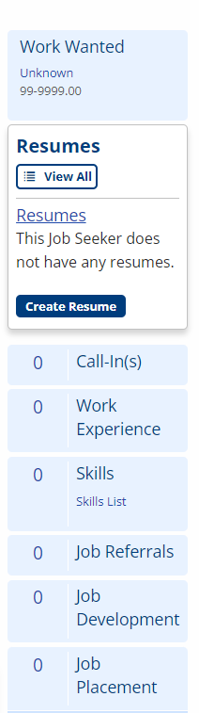
KANSASWORKS Review Trends
Work Wanted
Service Entry
Resume Review
IEP / Document Upload
Job Placement
Program Notes
Notes:
This is from a real client that is working.

Slide 30
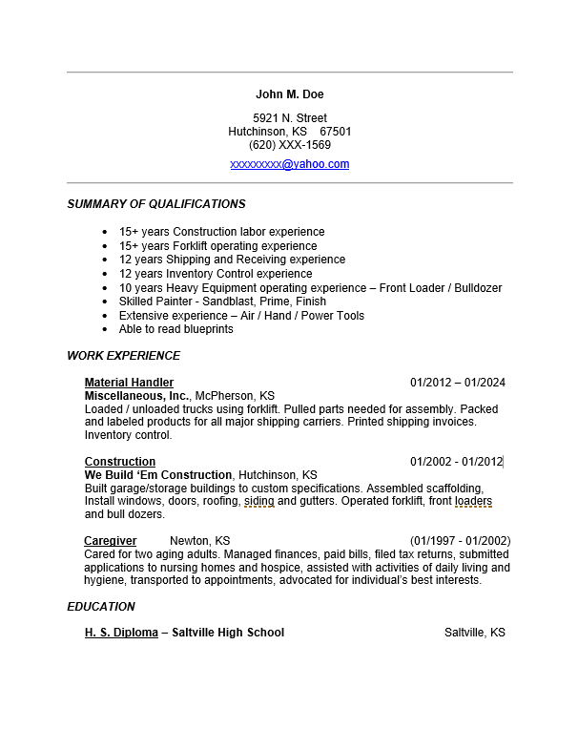
Importance of Resumes
Core workforce service
Agency wide priority
Added value for the participant
Marketing Tool
Required for applications / Job Fairs
Shows the participant the value they bring to workforce
Increase participant self-confidence
Preserved in KW, easily updated over time
Expands participant exposure to new opportunities

Slide 31
Best Practices
Caseload Increases
Utilization of workforce center staff
Resume, job search / applications, interview practice, WOTC, Federal Bonding
Communication
- Scheduled, preferred method, reminders, multiple methods, may change once working
Notes:
If it’s not in KW, it didn’t happen.
Continuity in staffing,
Utilize all tools
Reach out

Slide 32
Where Do We Go From Here?
Goals for yourself
Goals for your client
Empower the client
Success for your client
Support
TA assistance will be joining a few IEP calls for training and additional CQI improvements-will get with program leads to schedule those times
Assistance or question reach out to your team members and partners
Ask questions
DON’T FORGET this is a program that is making history—and YOU are part of it!

Slide 33

Questions

Slide 34

Thank You!
This Photo by Unknown Author is licensed under CC BY-NC

Slide 35
Contact Us
Leanne Garner
RETAINWORKS Coordinator
(785) 207-3907
leanne.garner@ks.gov
Kelly Collins
Employment & Work Incentives Specialist
785-250-8985
kelly.collins@ks.gov

