Slide 1


Resume Writing
Equal Opportunity Employer/Program - Auxiliary aids and services are available upon request to individuals with disabilities. Any individual with a disability may request accommodations by contacting the Disability Resource Coordinator at the Workforce Centers, 316-771-6800, TDD: 711 or 1-800-766-3777, (mfink@workforce-ks.com). Requests should be made at least five (5) working days in advance of the event.
Issued
Notes:
Introduce yourself and your expectation for the class.
“What do you hope to get out of the class?”
“What’s your biggest struggle with the resume?”

Slide 2
Goals
To help and facilitate customers with revising, updating, and/or re-writing their resumes.
Know what goes in a resume and what does not.
Find out what resume format works for what type of work experience
The dos and don’ts of resume writing.
Introduce yourself and the resources available to your client.
Use your Workforce Services staff
To help client get a job.

Slide 3
Steps to Making a Great Resume
Organize all their information.
Decide what resume format would fit their experience.
Edit their resume for errors.
Use bulleted lists to organize
job responsibilities.
Ask questions
Notes:
Give handout on different resume formats.

Slide 4
The Basics
Create a personal brand to show employers your uniqueness
Personal branding is about showing what sets your client apart from
others in their field.
It combines the personal with the professional – the brand
encompasses their skills and talents, along with their personality and style
Having a personal brand not only helps showcase their strengths but
it can also help bump up their resume to the top of the pile and help
them shine in interviews!
Have them take a moment to think of some of their best work
experiences.
What skill or characteristic are reflected in their best work stories?
How did they use it? What was the result?
Why do people like to work with your client?
Why do employers like to employ your clients?
What do people depend on them for?

Slide 5
Personal Brand cont.
Let’s take a moment to practice thinking of a couple of
“personal brands”
    Does your client take unusual care to ensure details are thoroughly
    thought through, and accurate?
If you answered yes, then their brand could be “willing to take on the
precision that scares others away.”
2. Is your client an outstanding supervisor who makes operations flow?
If you answered yes, then their brand could be “a problem solver who
excels at developing talent”

Slide 6
Sell, Sell, Sell!
Take the time to help create a summary of qualifications so that your clients can sell themselves to your potential future employer!
While your clients have developed skills unique to their past work history and these should be noted, do not forget about their transferrable skills!
What are transferrable skills?????
Transferrable skills are those that are used in many different careers and help make your client an attractive job candidate.
If you or your customer would like some assistance coming up with transferrable skills,
It is encouraged that you take a Skills Assessment.
You can do so here: O*NET Interest Profiler at My Next Move

Slide 7

What an Accomplishment!
Promote accomplishments to advertise what you can achieve!
Employers want to learn quickly how your client will help their organization.
Your client’s resume should clearly answer this question by including their accomplishments.
What problems did they solve?
What solutions did they come up with?
How did this benefit the business, customers, employees?

Slide 8
Accomplishments Cont.
Focus on accomplishments rather than just job duties. Make them quantifiable skills by adding numbers to it
  “Ensured 10% growth in all sales” instead of “Worked on a sales team”
Use action verbs
  Created, Provided, Managed, Researched, etc…
Notes:
- In regards to action verbs, mention tense-if currently employed, present tense,
if no longer employed, past tense, adding the “ed” to the end of a word.
- Start each sentence with a good, descriptive action verb. Ex. Designed the company’s new marketing flyer.
- Action verbs have a strong impact and help the employer visualize you in a productive way. (Hand out action verbs at this time.)

Slide 9
Use the STAR Method to Write Accomplishments
S: Situation (Have your client think of a situation where they performed well.)
T: Task (Have your client think about the task they had to accomplish.)
A: Action (What action did your client take to accomplish their task?)
R: Result (What was the result after your clients took action?)
While your client is only thinking about the S (Situation) and the T (Task) in the STAR method, they are only writing down the A (Action) and R (Result). This will produce a bullet point for their resume.

Slide 10

The Basics
Converting skills to “resume speak”
  Don’t get too fancy
  Keep it specific
  Pay attention to tense
  Action verbs/keywords
Different formats
  Printed hardcopy = Pretty
  Up-loadable/Electronic = Basic
Notes:
- “Resume speak” is just a professional way of stating the obvious.
- Microsoft Word, PDF, or Plain Text

Slide 11
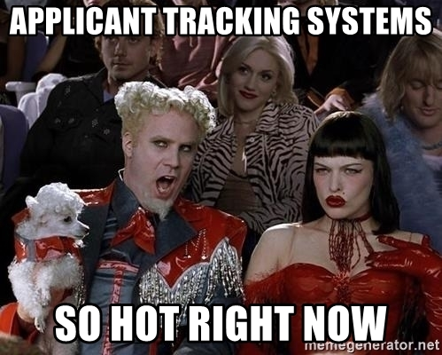
Applicant Tracking Systems (ATS)
Many employers use ATS software to make an initial sort of resumes
The software indicates whether or not a resume should move on to HR for further review
Employers can specify in the ATS skills, education, training, years of
experience, and other details needed to qualify candidates for any given
position
As applications are received, ATS scores each one and ranks it in order based on how well it meets the criteria listed
The software is likely to reject resumes because:
Qualified candidates fail to use the employer’s chosen keywords
The system doesn’t recognize unusual fonts or formatting
Candidates lack the preferred experience, but may have qualifications that could make up for what’s missing

Slide 12
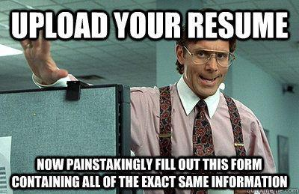
Resume vs. Application
The resume highlights the work experience, education and skills that relate to the position.
The application is used by most companies to perform background checks.
  The companies listed should have up to date contact information
  If a company is no longer in business, that should be noted in the entry
Notes:
Both may be required to apply. Be sure to spend equal time completing the application and resume.
- Application will ask for information that might be left off the resume, i.e. high school diploma

Slide 13
Resume Do’s
Pick one font style
  (ex, Arial, Times New Roman, Verdana)
Font size between 11-12
Proofread and spell check carefully
and have a 2nd set of eyes look at it
Notes:
-Arial or Times New Roman font is easy to read, scans well, and is common among different versions of Microsoft Word.
- Spell check does not catch grammar , from vs. form, too vs. two vs. to

Slide 14
Resume Do’s (cont.)
Focus on accomplishments rather than just job duties. Make them quantifiable skills by adding numbers to it
  “Responsible for 10% growth in all sales” instead of “Worked on a sales team”
Use action verbs
  Created, Provided, Managed, Researched, etc…
Notes:
- In regards to action verbs, mention tense-if currently employed, present tense,
if no longer employed, past tense, adding the “ed” to the end of a word.
- Start each sentence with a good, descriptive action verb. Ex. Designed the company’s new marketing flyer.
- Action verbs have a strong impact and help the employer visualize you in a productive way. (Hand out action verbs at this time.)

Slide 15
Organize Work History
Have your clients take a piece of notebook/paper and find a quiet place to concentrate
Have them write down the company name, company location, your job title, and the dates you worked there
Write down their employment history for the last 7-10 years (if making a master resume you will need all of your work history)
Make sure dates, job titles and applicable contact info is accurate
Notes:
Building master resume
Wage and salary on master resume for application purposes

Slide 16
Organize Work History (cont’d)
Write down main job responsibilities
  Later you will use this to identify their transferable skills
Write down any accomplishments (awards, honorable mentions or measurable metrics)
Write down any new software or skill they have learned
Write down any training/certifications they have received
Notes:
Building master resume
Wage and salary on master resume for application purposes

Slide 17
Importance of Keywords
  It is important to match their skills and abilities to the requirements of the job.
  Have them use as many keywords as possible that are applicable in their resume and cover letter
  Resumes containing the most keywords will be the first to be reviewed.
  *It is ok to use industry jargon/abbreviations such as hardware/software programs, tools & equipment, degrees, licenses and certifications if it is commonly used in the position you are applying for.
Notes:
-Companies that use searchable databases use software to search those databases for specific keywords that relate to the job posting.
-Pat Kendall, President of the National Resume Writers Association states that, “more than 80% of resumes are searched for job-specific keywords.”
-You do not want to emphasize keywords that relates to jobs you do not want.
-Human Resource staff screening resumes are not always familiar with industry jargon/abbreviations versus the direct supervisor for the position.

Slide 18
Where Do You Find Keywords
  Employment Postings/Descriptions
    Internet job boards, company websites, trade publications, or internal job postings will be the most useful in obtaining keywords and job descriptions.
    Finding keywords from the job descriptions can be useful in writing the skills summary and cover letter.
Eye-Tracking Webpage
Notes:
The companies Mission and Vision statements are helpful places for keywords also.
Show the “Human Resource Hot Spots on Resumes” link:
http://www.businessinsider.com/heres-what-recruiters-look-at-during-the-6-seconds-they-spend-on-your-resume-2012-4?utm_source=twbutton&utm_medium=social&utm_campaign=careers

Slide 19
Resume Scanning Software
https://cultivatedculture.com/resume-scanner/
https://skillsyncer.com/
https://www.jobscan.co/

Slide 20

Identifying Keywords
Free online word cloud generator and tag cloud creator - WordClouds.com
Notes:
Utilizing sites like Wordle can help to pinpoint keywords to get you pointed in the right direction
- Website shows highest number of words uploaded from a document

Slide 21

Resume Speak
Generic:
Screwed in light bulbs
Made copies
Professional:
Installed and maintained lighting implements
Photocopied and prepared documentation
Notes:
Professional Resume speak
Give yourself more credit for the work you have done

Slide 22
Transferable Skills
Communication: the skillful expression, transmission and interpretation of knowledge and ideas.
        Speaking effectively
        Writing concisely
        Facilitating group discussion
        Negotiating
        Reporting information
        Describing feelings
        Interviewing
        Editing
Notes:
-Definition of transferable skills-skills acquired during an activity in one’s life that are transferable and applicable to the position you are applying for.
--There are 5 broad categories of transferable skills and each category can be broken down into specific skills.
-Listing your transferable skills are a key factor in your resume, cover letter and interview.

Slide 23
Transferable Skills
Research and Planning: the search for specific knowledge and the ability to conceptualize future needs and solutions for meeting those needs.
        Forecasting, predicting
        Creating ideas
        Identifying problems
        Imagining alternatives
        Identifying resources
        Gathering information
        Solving problems
        Setting goals
        Extracting important information
        Defining needs
        Analyzing
        Developing evaluation strategies

Slide 24
Transferable Skills
Human Relations: the use of interpersonal skills for resolving conflict, relating to and helping people.
        Developing rapport
        Being sensitive
        Listening
        Conveying feelings
        Providing support for others
        Motivating
        Sharing credit
        Counseling
        Cooperating
        Delegating with respect
        Representing others
        Perceiving feelings, situations
        Asserting

Slide 25
Transferable Skills
Organization, Management and Leadership: the ability to supervise, direct and guide individuals and groups in the completion of tasks and fulfillment of goals.
        Initiating new ideas
        Handling details
        Coordinating tasks
        Managing groups
        Delegating responsibility
        Teaching
        Coaching
        Counseling
        Promoting change
        Selling ideas or products
        Decision making with others
        Managing conflict

Slide 26
Transferable Skills
Transferable Skills
Work Survival: the day-to-day skills that assist in promoting effective production and work satisfaction.
        Implementing decisions
        Cooperating
        Enforcing policies
        Being punctual
        Managing time
        Attending to detail
        Meeting goals
        Enlisting help
        Accepting responsibility
        Setting and meeting deadlines
        Organizing
        Making decisions

Slide 27
Online Resources
Online Resources
www.onetonline.org
  Research tasks performed, tools, equipment, and soft skills used in past jobs
  How to write tasks in “resume speak”
www.google.com
  Find information about previous companies worked for such as addresses and telephone numbers
www.careeronestop.org
  Resume advice and tutorials including a resume creator walk-through and samples

Slide 28
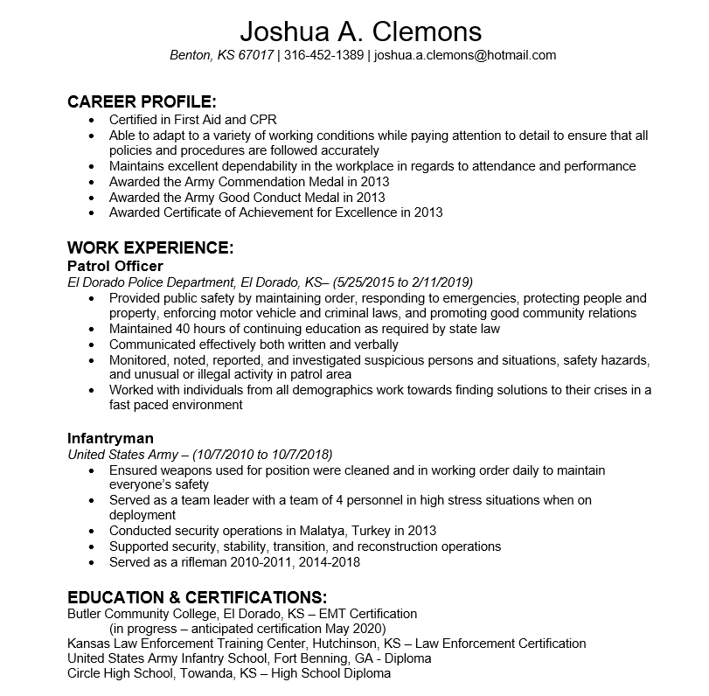
Types of Resumes: Chronological
Emphasizes one’s work history
Easy for employers to scan
Often used by job seekers with steady work experience in their desired career field

Slide 29
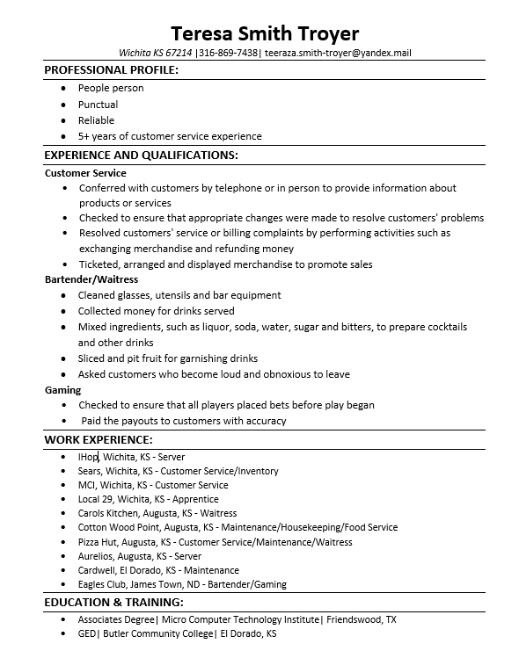
Types of Resumes: Functional
Groups work experience and skills by skill areas or job function
De-emphasizes lack of experience in a field
Useful for first-time job seekers, those re-entering the workforce and career changers
Employers don’t love true functional resumes
  Can anyone think of a reason why this may be?

Slide 30
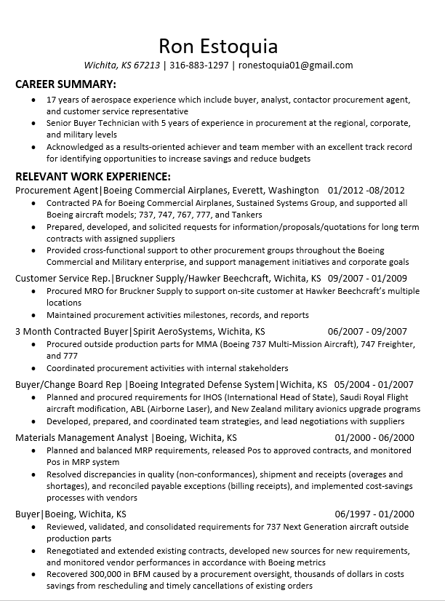
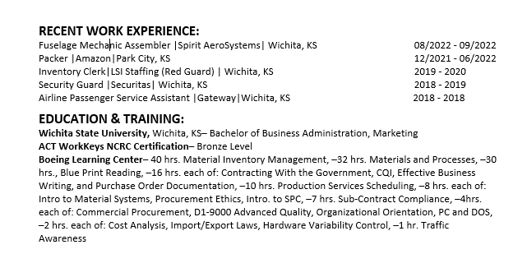
Types of Resumes: Combination
Combines the knowledge, skills, and abilities as highlighted in a functional resume with a shorter, chronological work summary
Easily incorporates other experiences, like volunteering or internships
Often used by job seekers with a varied employment history and by career changers

Slide 31
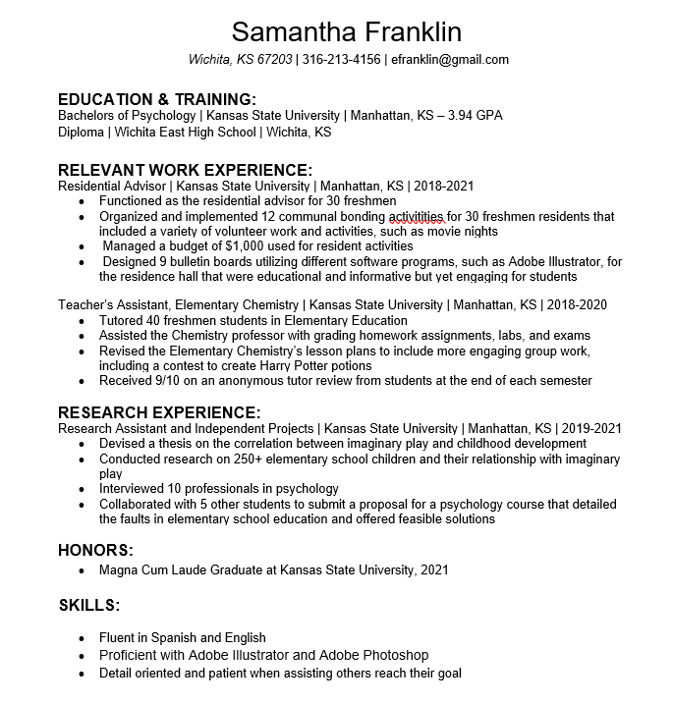
Types of Resumes: Academic
Highlights an education section that includes degrees, certifications, and/or achievements
Easily incorporates other experiences, like volunteering or internships
Often used by recent graduates with little experience in the field

Slide 32
Top 10 Resume Mistakes
Mistake #1: Too Long or Too Short
  One page is preferred for a new college graduate. If your experience warrants it, two pages are acceptable.
Mistake #2: Disorganized and Poor Formatting
  While the most important part of your resume is the content, there is no question that the document's overall look and feel is also important. Illogical order, disorganization, and an inconsistent format makes your resume difficult to read. You should be comfortable enough with a word processing program to create a clean, polished document. Use bullet points to highlight job responsibilities rather than paragraph format. Use consistent formatting for headings and bullet points.
Notes:
-#2- a resume that has consistent formatting shows your attention to detail
-#3- colored or patterned paper do not scan, fax or copy well

Slide 33
Top 10 Resume Mistakes
Mistake #5: Including Unrelated and Irrelevant Personal Information
  As mentioned previously, you do not have much room in a resume, so why take up valuable space with information unrelated to the position you are seeking? Your resume is not a personal correspondence, and should not include words such as “I,” “my,” and “me.” Save the first person pronouns for your cover letter. Also, leave the details about your personal life, such as marital status, religion, age, race, height, weight, hobbies, and other interests out of your resume.
Mistake #6: Poor Descriptions of Experience and Education
  You need to give the reader an idea of what you have done throughout your career, but instead of focusing on the duties you were responsible for at your previous jobs, list your accomplishments along with quantifiable facts to back up your claims.
Notes:
-#6- listing accomplishments/contributions can be listed alone or included in the job duty description. After listing your job duty, list an accomplishment for that particular job duty. Strive to list accomplishments that can be quantified (example on next slide)

Slide 34
Top 10 Resume Mistakes
Mistake #6: Poor Descriptions of Experience and Education, continued
      Saying you were responsible for a 10 percent growth in overall sales is more impressive than simply stating you worked on a sales team. Your resume needs to make a bold, strong statement, and the best way to do this is by utilizing action words to describe your accomplishments. Words like "coordinated," "achieved," "managed," and "implemented" will spice up your resume and make it more interesting and relevant to the reader.
      In addition, you do not need to list your educational related course work if it is implied by your major; although special projects and professionally relevant courses can be cited.

Slide 35
Top 10 Resume Mistakes
Mistake #7: Sending an Unfocused/Generic Resume
  While your past experience does not change, depending on the job or industry you are targeting your resume certainly should. If you are seeking a sales-related position, your resume will include details that are different than those that would be included in a resume for a management job. Make sure you write to what you are seeking and make it easy for the reader to see why you are a good fit.
Mistake #8: Repetitiveness
  While using action words is important, it is also key to make sure you have variety in your resume. Don't pick a couple of words and stick with them throughout the entire document. Break out a thesaurus if you are having problems coming up with new ways to say the same thing.

Slide 36
Top 10 Resume Mistakes
Mistake #9: Sending a Resume Without a Cover Letter
  One of the worst things you can do is send a great resume without an official introduction. Resumes and cover letters should be inseparable. Make sure you don't give up your chance to really sell yourself with a cover letter. Unless told otherwise, send a cover letter.
  Mistake #10: Misdirected
  Too many resumes arrive on employers’ desks unsolicited, and with little or no connection to the organization. If you want your resume to get thrown out with the trash just send it to the company's "Hiring Manager," or "To Whom it May Concern." Targeted cover letters, directed to an identified person in the organization are much more successful. Do yourself a big favor and take the time to find a real person at the company who is responsible for hiring in the department you are targeting. This is often the first and most helpful step to getting your foot in the door.

Slide 37
References
References
Use a separate sheet of paper to list professional references
  Use professional rather than personal
Ask permission
  Don’t let your reference be caught off guard when notified
Keep current
  As you progress in your employment update references as necessary
Notes:
* List references on a separate sheet of paper; same format (font style/size) as resume
* Have a least 3 references
* Know references current contact info: name, job title, how long you have known them, phone number, address (work or home) and email address
Send your references a copy of your latest resume and the job description you interviewed for (if possible)
* Know what time reference can be reached/contacted .

Slide 38
Writing a resume is comparable to exercising: You may not look forward to it, but you feel better once it’s done.
THANK YOU!
Good Luck and Stay Positive!

Slide 40
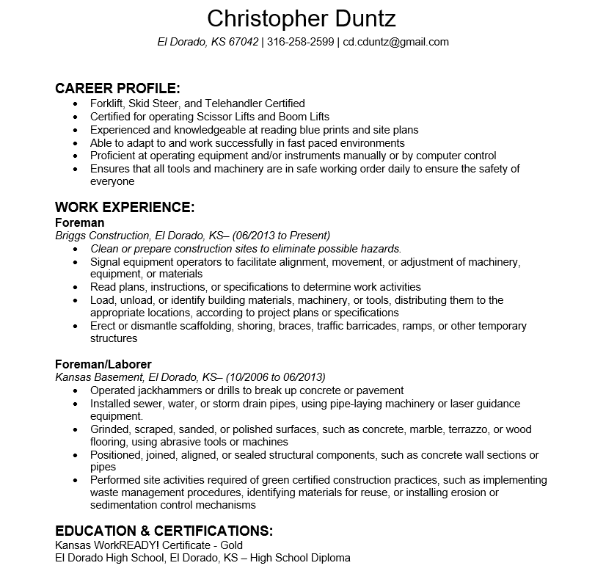

Slide 41
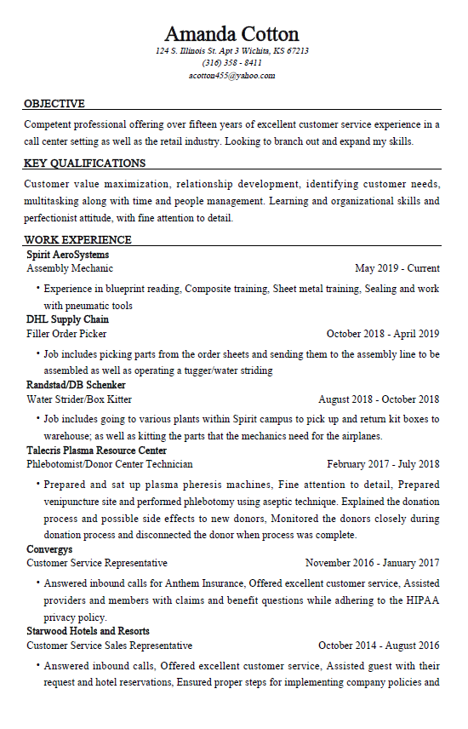
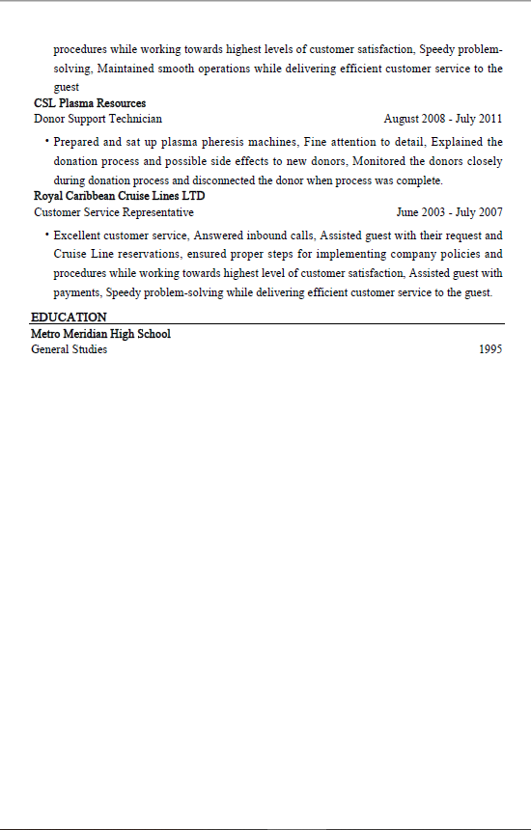

Slide 42
Any Questions?
Interview Appearance
Thank you!
Please contact me, Selen Light at KANSASWORKS for any questions or to schedule one-on-one resume review.
Junction City
1012 W 6th St. Ste. A
Junction City, KS 66441
785-762-8870

