Slide 2
Program Updates
Kansas Department of Commerce
Kansas WorkforceONE
Heartland Works
Workforce Partnership
Workforce Alliance of South-Central Kansas
Southeast KANSASWORKS
Ascension Via Christi Health System
Stormont Vail Health
University of Kansas Health System
Kansas Clinical Improvement Collaborative
Kansas Department of Administration
Mid-America Coalition on Health Care
Kansas Business Group on Health
Kansas State Council of SHRM (Society of Human Resource Management)
Kansas Department of Health and Environment
Kansas Rehabilitation Services (VR)
University of Kansas Medical Center Research Institute

Slide 3
Program Update
Enrollment, Participation and Outcomes to Date
Enrollment
Provider Coverage
Outreach
Success Story - Liz

Slide 4
Welcome New Staff
Sarah Peoples, RTW Nurse Navigator for Ascension Via Christi Manhattan
Kiona Daye, Referral and Enrollment Assistant, Ascension Wichita
Rachel NaSal, Workforce Coordinator, Heartland Works
Open Positions
Clinical Nurse Navigator for Southwest KCIC
Employer Engagement Coordinator for Southeast KANSASWORKS

Slide 5
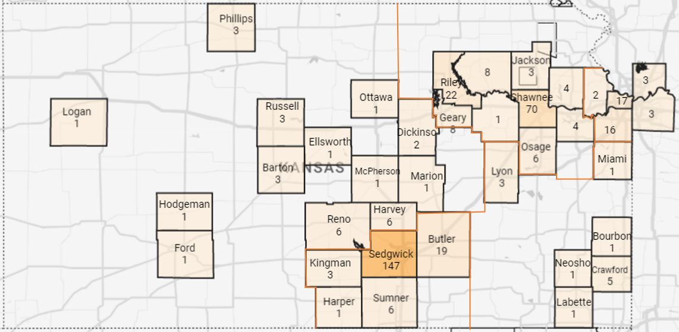
Enrollments by County

Slide 6
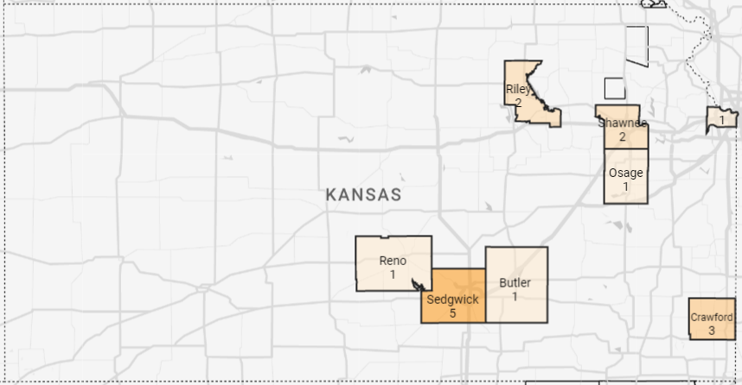
Enrollments in Opportunity Zones

Slide 7
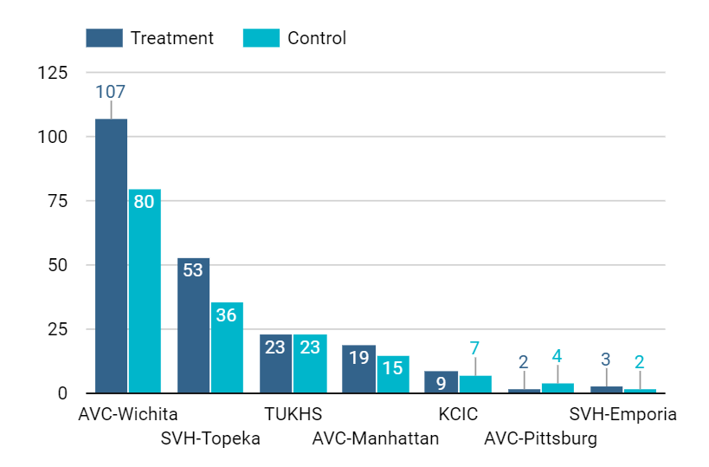
Enrollment = 383
through 8/11/23
By medical system

Slide 8
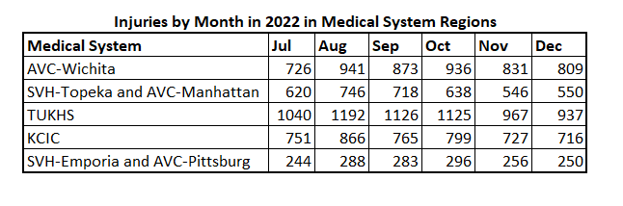
Injuries by Medical System Regions by month
Note: in 2022, 21.3% person with disability were employed. According to SSA, 17% of disability occur due to work related accident or injury between the age 51-61.

Slide 9
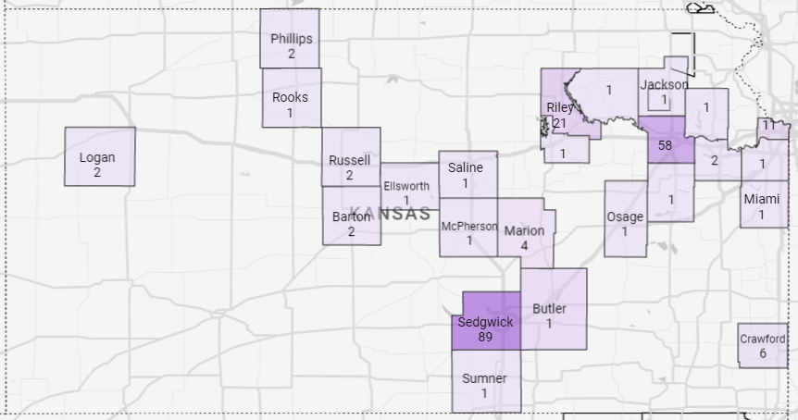
Participating Providers by Counties

Slide 10
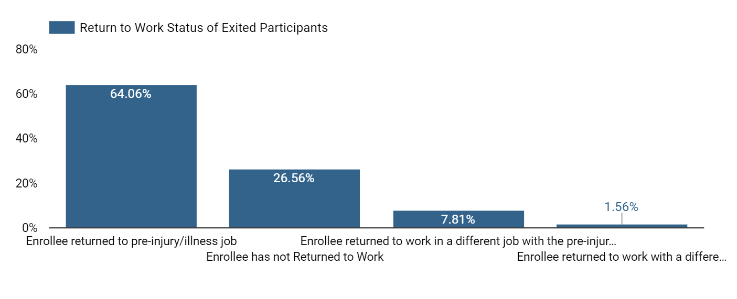
RTW After Exit

Slide 11
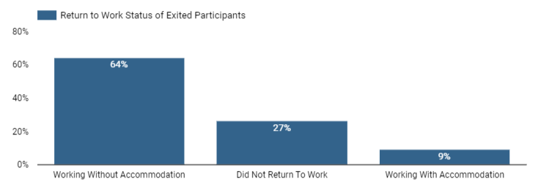
RTW After Exit

Slide 12
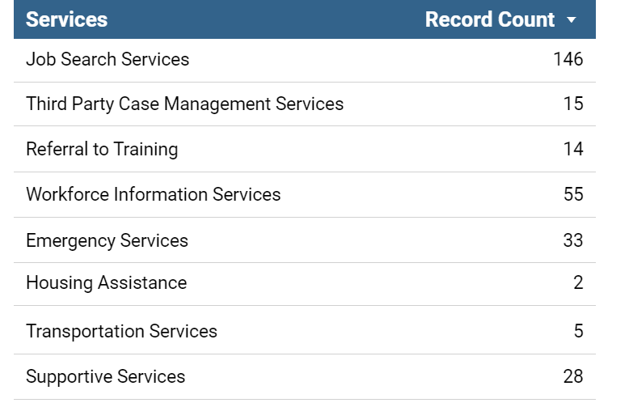
Workforce Services
Average Work Loss Days = 38
Individual Employment Plans = 156

Slide 13
OUTREACH & EVENTS
Kansas Hospital Association Convention September 7th
Kansas State Fair September 8th
RETAIN National Meeting September 19th
Annual KSSHRM Conference September 20th
73rd Annual Safety & Health Conference September 25th
Kansas Economic Development Alliance September 26th
Workforce Innovation Conference October 2nd
Rooted in the Community Conference October 4th
League of Municipalities Conference October 7th
Provide Champion & Knowledge Sharing Luncheons TBD

Slide 14
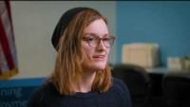
Success Story

