Slide 2
Program Updates
Kansas Department of Commerce
Kansas WorkforceONE
Heartland Works
Workforce Partnership
Workforce Alliance of South-Central Kansas
Southeast KANSASWORKS
Ascension Via Christi Health System
Stormont Vail Health
University of Kansas Health System
Kansas Clinical Improvement Collaborative
Kansas Department of Administration
Mid-America Coalition on Health Care
Kansas Business Group on Health
Kansas State Council of SHRM (Society of Human Resource Management)
Kansas Department of Health and Environment
Kansas Rehabilitation Services (VR)
University of Kansas Medical Center Research Institute

Slide 3
Program Update
Enrollment, Participation and Outcomes to Date
Expansion
Outreach
Feedback and Continuous Improvements

Slide 4
Welcome New Staff
Leanne Garner
Jeana Payne
Theresa Finley
Barbara Whitney
Kendall Runnebaum
Kendra Lawless

Slide 5
Enrollment through 7/17/2023
342

Slide 6
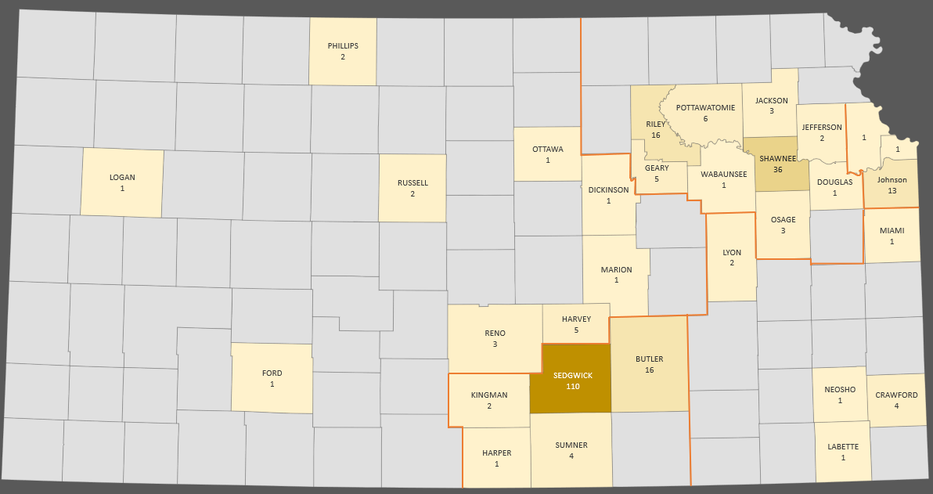
Enrollments by County

Slide 7
Enrollment by Month for 2023

Slide 9
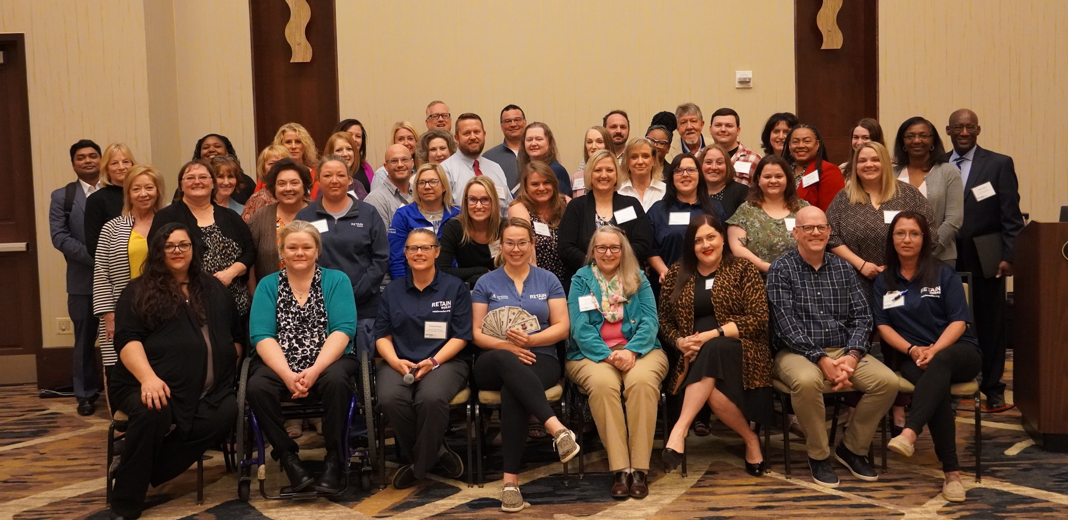
Annual Summit

Slide 10
Outreach
  Past Events
  Wichita Chamber of Commerce
  Behavioral Health Symposium
  Upcoming Events
The 2023 Workforce Development & Education Summit (WDES)

Slide 11

Stormont Vail Health
EMR Screening
Continuous Improvements Efforts
Daily task performed by 1 FTE:
  ~800 encounters
  10-15 potential candidates per day
  Those leads are then messaged through our secure system in EPIC
  Once both interest and eligibility are confirmed, the provider is contacted
  To date, 58% of our enrollees came from screening
  YTD, 92% of our enrollees came from screening
Future of our screening:
  Prescreening future scheduled appointments
  Expanded screening of existing report
  Monitoring and follow up of messages that have gone unread
  In process of bringing on an additional FTE for chart screening and other administrative/clerical tasks

Slide 12
New Hires
RETAINWORKS Administration Coordinator
RETAINWORKS Coordinator

