Slide 2
Program Updates
Kansas Department of Commerce
Kansas WorkforceONE
Heartland Works
Workforce Partnership
Workforce Alliance of South-Central Kansas
Southeast KANSASWORKS
Ascension Via Christi Health System
Stormont Vail Health
University of Kansas Health System
Kansas Clinical Improvement Collaborative
Kansas Department of Administration
Mid-America Coalition on Health Care
Kansas Business Group on Health
Kansas State Council of SHRM (Society of Human Resource Management)
Kansas Department of Health and Environment
Kansas Rehabilitation Services (VR)
University of Kansas Medical Center Research Institute

Slide 3
Program Update
Enrollment, Participation and Outcomes to Date
Expansion
Outreach
Feedback and Continuous Improvements

Slide 4
Welcome New Staff
Sarah Peoples, RTW Nurse Navigator for Ascension Via Christi Manhattan
Kiona Daye, Referral and Enrollment Assistant, Ascension Wichita
Rachel NaSal, Workforce Coordinator, Heartland Works

Slide 5
Enrollment through 5/11/2023
259

Slide 6
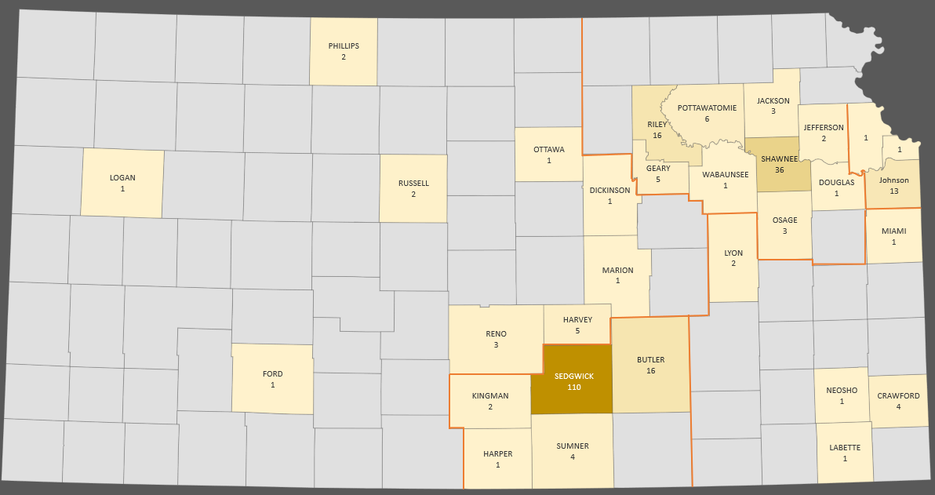
Enrollments by County

Slide 7
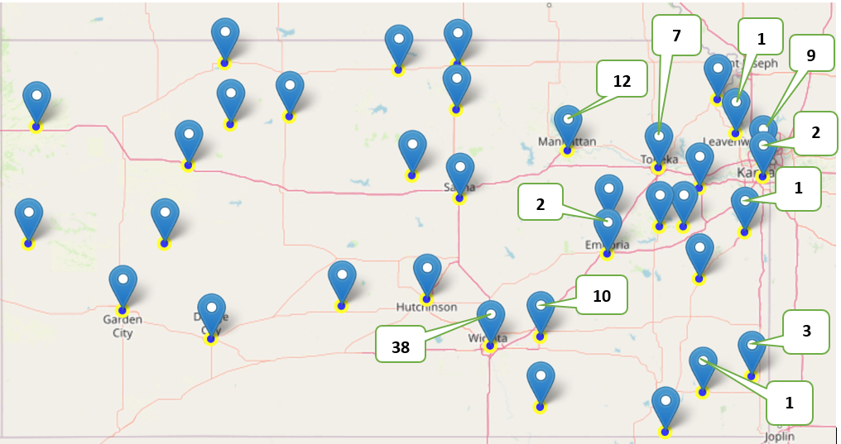
Enrollments in Opportunity Zones

Slide 8
Enrollment by Month for 2023

Slide 10
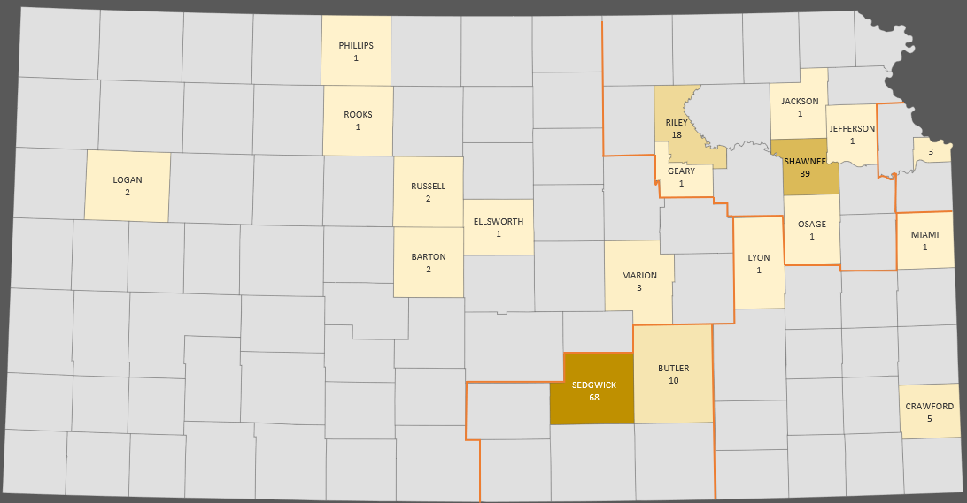
Participating Providers by Counties

Slide 11
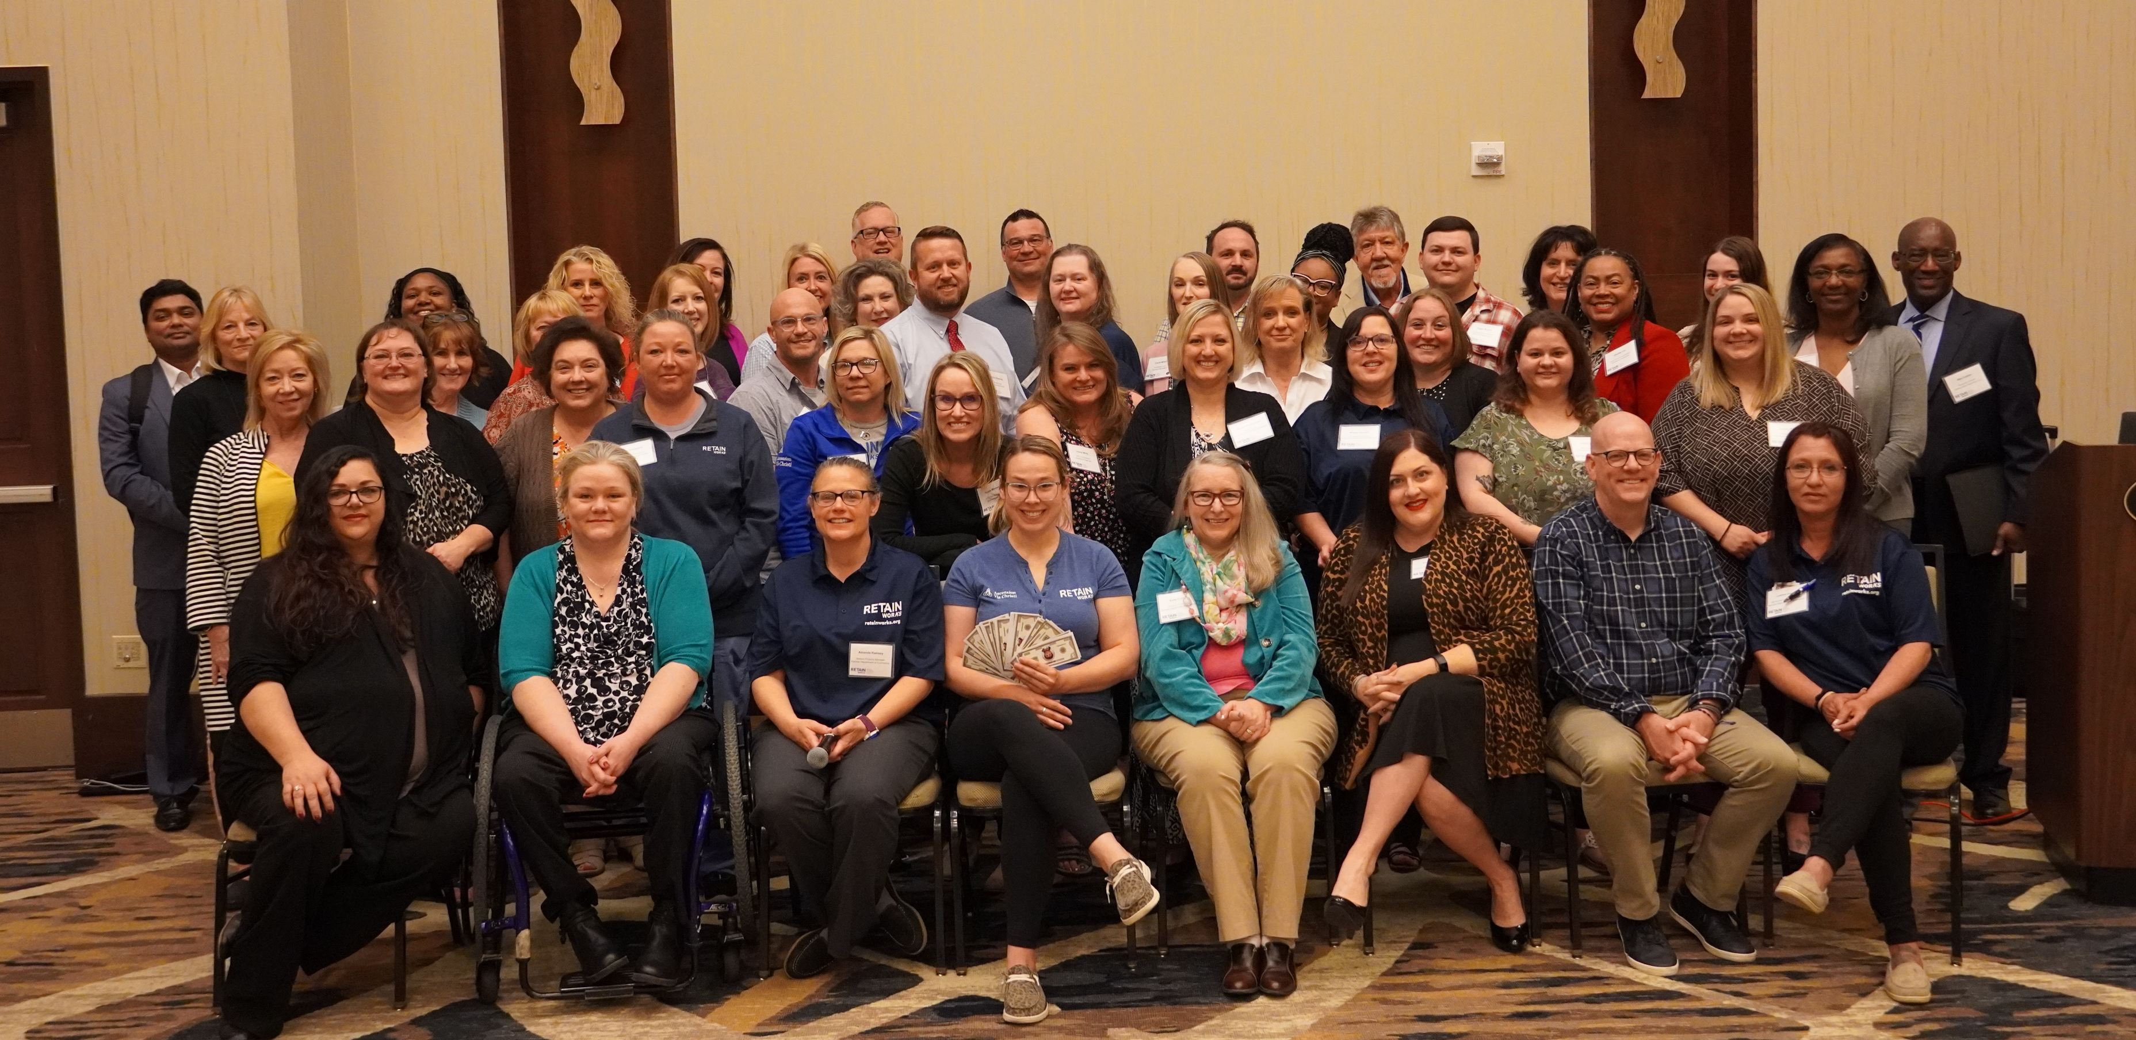
Annual Summit

Slide 12
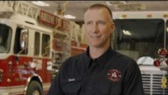
Success Story

Slide 13

Outreach
Radio ads and podcasts through June
Development of Video assets for social media
Updates to the Website
Digital Campaign July through September
Targeted Outreach to KANSASWORKS Employers
Targeted Outreach to Providers Using Data from the Board of Healing Arts
Stakeholder Events both Statewide and Locally
  SHRM
  Chamber
  Medical Associations
  FQHC
  Training Webinars, i.e. Accommodations and Pregnancy
Employer Outreach Tracking
Provider Outreach Toolkit
Employer Outreach Toolkit

Slide 14
AIR/Bizzell
Communications Plan
Focus on Patient Communication
Process Mapping
Local screening and enrollment procedures

Slide 15
RETAINWORKS LEADERSHIP Team
Announcements
May 17 - Accommodations and Pregnancy, Collier
May 22 – Medical System Leadership Discussion
May 25 - Business Engagement Bootcamp Series, AIR
June 12 & 13 - Council of State Government Exchange
September 19 & 20 - RETAIN National 3rd Annual Convening

Slide 16
Outreach
Website Updates
Dashboard
Summit Materials
Video and Audio Assets
Radio Ads – run through June
Digital Outreach – Starts in July
Board of Healing Arts – targeted outreach to providers
KANSASWORKS Business Users – targeted outreach
Printed Material
  Brochures/One Pagers
  Return to Work Handbook (spiral bound for patients)
Notes:
Here are some strategies the Areas would like the state to consider, which would take lead action by the state:
Utilize KDHE to outreach to county level health departments
Utilize League of Municipalities to reach local cities

Slide 17
Data Collection and Enrollment
Updated Training Material, shared on May 1, 2023
  Partner Data Entry Responsibilities Crosswalk Developed
Behavioral Health RTW Form
  Form M-004 BH Activity Prescription
Supplemental Wage Data
  Form M-001c, updated May 15
April (48)
May (need 30 +)
Reminder
  April 25, 2023 – 60/40
  June 27, 2023 – Reverts to 50/50

Slide 18
Provider Training Announcements
ECHO
05-25-2023 "How Primary Providers can Help Workers with Illness or Injury Prior to Referral for Worker Compensation"
Larry Wilkinson MD, Medical Director, Ascension Via Christi Occupational and Environmental Medicine
06-22-2023 "SAW/RTW Strategies for Patients with Injury to Lower Extremities "
Andrew Porter, DO, Physician Sports Medicine Ascension Via Christi Wichita, Kansas,
07-27-2023 "Helping Patients with Long Covid-19 Symptoms Thrive at Work"
Clifton Jones, MD, Infectious Disease, Stormont Vail, cjones@stormontvail.org
Updated Online Training Update

Slide 19
Guidance and Clarifications
Selective Service
  *not required as a part of RETAIN Eligibility
Participating in the Workforce
  *required for eligibility –this means that someone is employed or actively seeking employment.
Security Applications
  *those who apply after enrollment will not be penalized or terminated from RETAIN
Incentive payments from Workforce
Example: Someone goes back to work prior to completing the IEP. Once IEP is completed, participant can
RETAIN Treatment participants who have already returned to work (or never stopped working) –
These individuals would be eligible for the following incentives:
$25 for completing the IEP,
$100 for returning to work post injury or illness, and
$100 for job retention for 30 days after their original date of return-to-work post injury/illness.

