Slide 2
Announcements & Updates
  Business Engagement Planning Survey (7/20)
  Quarterly Reports to Jeana (7/20)
  RETAIN 3rd Annual Convening – September 19 & 20
  New Provider Training
  ECHO Training July 27th & August 24th

Slide 3

Welcome New Staff
Rachel NaSal, Workforce Coordinator
Heartland Works
Sarah Peoples, Nurse Navigator
AVC Manhattan
Kiona Daye, Referral and Enrollment Lead
AVC Wichita

Slide 4
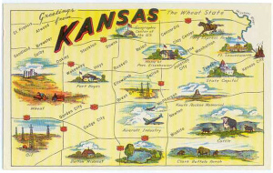
Highlights Around the State
Enrollment & Recruitment
Participant Engagement, Job Placement, and SAW/RTW
Accomplishments
Challenges
Upcoming Opportunities
This Photo by Unknown Author is licensed under CC BY

Slide 5
Enrollment through 7/17/2023
342

Slide 6
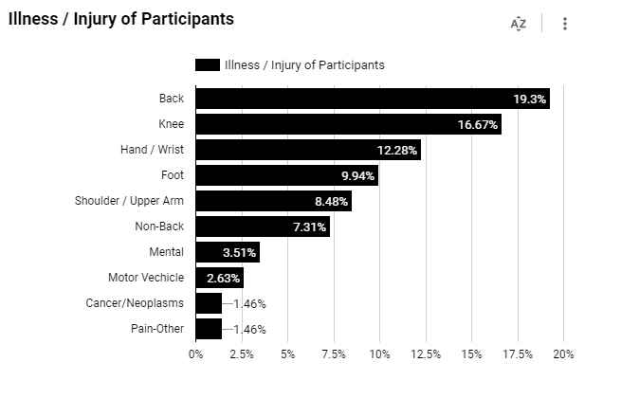

Slide 7
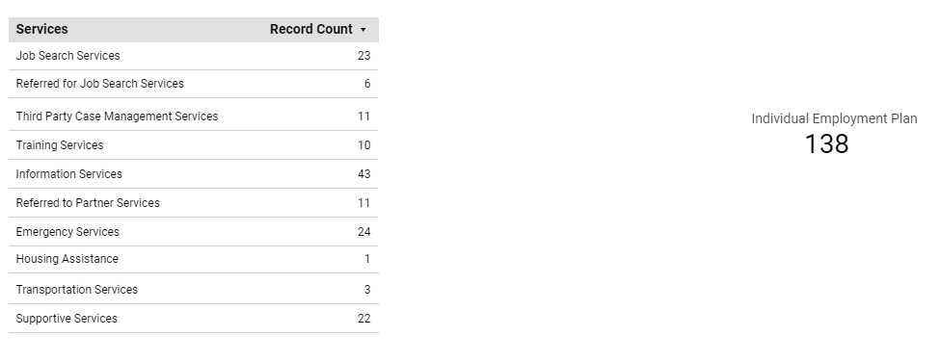

Slide 8
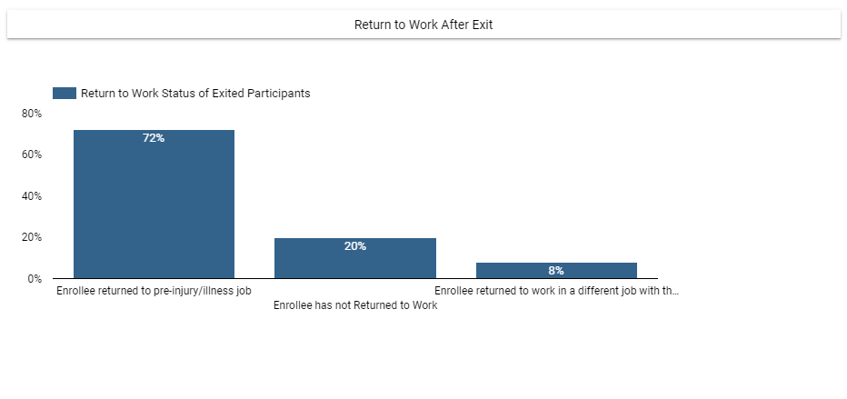

Slide 9
