Slide 2
Program Updates
Kansas Department of Commerce
Kansas WorkforceONE
Heartland Works
Workforce Partnership
Workforce Alliance of South-Central Kansas
Southeast KANSASWORKS
Ascension Via Christi Health System
Stormont Vail Health
University of Kansas Health System
Kansas Clinical Improvement Collaborative
Kansas Department of Administration
Mid-America Coalition on Health Care
Kansas Business Group on Health
Kansas State Council of SHRM (Society of Human Resource Management)
Kansas Department of Health and Environment
Kansas Rehabilitation Services (VR)
University of Kansas Medical Center Research Institute
Kansas Department of Labor

Slide 3
Program Update
Staffing
Enrollment, Participation and Outcomes to Date
Enrollment
  Update on process modification
  Provider Coverage
Satisfaction Surveys
  Providers
  Participants
CQI
  Site Visits
  EMR Screening TA
Outreach
  Activities
  Data Collection Updates
  Success Story Submission

Slide 4
Welcome New Staff
Amanda Guthrie, CNC KCIC
Samantha Cole, RETAINWORKS Outreach Coordinator - Southeast KANSASWORKS
Open Positions
Workforce Coordinator (2) Southeast KANSASWORKS
RETAINWORKS Program Manager(1) Heartland Works (under development)
Nurse Navigator, Ascension Via Christi Manhattan

Slide 5
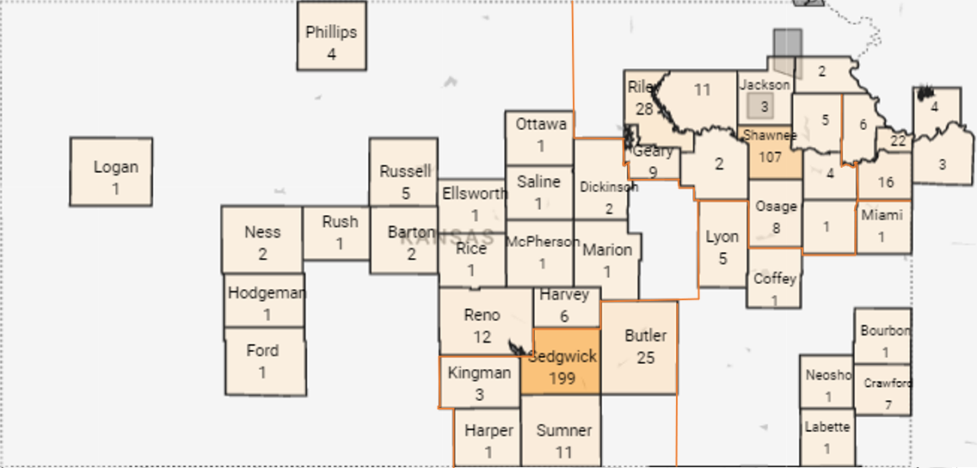
Enrollment by County

Slide 6
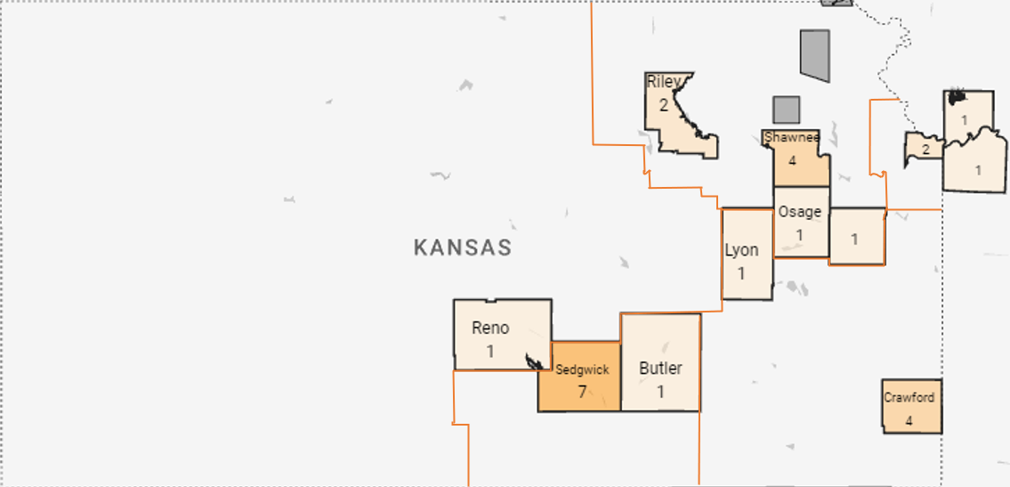
Enrollments in Opportunity Zones

Slide 7
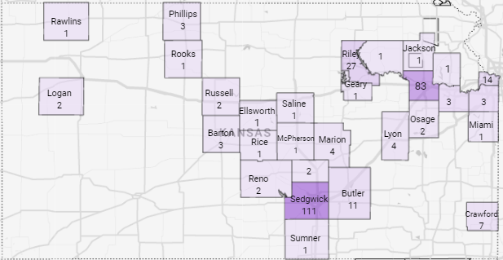
Participating Providers by Counties
**61 Providers have completed the revised training since July 1, 2023
Notes:
\

Slide 8
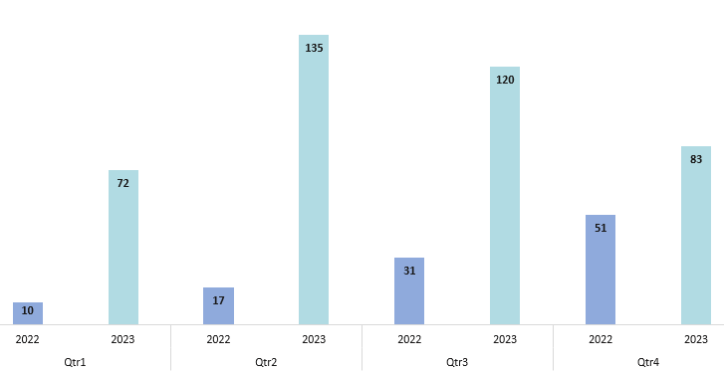
Enrollments Comparison by QTR
Total Enrollment in 2022 = 109 and Total Enrollment in 2023 = 410

Slide 9
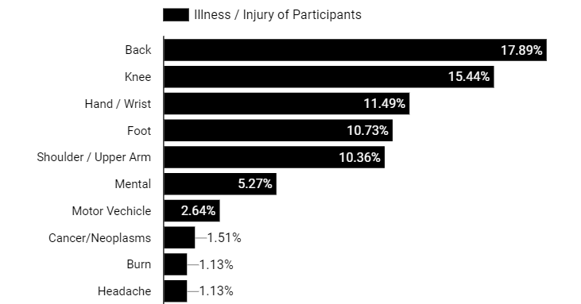
Types of Injuries

Slide 10
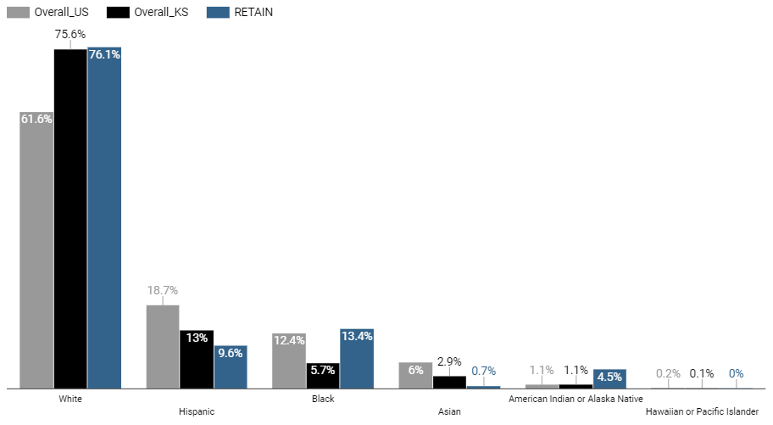
Demographic Comparison of Enrollment to Population

Slide 11
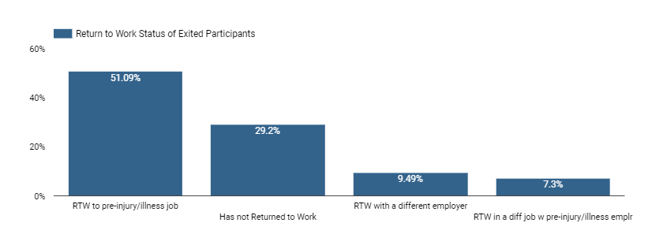
RTW After Exit
**Balance of 100% are yet to appear

Slide 12
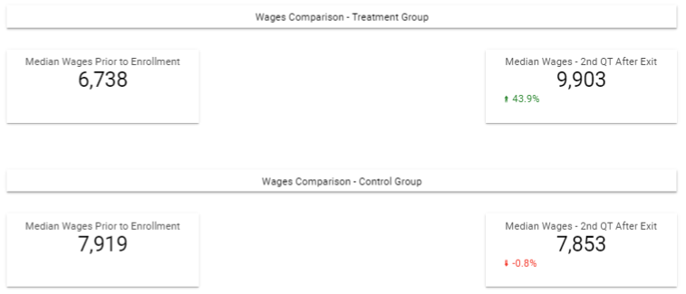
Wages after Exit

Slide 13
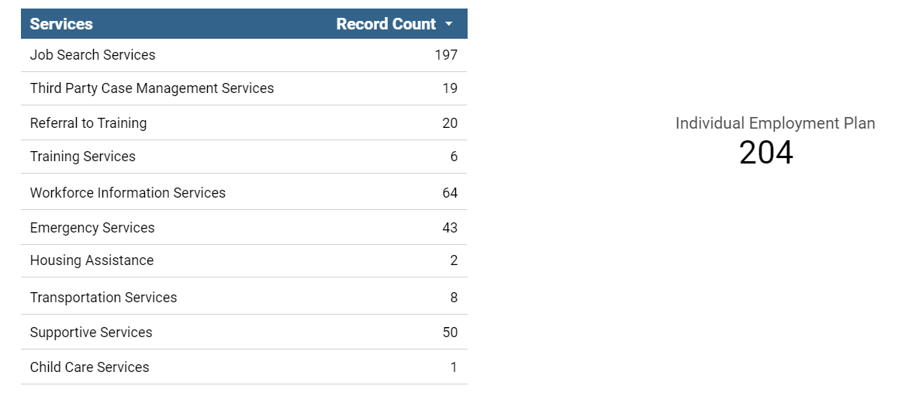
Workforce Services

Slide 14
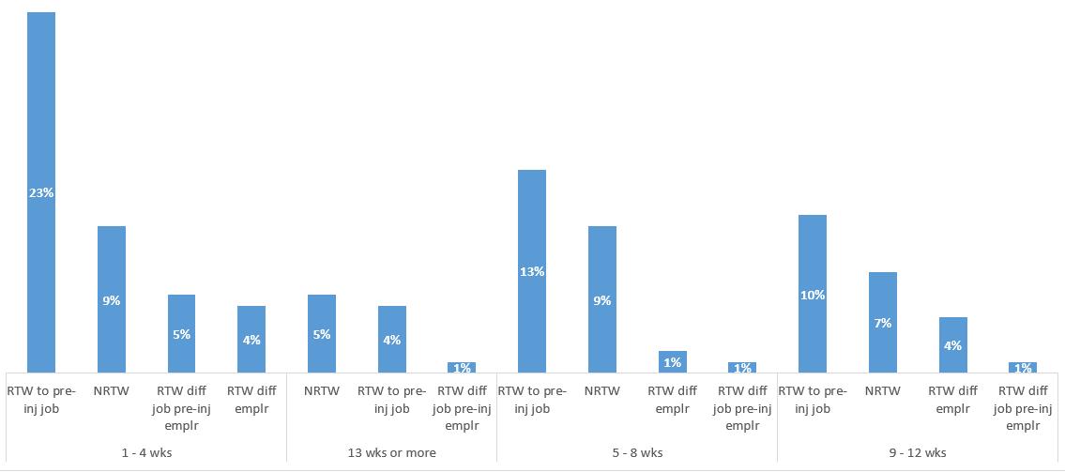
RTW Time from Onset of Injury to Enrollment

Slide 15
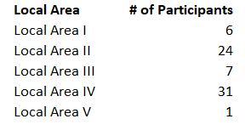
Satisfaction Surveys - Participants

Slide 16
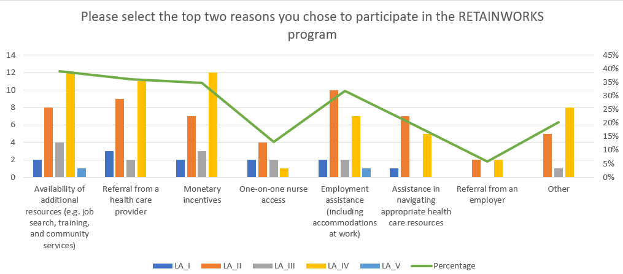
Reasons for Participation

Slide 17
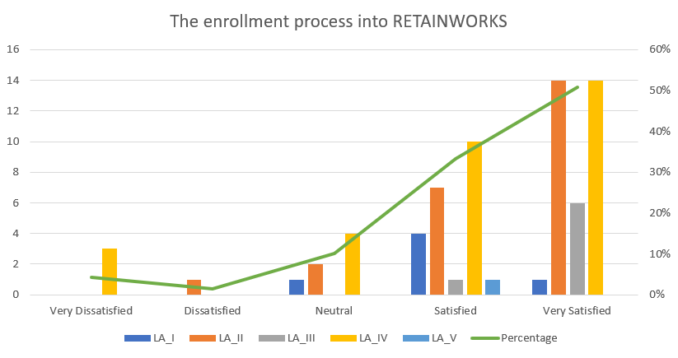

Slide 18
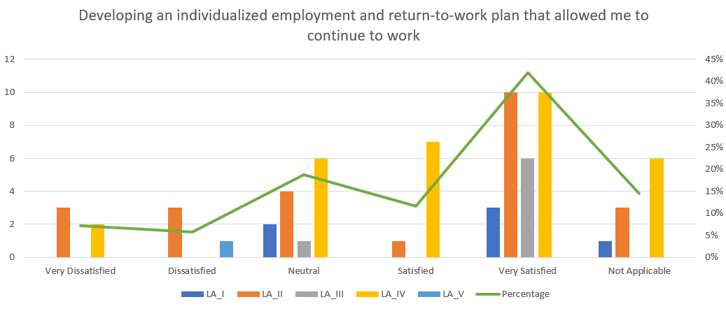

Slide 19
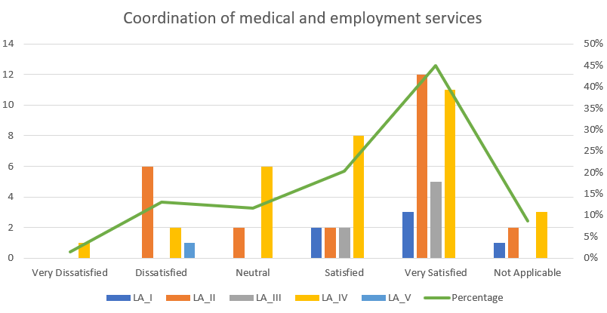

Slide 20
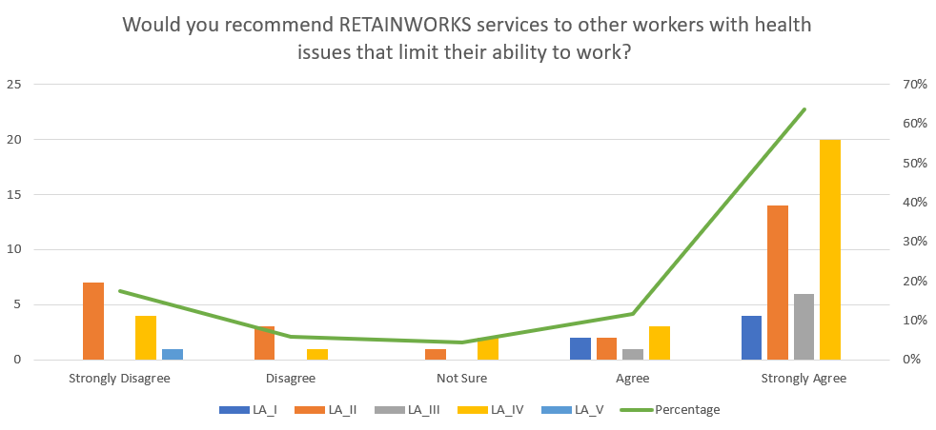

Slide 21
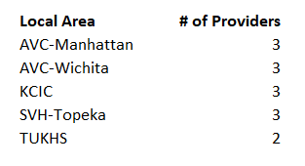
Satisfaction Surveys - Providers

Slide 22
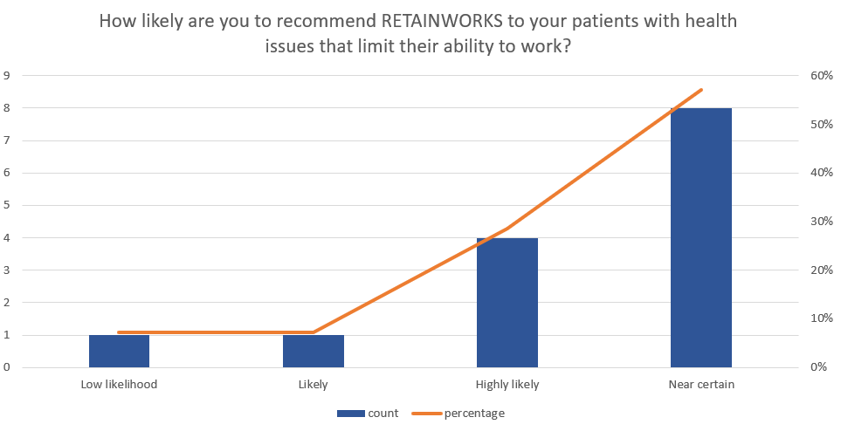
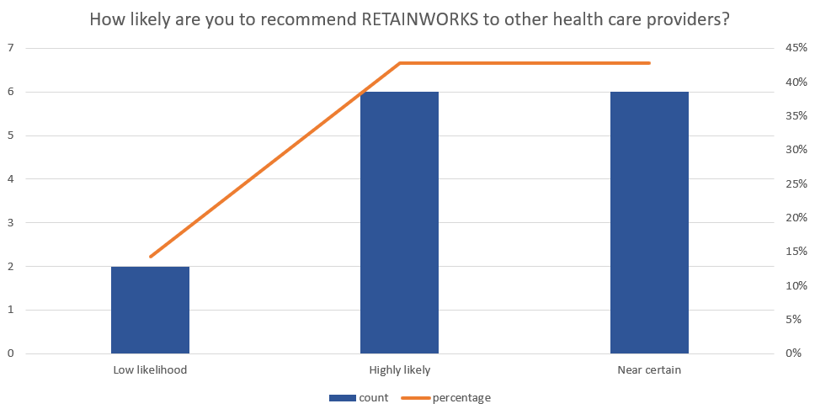
Likelihood of Referring Patients and Recommending to other HCPs
Likelihood of referring patients
Likelihood of recommending to HCP

Slide 23
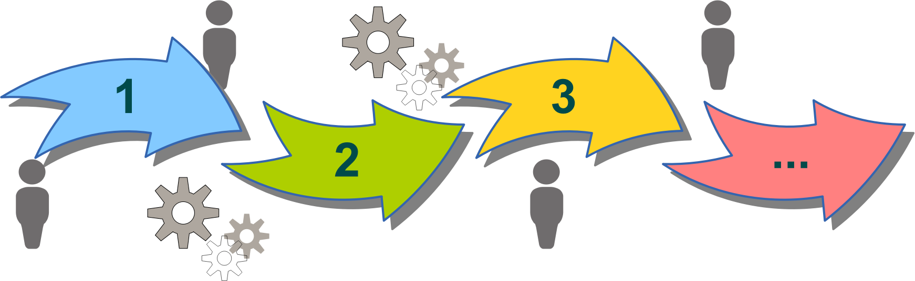
CQI
Site Visits & Technical Assistance for program improvement
Notes:
Working with in the Framework – Fidelity to Model
TEAM Coordination and Collaboration are HIGH … they are working together to answer any questions and solve problems together when needed.
In each area there were a handful of unique areas that needed clarified and we’ve been able to provide TA to resolve those issues.
For example, clarifying incentive payments, reiterating uploading IEPS to REDCap and KW.com
Program improvement (based on conversations, some areas follow up with Mo to streamline EMR screening)
Data EMR being filtered. —Data Manger and teams working together to improve for quality
Commerce improvement We also discovered the need to update our operations manual and communicate more effectively when changes and updates are made.
Manual update
Communication updates
Take-Backs
Teams got a better idea understanding the process of each persons role—chart screeners

Slide 24
OUTREACH
Local and Statewide Events
Email blasts to provider, employers, and state employees
Expanding Partnerships – Community Care Network of Kansas, Kansas Health Foundation, Kansas Worker’s Compensation
Piloted Targeted Outreach to high barriered groups.
Upcoming Activities
Walgreens
Targeted outreach to pharmacies and insurance companies
Digital Campaign

Slide 25
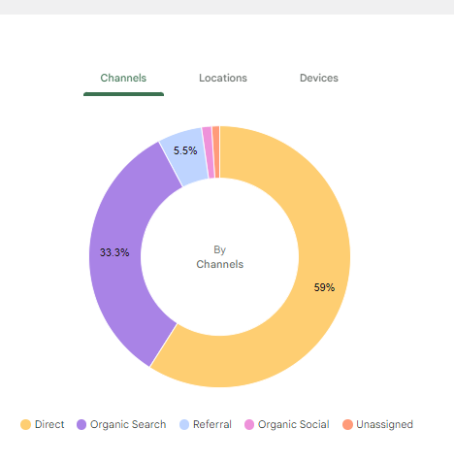
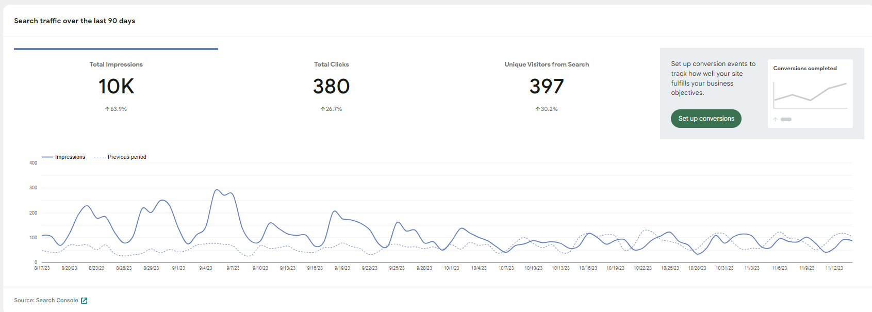
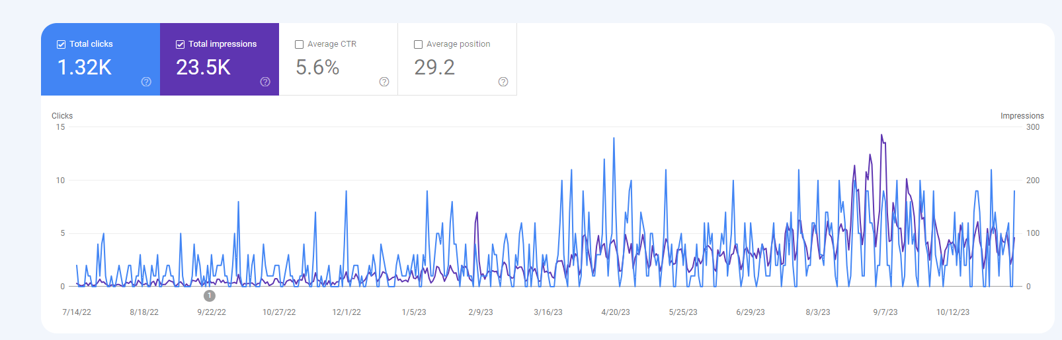
WEB TRAFFIC

Slide 26
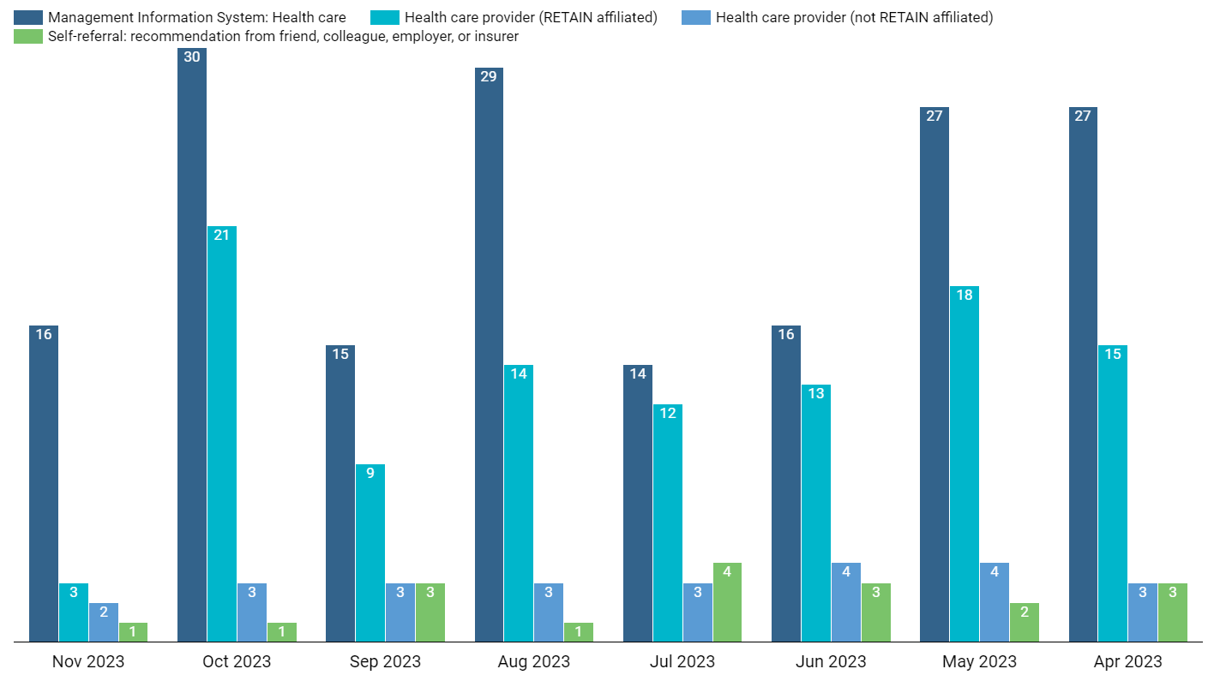
Referral Source Comparison

Slide 27

Success Story Submission

