Slide 1
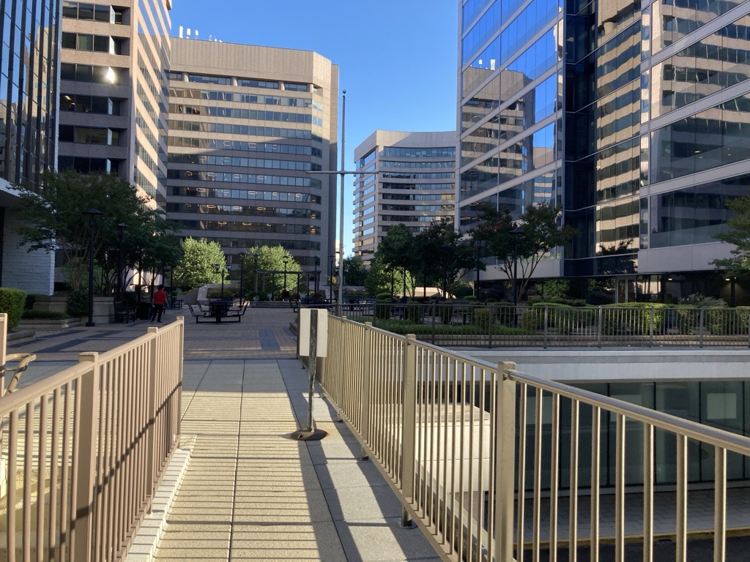
RETAINWORKS

Slide 2



In the beginning…

Slide 3
Learning is a process!
You don’t know what you know!
You know what you know!
You don’t know what you don’t know!
You know what you don’t know!

Slide 4


Slide 5
U.S. DEPARTMENT OF LABOR ANNOUNCES AVAILABILITY OF $20 MILLION IN GRANTS TO HELP INJURED OR ILL AMERICANS REMAIN IN LABOR FORCE
WASHINGTON, DC – The U.S. Department of Labor today announced the availability of $20 million in grants to help Americans who are injured or ill remain in or return to the workforce. The grants are intended to identify new, replicable strategies to help individuals with a work-related disability stay on the job.
“America’s workforce is strengthened by the participation of all Americans. After an injury or illness, it is critical for workers to have the ability to return to the labor force as quickly as possible,” said U.S. Secretary of Labor Alexander Acosta. “These grants will help develop innovative strategies that enable injured or ill Americans to return to work so they can support themselves and provide for their families.”
The grants represent the first phase of funding for Retaining Employment and Talent After Injury/Illness Network (RETAIN) Demonstration Projects, which will be administered by the Department’s Office of Disability Employment Policy (ODEP), in partnership with the Department’s Employment and Training Administration and the Social Security Administration (SSA).
Successful applicants will propose coordinated employment and health services through an integrated network of partners, including state and/or local workforce development agencies; health-care systems and/or provider networks; and other strategic partners, such as employers or insurers.

Slide 6
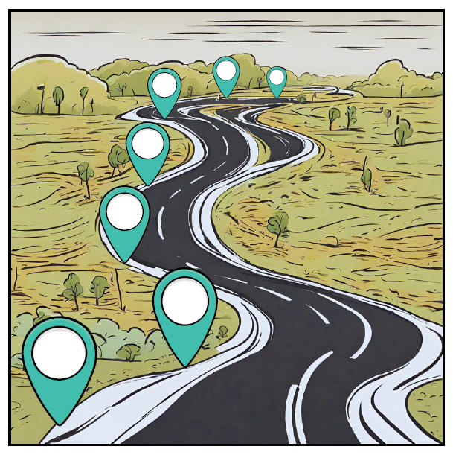
Milestones
Phase 1-Planning & Pilot Implementation
Phase 2-Statewide Expansion & Implementation
Medical & Workforce System Partnerships
Developed Statewide
REDCap Implementation
Use of EMR Data
Targeted Statewide Outreach
Behavioral Health RTW Activity Prescription Plan
Implementation of Provider Exception Rule

Slide 7
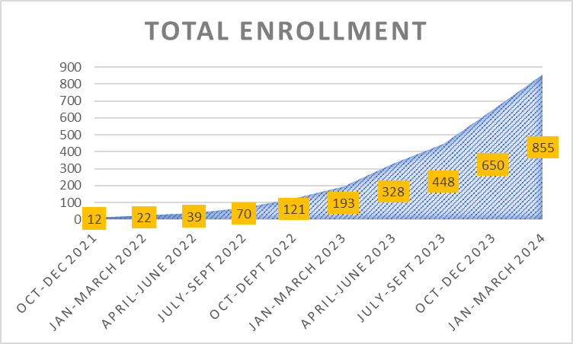
YOU increased enrollment!
EMR ~ Live Dashboard ~ Digital Ad Campaign

Slide 8
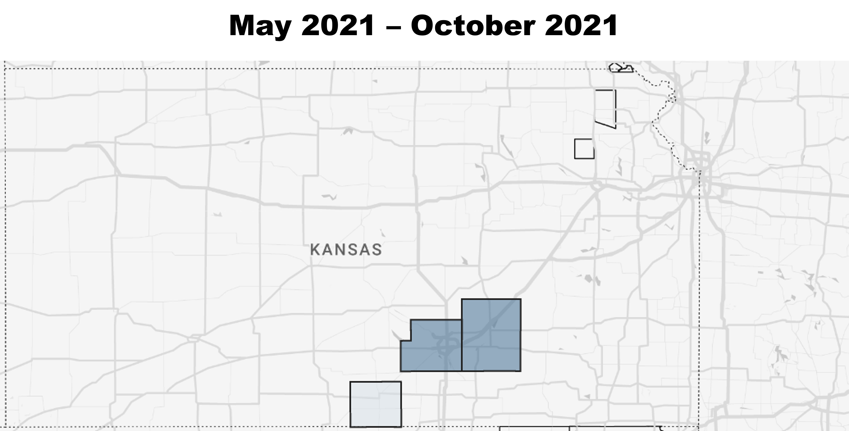
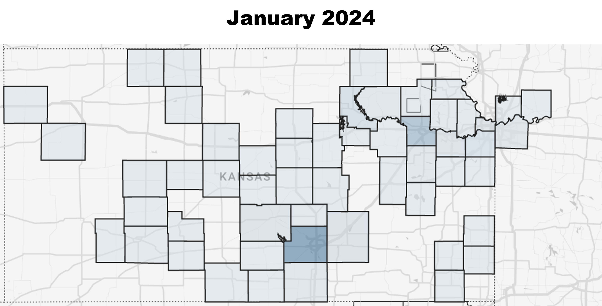
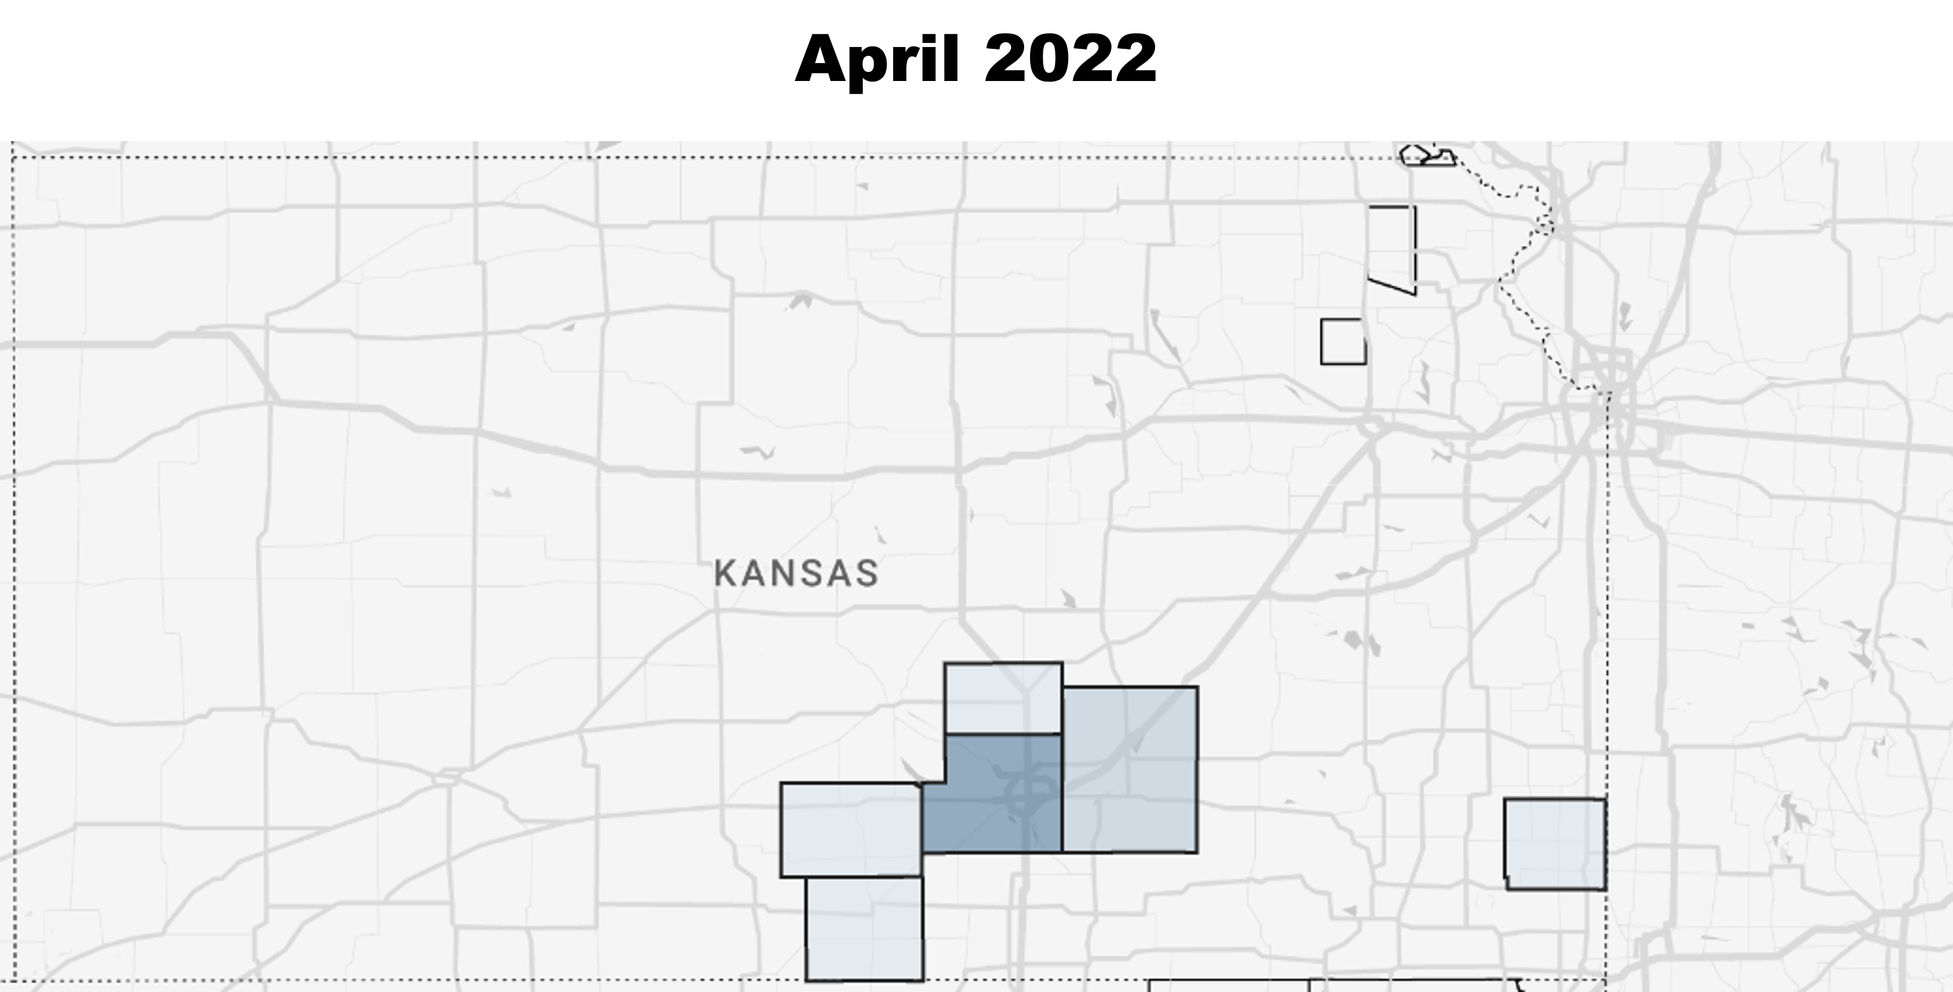
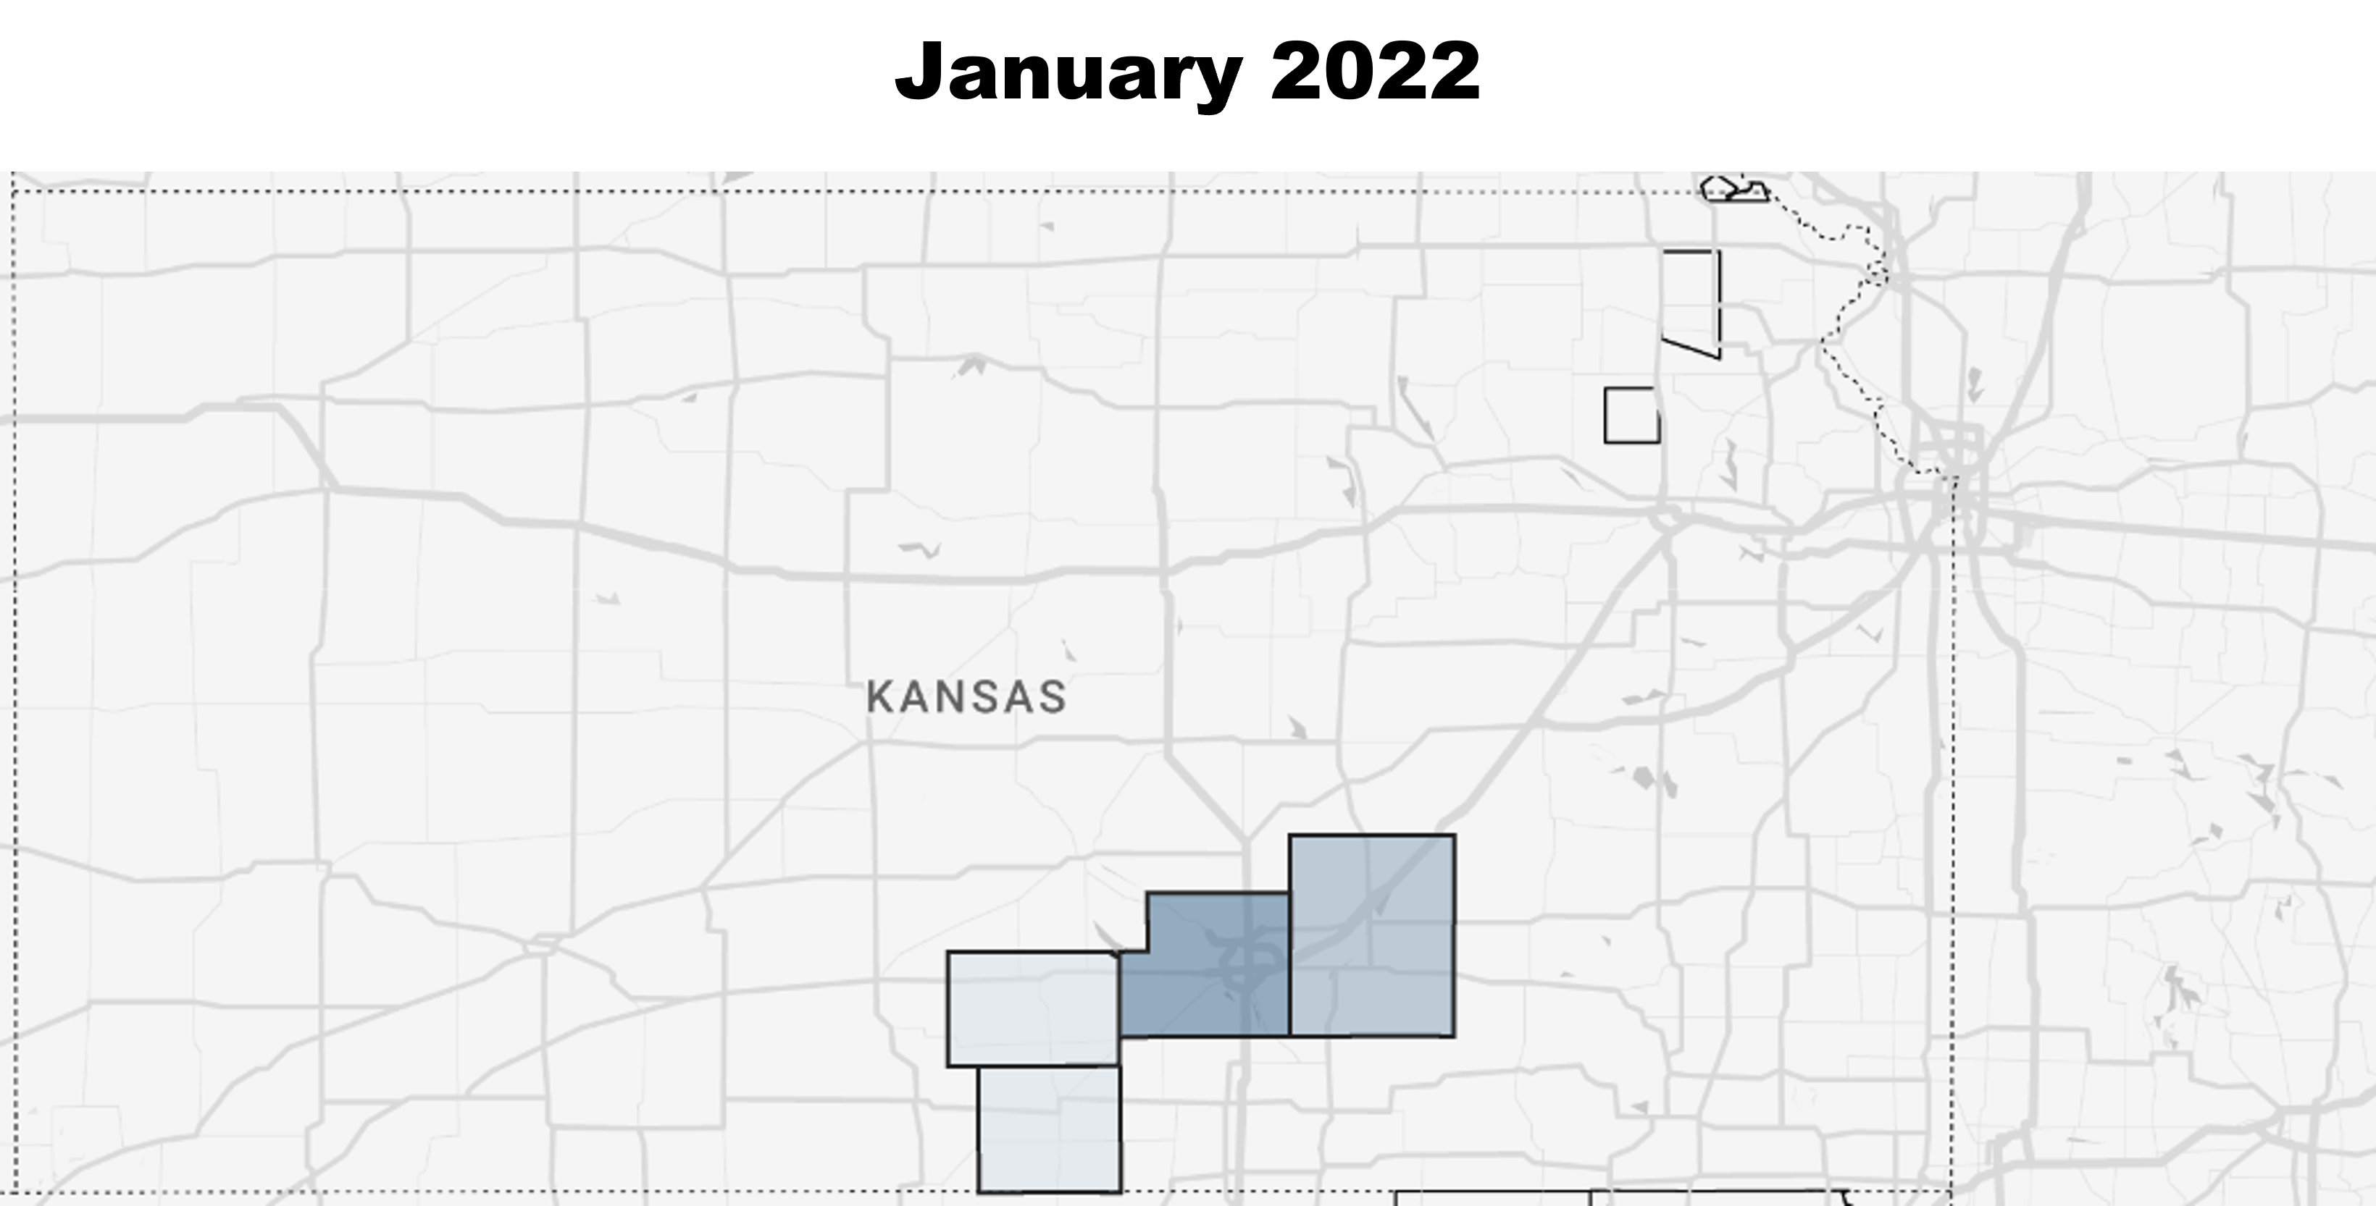
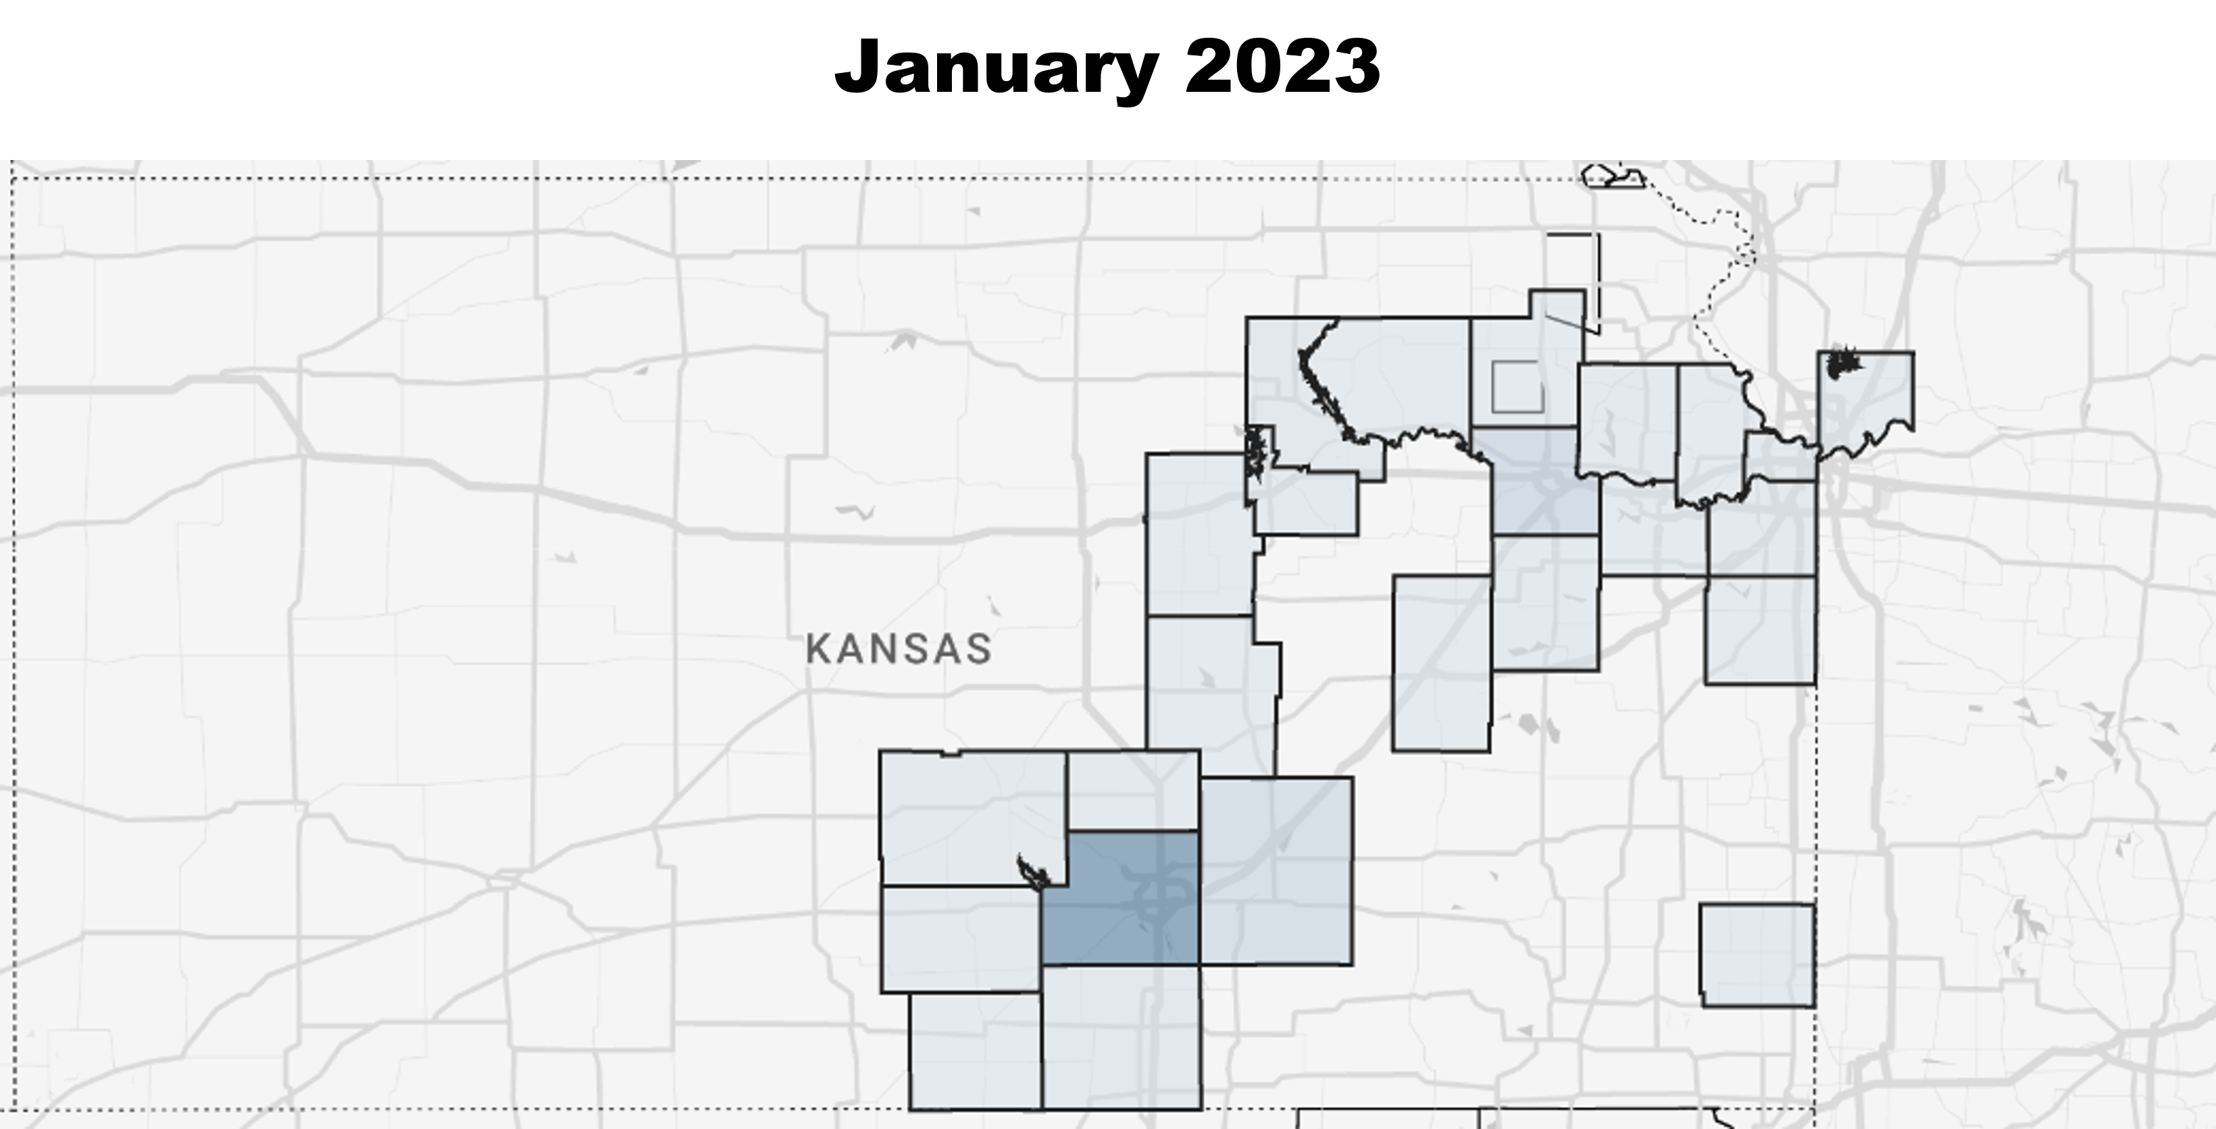
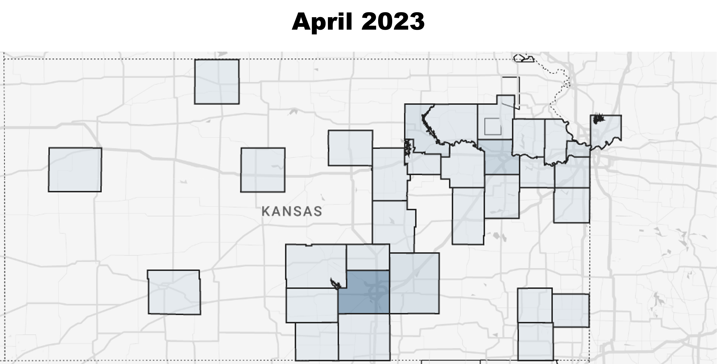
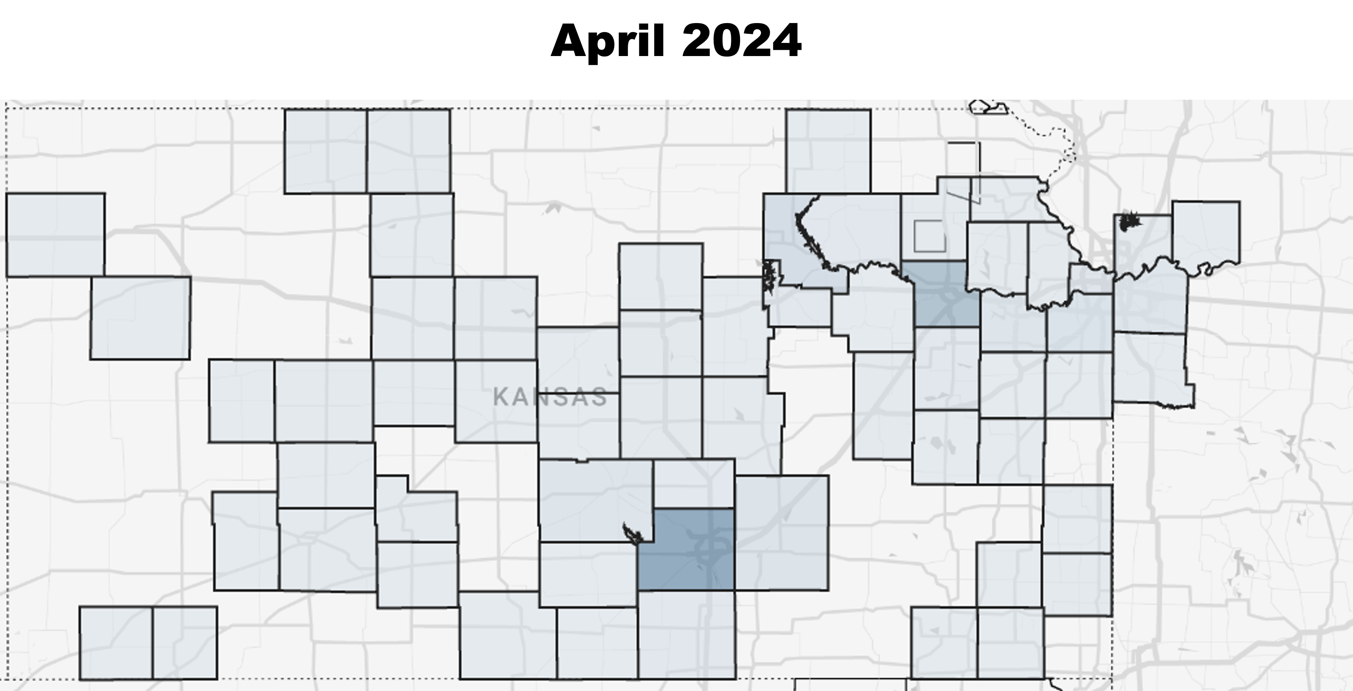
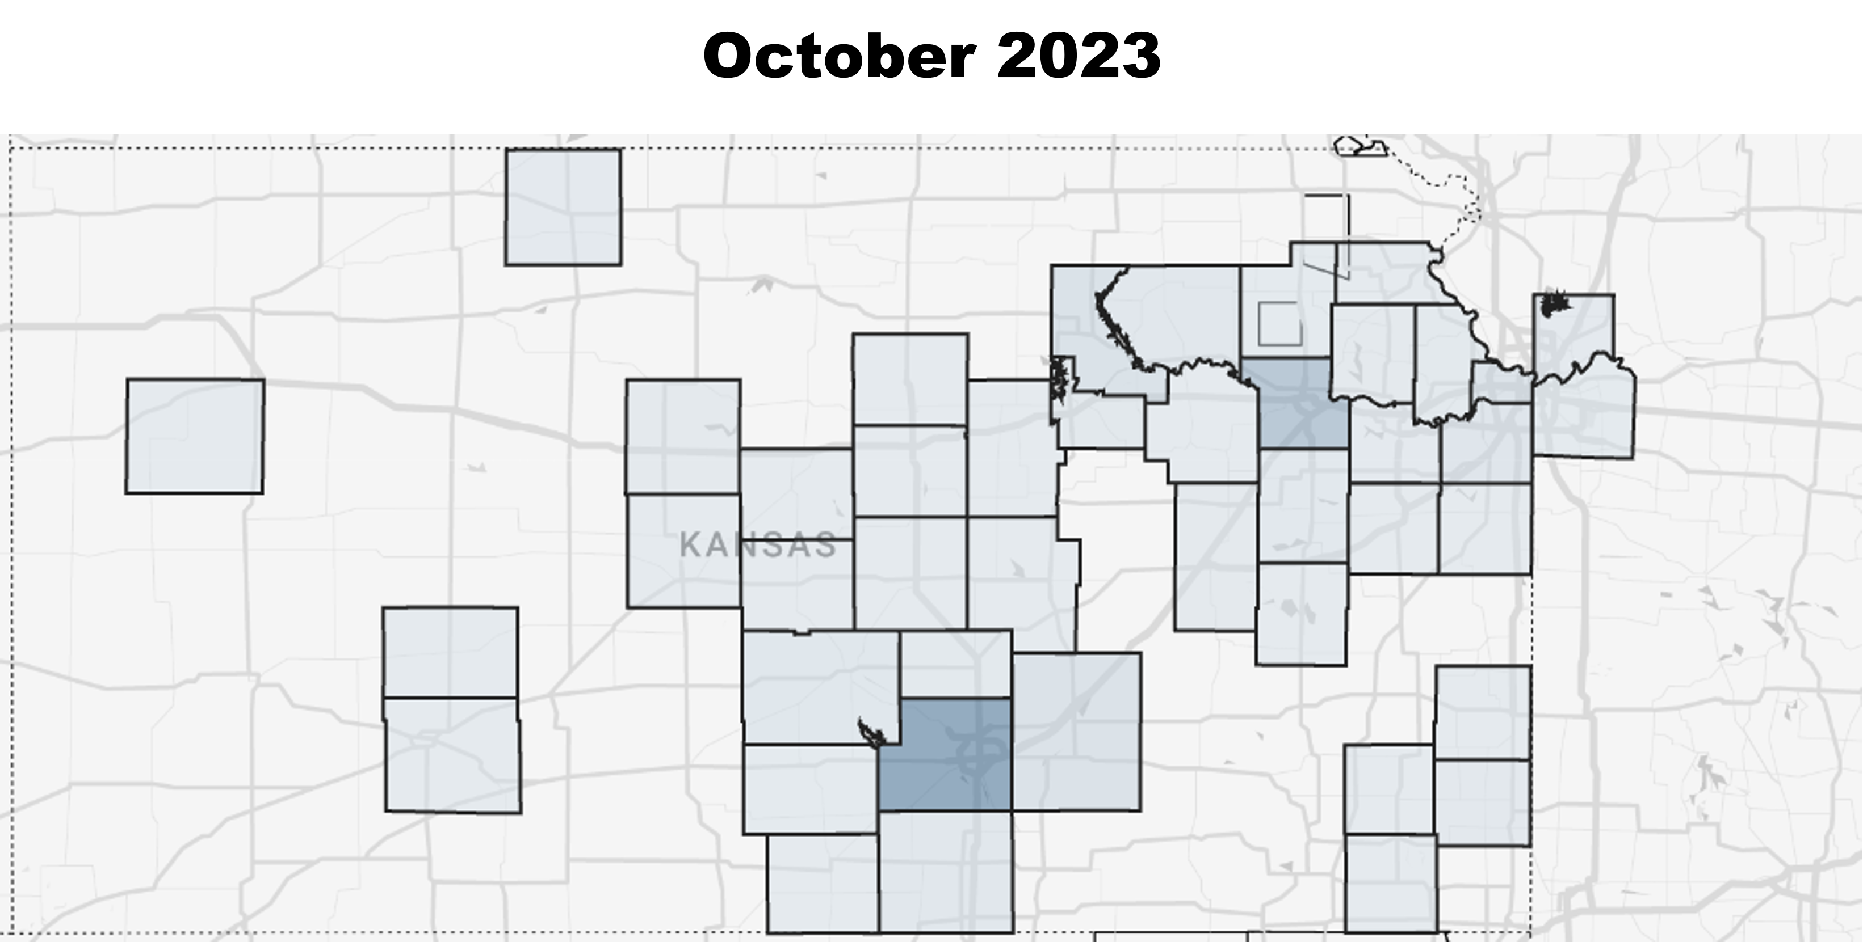
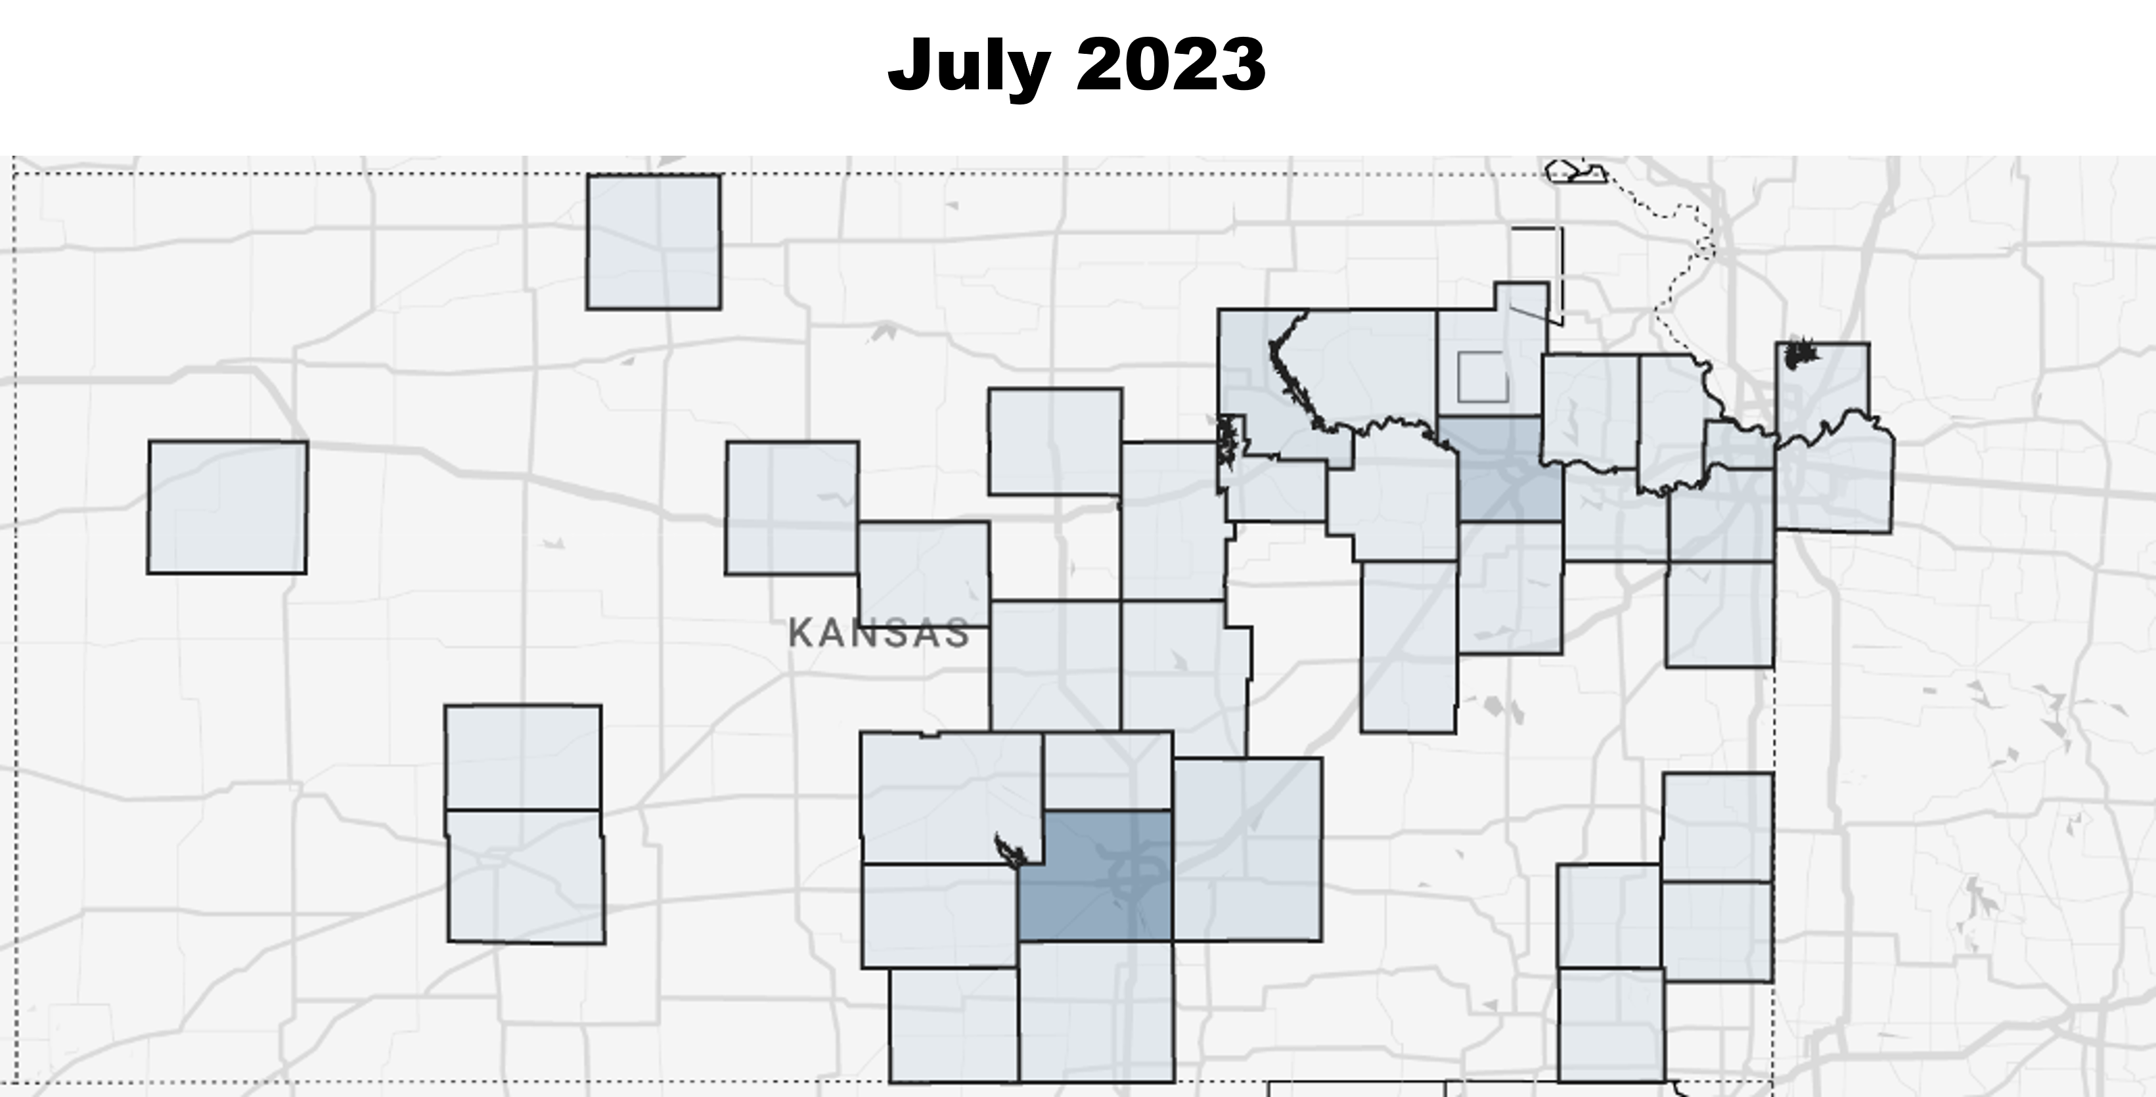
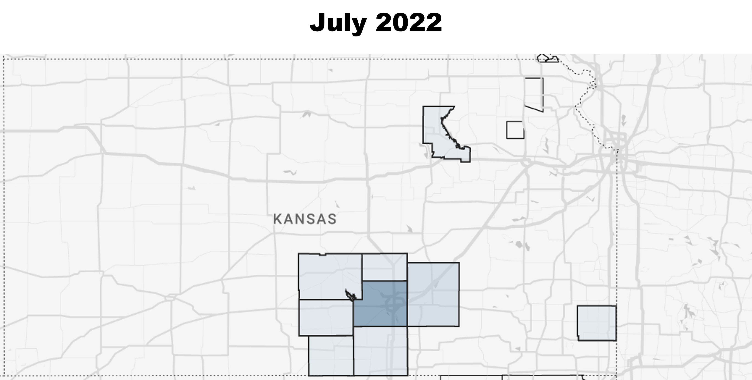
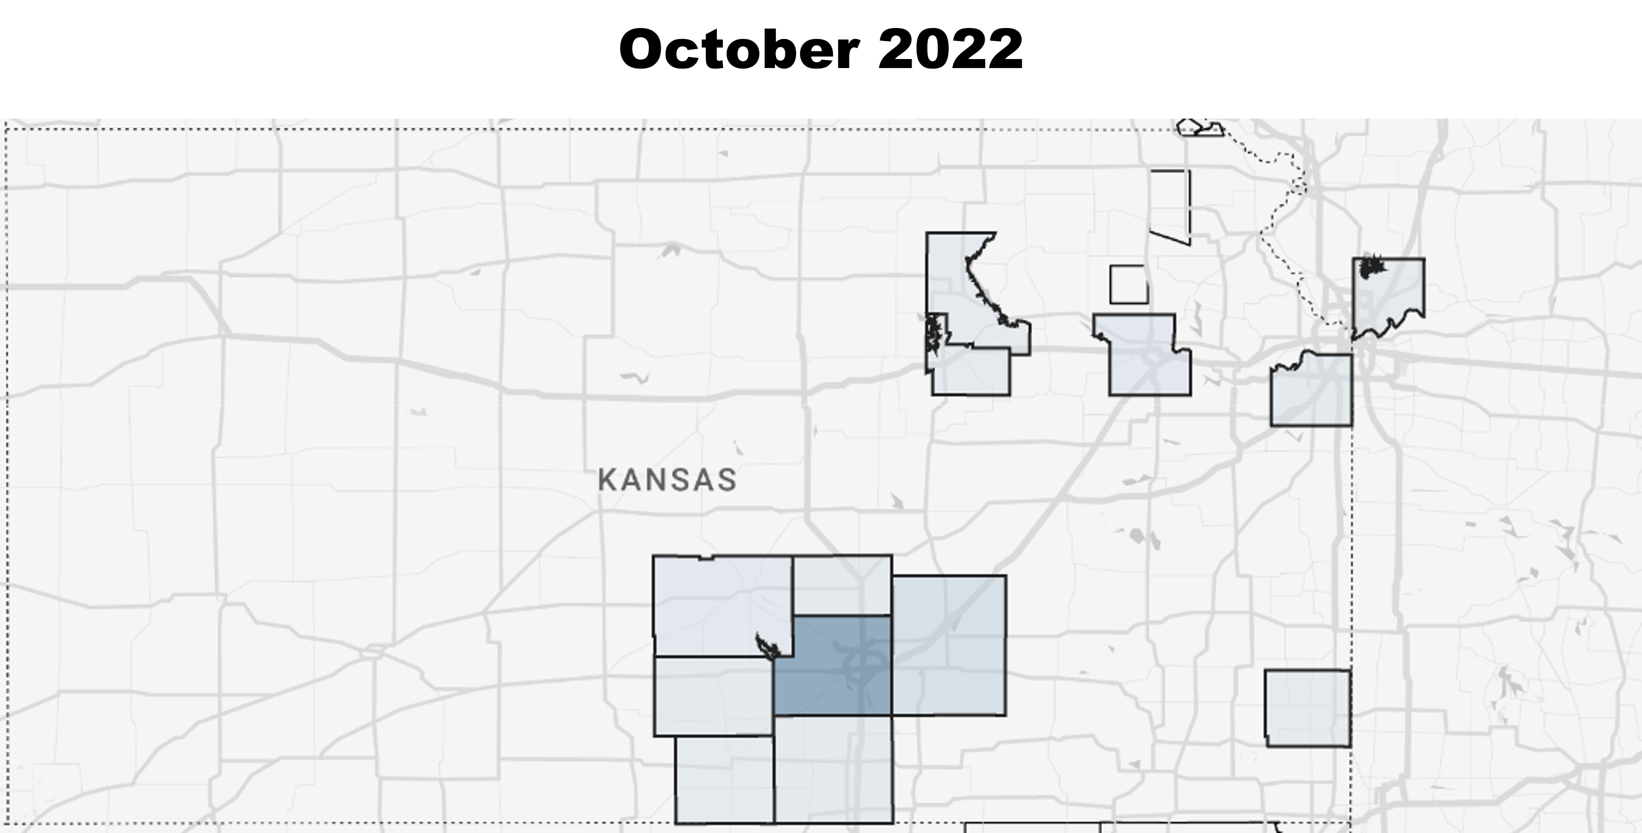
YOU expanded our service area!
RETAINWORKS Enrollment Timeline

Slide 9
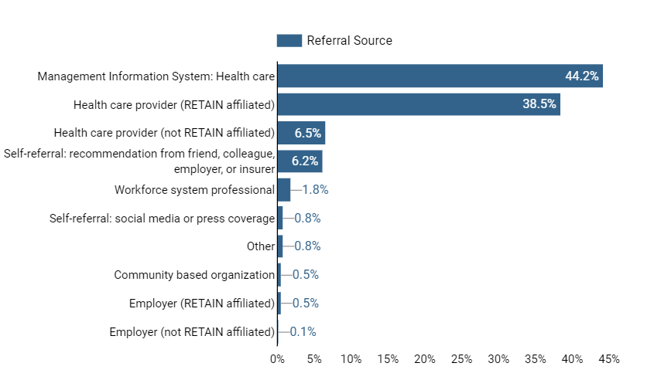
YOU developed multiple referral methods!

Slide 10
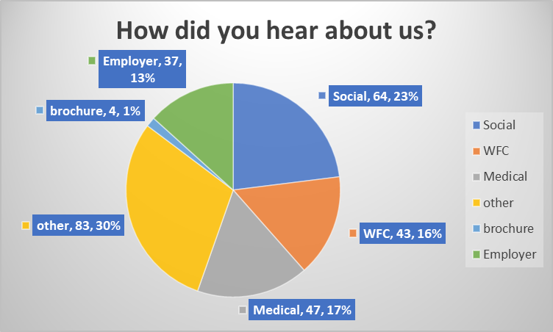
YOU Increased Outreach & Self Referrals!

Slide 11
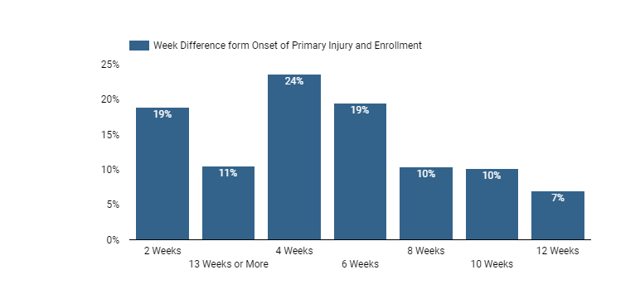
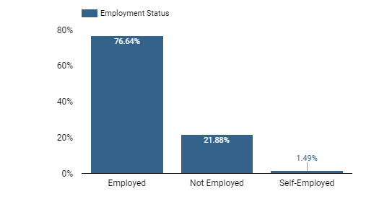
YOU provided quality services to patients, providers, and employers!

Slide 12
YOU are important!
YOUR communities are important!
The health and well-being of KANSANS is important!

Slide 13


Slide 14


Slide 15
THANK YOU!

