Slide 1
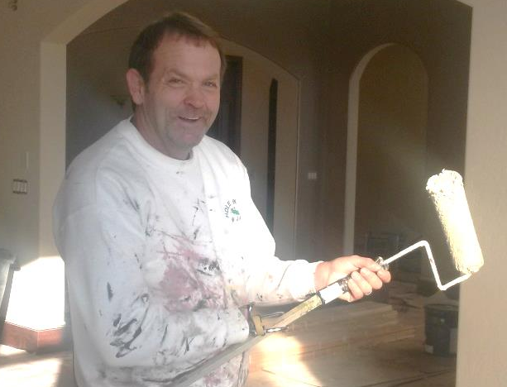
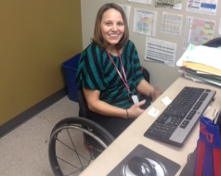
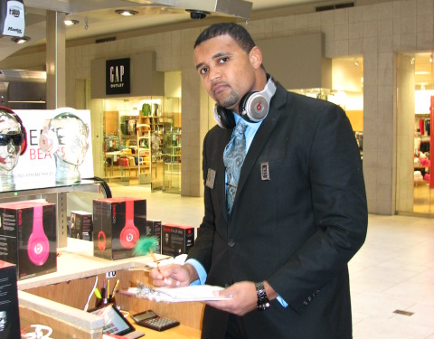
KANSAS REHABILITATION SERVICES

Slide 2
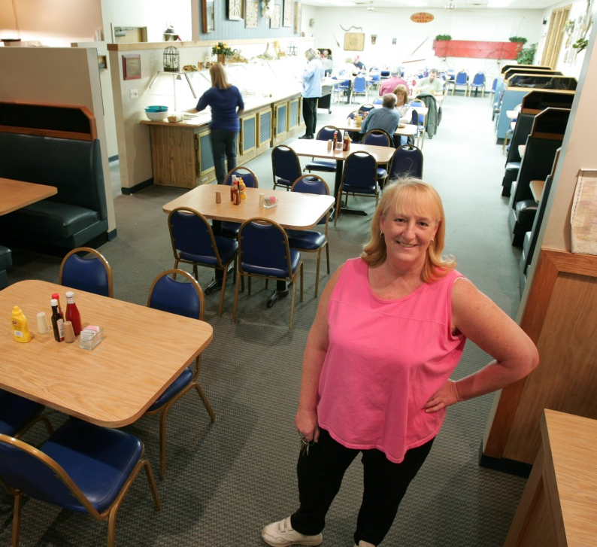
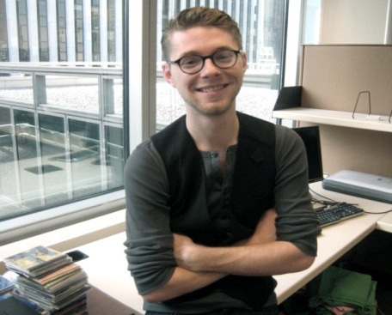
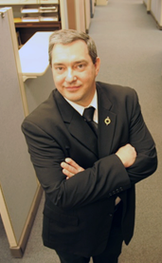
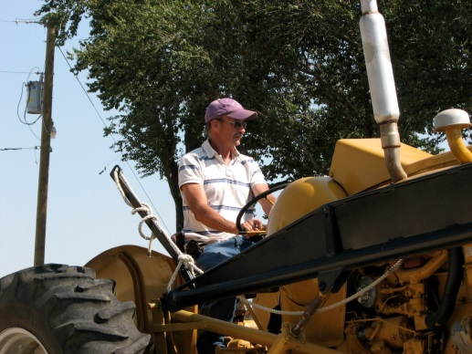
Kansans on the job
Throughout this presentation, we feature photos of Kansans with disabilities who are successfully employed as a result of our services.

Slide 3
Our mission
Kansas Department for Children and Families (DCF)
To protect children, strengthen families and promote adult self-sufficiency
Vocational Rehabilitation (VR): A program of the Rehabilitation Services (RS) Division
Working in partnership with Kansans with disabilities to achieve their goals for employment, independence and self-sufficiency

Slide 4
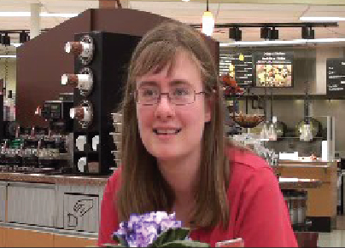
The Rehabilitation Act
Vocational rehabilitation (VR) is authorized through the Rehabilitation Act of 1973, as amended (Title IV of the Workforce Innovation and Opportunity Act of 2014). The purpose of this program is to empower persons with disabilities to maximize:
  Employment
  Economic self-sufficiency
  Independence
  Inclusion and integration into society

Slide 5
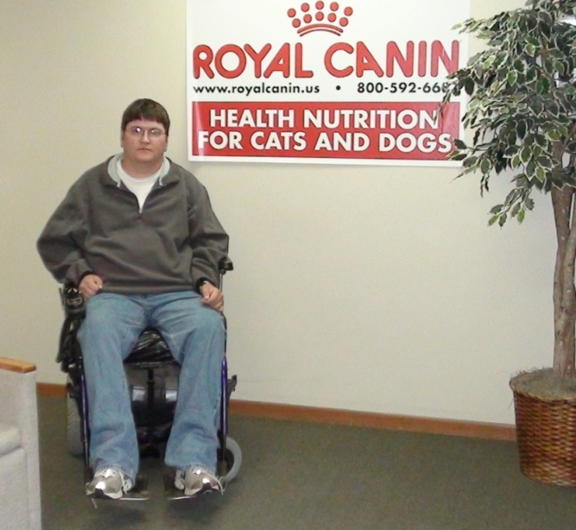
Congressional Findings
Work is a valued activity, both for individuals and society
Work fulfills the need of an
individual to be productive
Work promotes independence
Work enhances self-esteem
Work allows for participation
in the mainstream of life

Slide 6

Research on the Benefits of Work
People with Disabilities who participated in a research project called “Because I Work” made strong statements about the significant impact of employment.
Work “fills a big void in my life.”
I feel more “interesting” because I work.
Work contributes to a sense of identify.
How do you introduce yourself if you
don’t work?
Source: “Because I work: A Phenomenological Inquiry of People with Disabilities;” Patricia Yeager, MS, Michael Donnelly, BS, Jana Copeland, PhD, Rocky Mountain Disability and Business Technical Assistance Center; 2009

Slide 7
Because I Work . .
Working gave me a “sense of accomplishment and self-pride.”
I felt “a purpose,” “joy,” and the “confidence to learn new things.”
Work gives people the opportunity to choose their own path.
Work gives hope to be part of the world.
Source: “Because I work: A Phenomenological Inquiry of People with Disabilities;” Patricia Yeager, MS, Michael Donnelly, BS, Jana Copeland, PhD, Rocky Mountain Disability and Business Technical Assistance Center; 2009

Slide 8
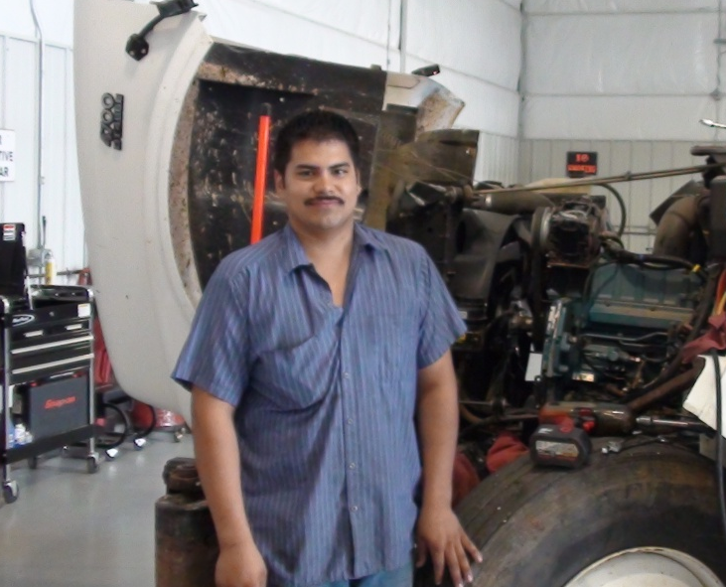
VR Emphasizes Employment
VR offers the opportunity to pursue work and self-sufficiency
Individuals with disabilities, including individuals with the most significant disabilities, are presumed to be capable of engaging in gainful employment.
The provision of individualized VR services can improve their ability to achieve competitive, integrated employment.

Slide 9
VR Core Principles
Community-based services and competitive, integrated employment outcomes are emphasized.
VR counselors work in partnership with consumers to help them assess their skills and interests, to develop Individual Plans for Employment, and to provide or purchase needed services.
VR counselors prioritize maximizing employment and training opportunities.
Services are customized according to each person’s strengths, interests, skills, goals and informed choice.

Slide 10
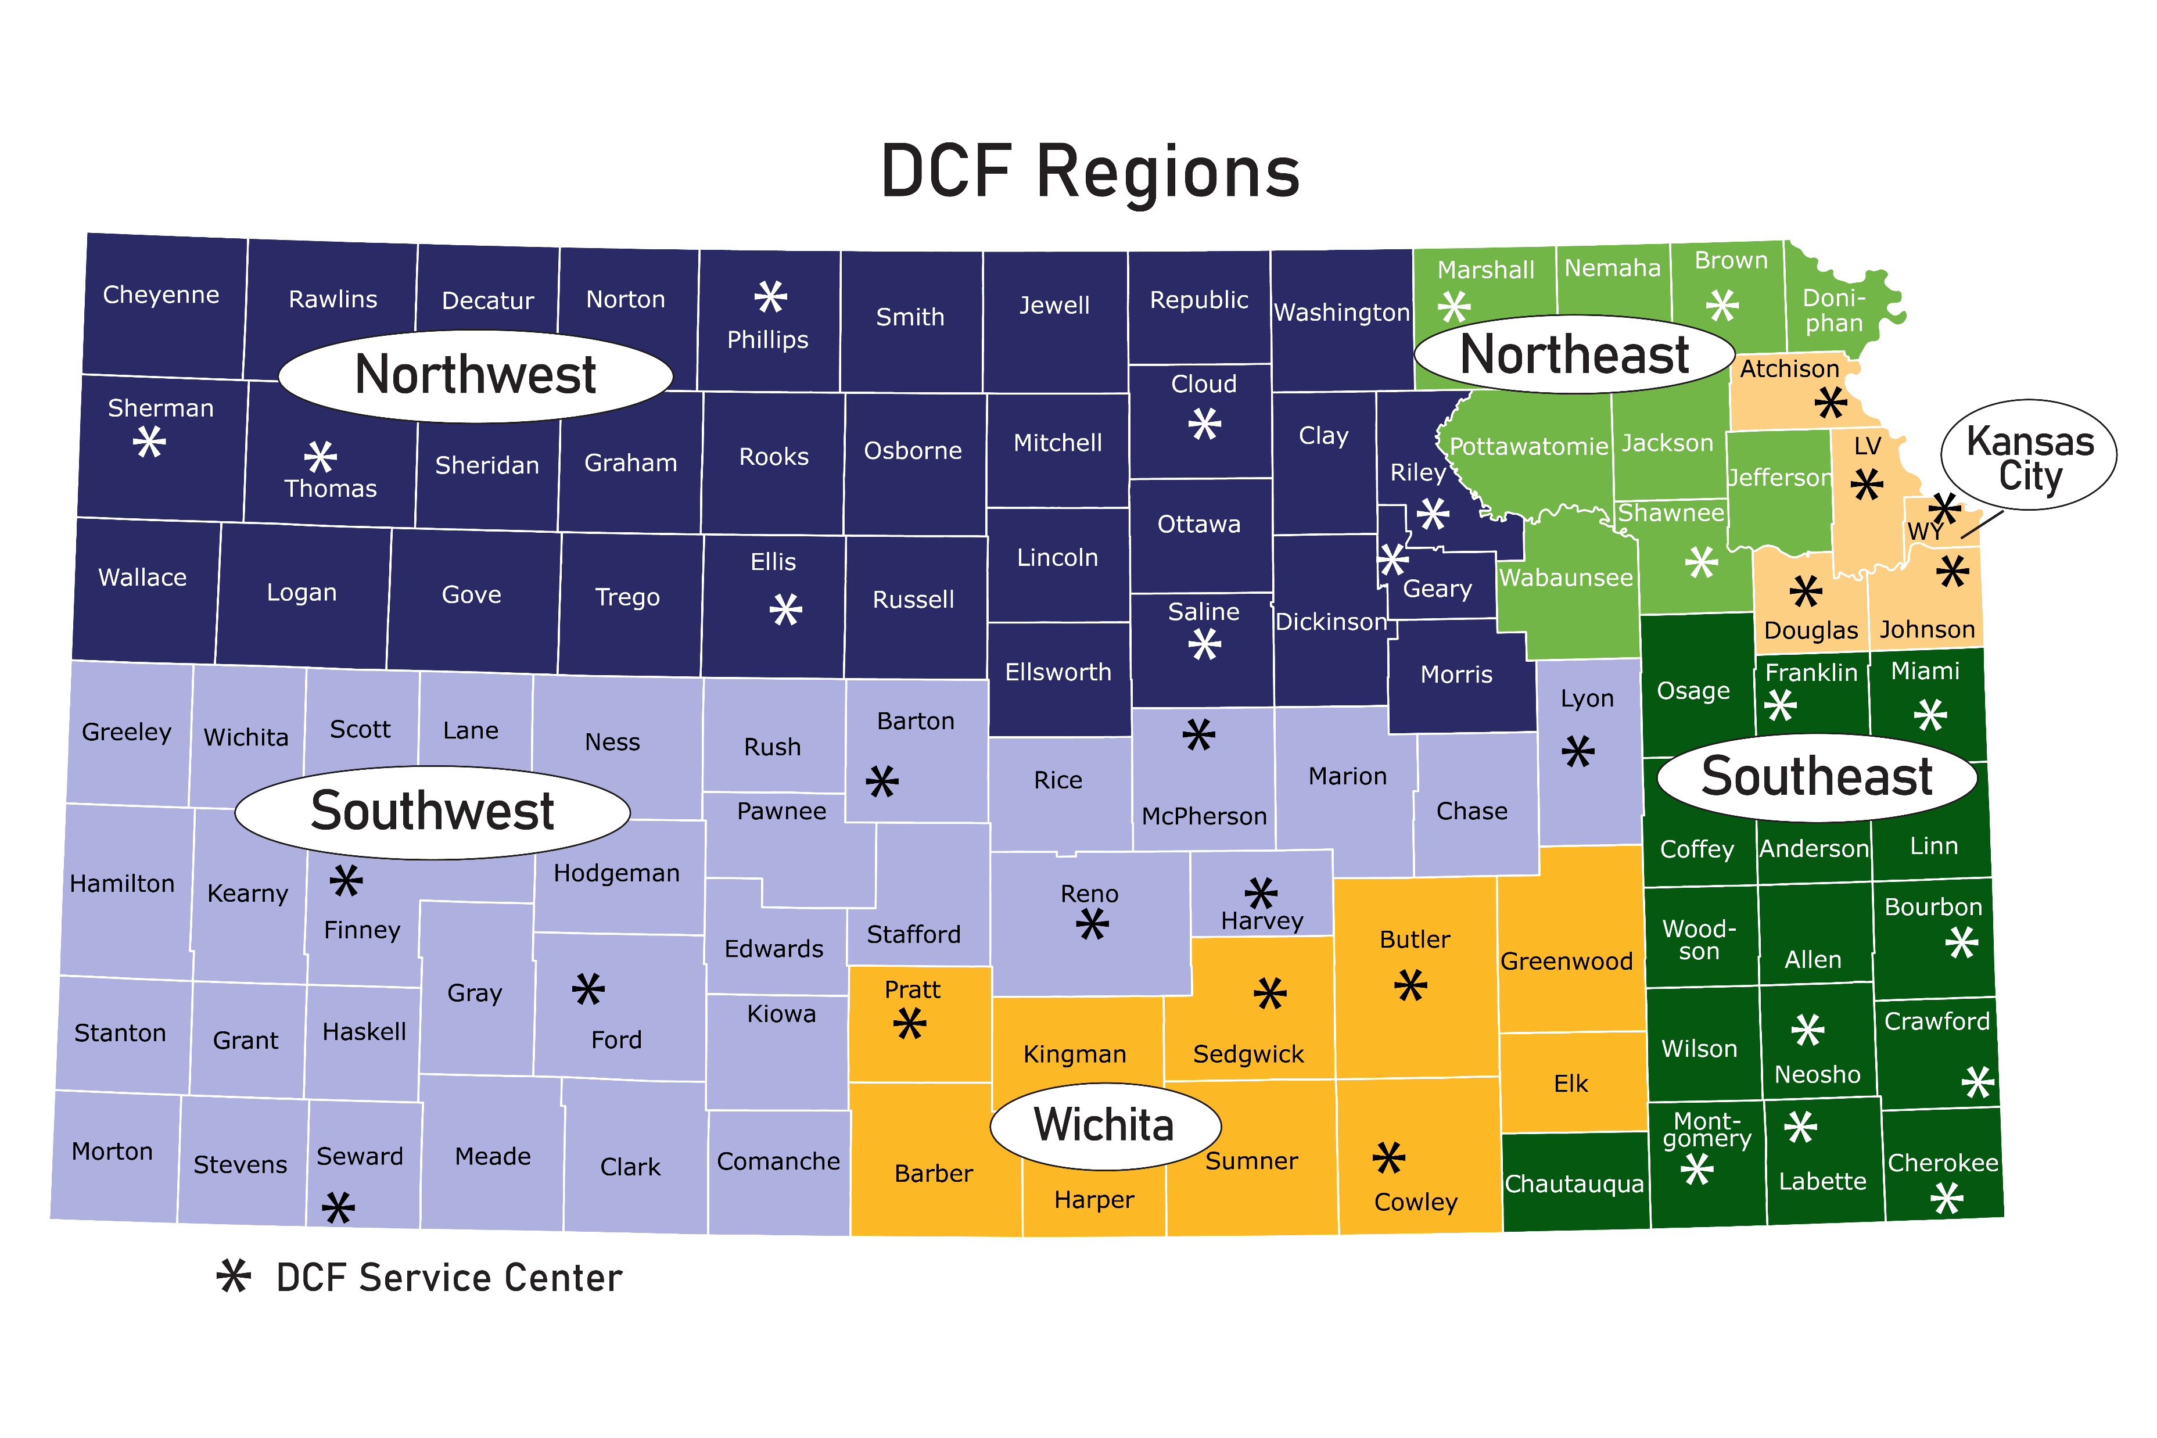
State-Wide Service Delivery
74 Qualified VR counselors
Stationed in DCF offices throughout the State.
Average Active caseload: 76
25 Pre-ETS Transition Specialists
Stationed in DCF offices throughout the State and assigned schools.
Average Active caseload: 66
Network of more than 100 public and private service providers

Slide 11
Referrals to VR are Encouraged
VR is an employment program, and individuals who participate are expected to become employed as a result of services.
Individuals must be available to pursue employment.
Persons referred and applicants may be unemployed, underemployed or in need of services to maintain employment.
Individuals who have temporary health conditions, such as broken limbs or pregnancy, are not eligible for VR services on the basis of those conditions alone.
VR is not a source for emergency medical or medical insurance coverage.
VR works with persons with all types of disabilities.

Slide 12
VR PROCESS
Application and Eligibility
Provision of Services
Job Search
Employment
Order of Selection
IPE Development

Slide 13
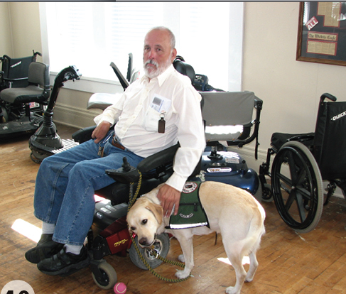
Application and Eligibility
After a consumer applies for services, he or she will meet with a VR counselor or another staff person for an interview.
During this interview and other meetings, VR will collect information about:
The individual’s strengths
The individual’s employment skills and interests
The individual’s educational, disability and employment background
If more information is needed, then the consumer and the counselor may discuss participation in additional assessments.

Slide 14
Eligibility
Require VR services to achieve employment
Have a physical or mental disability
Disability
results in a substantial impediment to employment
This information is then analyzed by the Counselor to determine if an individual is eligible for services
Individuals must meet all 3 of these components to be eligible

Slide 15
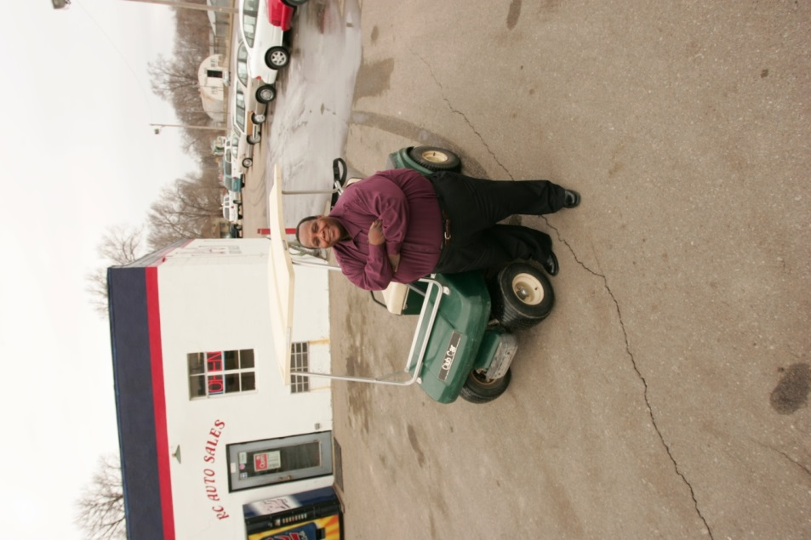
IPE Development
Persons who are found eligible will develop an Individualized Plan for Employment (IPE). This is a plan of action that describes the steps and services a consumer will need to reach his or her employment goal.
One of the first steps is to identify what kind of job the consumer wants to get, and how soon he or she will be able to begin working. To help individuals think about this decision, the counselor will discuss:
The kind of life the individual wants to build
The individual’s career interests and abilities
Jobs that fit the individual’s interests and abilities
Available jobs in the labor market

Slide 16
Necessary Services are Identified
After an individual determines the employment goal, the next step is to identify the services needed to meet that goal.
There are many core VR services, including:
Vocational counseling and guidance
Employment-related training at a vocational school, community college or university
Physical or mental restoration services
Supported employment
Job-seeking skills training
Job development and placement
On-the-job coaching
Community-based job tryouts and on-the-job training funds
Assistive technology, telecommunications devices or other tech aids

Slide 17
Services are Provided
Partnerships
VR collaborates with several partner agencies to expand the program and services available to persons with disabilities.
Our partners include:
State Agencies
Educational Institutions
Consumer & Advocacy Agencies
Community Partnerships
Business and industry are vital partners in what VR does also

Slide 18
Pre-Employment Transition Services
Pre-Employment Transition Services (Pre-ETS) offer job exploration, counseling, and other support to students aged 14 to 21. These services aim to prepare students for employment and self-sufficiency, reducing reliance on public benefits.
In collaboration with local education agencies and qualified community partners, RS will provide or arrange for the provision of Pre-ETS for students with disabilities who are in need of such services.
The services are designed to provide early start at job exploration and to assist students with disabilities in making the transition from secondary to post-secondary education/training and competitive, integrated employment.
Notes:
Job exploration counseling, self-advocacy, workplace readiness training, counseling on comprehensive traisiton or post-secondary training, and work-based learning experiences

Slide 19
Providing Service
Funding
A critical piece of VR is funding. The cost of the program is shared by state and federal governments.
78.7% coming from the Federal government
21.3% match by the state is required to pull down these federal funds.
When providing services to consumers, we work with our partners to blend funding to serve our mutual consumers.

Slide 20
Services are Provided
During the plan, the Counselor will meet with the individual from time to time to talk about progress, to make sure the plan is still working, and to discuss anything important for success.
Depending on individual needs, VR services may last from a few months to several years. Progress measures help ensure that the plan for employment stays on track.
Services must be pre-authorized in writing by the VR counselor.

Slide 21
Job Search
Getting a job is the goal of the partnership between the individual receiving services and VR.
The job search and placement services the individual will receive will depend on individual needs. These services may include:
Resume preparation
Practice interviews
Development of job leads
Guided placement
Customized placement
For some of these services, an individual may be referred to a service provider who will assist in seeking employment.

Slide 22
Service Provider Network
In addition to receiving direct services from staff, consumers may receive services through our extensive network of service providers.
Independent living centers
Assistive technology programs
Mental health centers
Community developmental disability organizations and affiliates
Medical providers
Other community rehabilitation programs
Other private providers

Slide 23
Vocational Rehabilitation (VR)
PY 2022 Highlights
8,556
Number of persons with disabilities served
3,813
Number of new applications processed
3,546
61
Number of active Individual Plans for Employment as of June 30, 2023
Number of VR Counselors
Notes:
Program Year 2022 is July 1, 2022 to June 30, 2023

Slide 24
Vocational Rehabilitation (VR)
PY 2022 Highlights
1,364
Persons achieving stable competitive integrated employment
31%
Percent of employment outcomes achieved by transition youth

Slide 25
Primary Disabilities of Persons Closed Successfully

Slide 26
Vocational Rehabilitation (VR)
FY 2022 Highlights
$14.69
76%
Average hourly wage
Percent of persons employed who report their own earnings as their largest source of support
Percent of persons employed who have health insurance through employment
43%

Slide 27
Vocational Rehabilitation (VR)
PY 2022 Highlights
1,145
Number of students with disabilities participating in Pre-Employment Transition Services

Slide 28
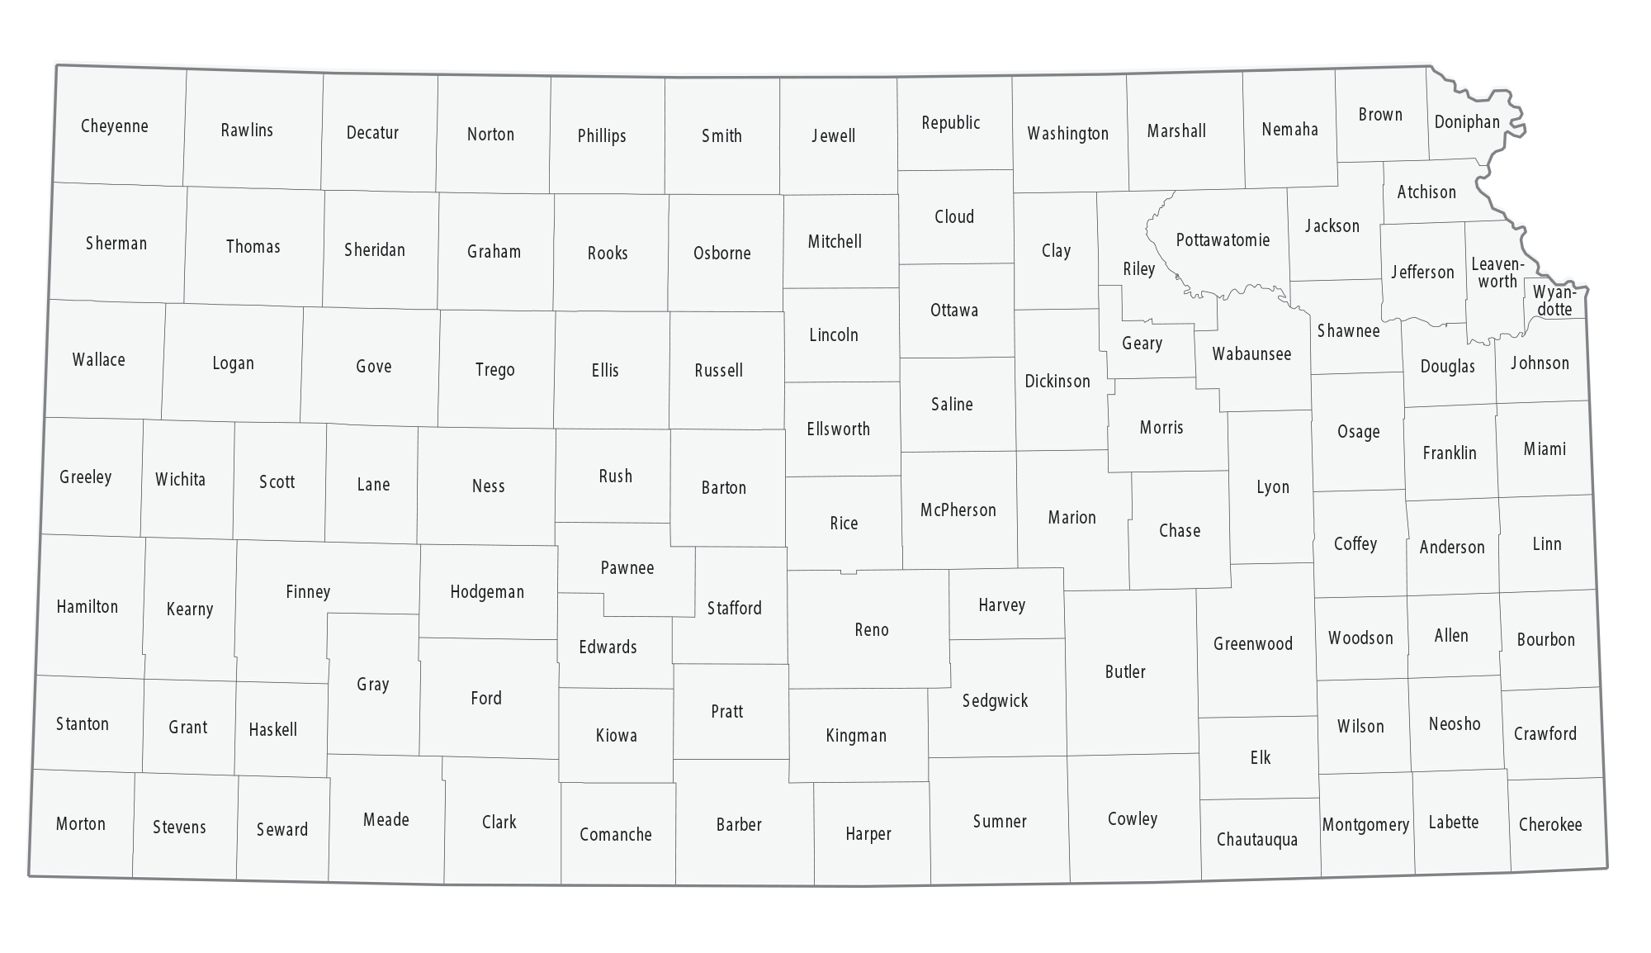
Examples of High-Wage Jobs
KC Region
Director of Finance
$62.50 Per Hour
West Region:
Pharmacist
$48.08 Per Hour
East Region:
Self-Employed
Insulator
$99.99 Per Hour
PY 2023
Wichita Region:
Principal
$49.77 Per Hour

Slide 29
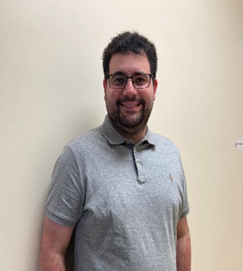
Empowering Success:
Eric’s Journey to Employment
Notes:
Eric came to Vocational Rehabilitation to receive assistance transitioning to a job that he had had in janitorial work since 2017. He was ready to find a new job other than cleaning. Eric and his parents knew that he was capable of a higher level position, and one that was a little more challenging. Eric has an English degree from Fort Hays University but a diagnosis of autism, makes it extremely difficult for Eric to be confident in social situations, especially in self-advocacy. Eric is extremely shy , but this counselor has seen his growth and he speaks up much better now.
Eric and this counselor worked with the Hays Workforce Center. He had a job try out at Hermann Law Practice. He enjoyed this job, but we were able to discover it was not the best fit. This counselor was able to go to an interview with Eric, per his request, at Hays Med. Unfortunately, another candidate was chosen for the Medical Documentation position.
Jason Hickson, of Hays Workforce, then helped Eric to apply at Cloud Storage and discuss some of the supports for Eric with the employer that would help his success. Eric was excited about this and has a friend that is an employee there. This really helped Eric to feel more comfortable pursuing the job. Eric accepted his job with Cloud Storage and started on May 8, 2023. He worked at Dillons for a while to make sure the transition was one he enjoyed. He now loves his job with Cloud Storage and is earning $3 more/ hour. Eric works around 20 hours per week but has been in conversation with his manager and they plan to get him full-time status soon.
Eric’s KRS services closed successfully on 8/15/2023.
Services/Comparable Benefits: Customized Job Placement; Community Based Job Try Out & Career Counseling & Guidance
Eric had a private family insurance to cover any and all medical needs.
Partners:
Local Area WorkforceOne, Hays Workforce, Jason Hickson
The client’s views about their VR services and their employment:
Eric is really enjoying his job. He was happy to tell this counselor when he was able to provide a two week notice to his old job. He is now earning $3/ hour and hopes to become a full-time employee soon.

Slide 30
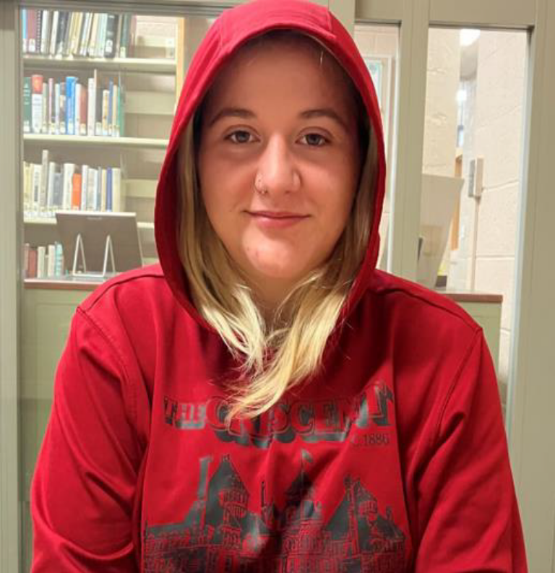
Charting Success:
Katelyn’s Pre-ETS Journey
Notes:
Katelyn is a 15-year-old attending Iola high school where she will be starting her Junior year this coming August. Katelyn has participated in services such as Job exploration, Self-Advocacy, Workplace Readiness, Counseling on post-secondary education and Work based learning experiences. Katelyn has grown and shown great improvement with her self-confidence and social interactions while participating in Pre-ETS. I’m excited see Katelyn grow as she shapes her goals and career interests into her future through Pre-ETS.

Slide 31
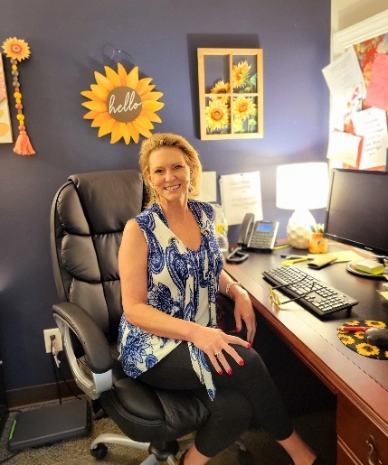
Empowering Success:
Jen’s Journey to Employment
Notes:
Jen was working as a tech at mirror inc. earning $13 an hour. She is an addict in recovery and states it is a struggle she feels daily. She is stable on her current medicine and working helps her stay stable. She enjoys working with others who are dealing with addiction; it has become her passion to help others that struggled like her. Jen wanted VR to assist her in gaining her Substance Abuse counselor license.
Jen pursued her credential through KCKCC; VR supported her with tuition, books and the cost of her test to get her permanent license. Jen really wanted to stay at Mirror inc. and work there as a counselor. It so happens a counselor did leave which opened a spot for jen. She was able to go from a tech earning $14 an hour to a SA Counselor earning $25 an hour; but the most important aspect; she was able to stay at Mirror inc. where she has grown to love working with those around her; staff and patients.

Slide 32
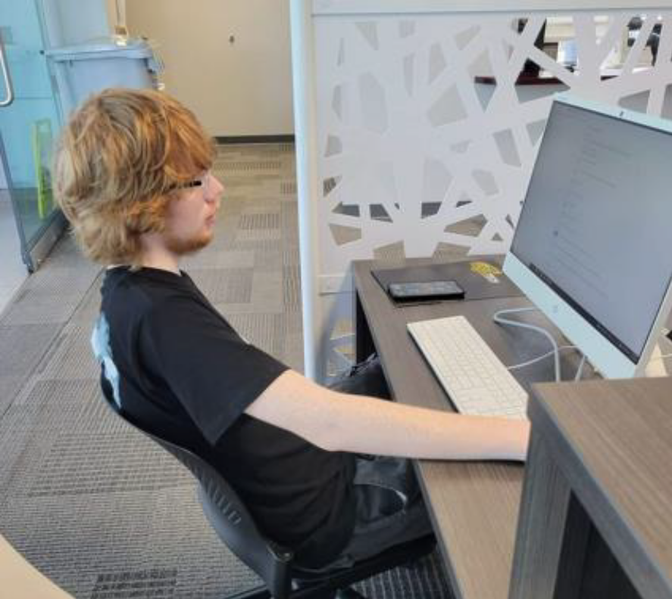
Charting Success:
Zandar’s Pre-ETS Journey
Notes:
Zandar is a student who has worked with Pre-ETS and is continuing to work with VR. I received a call from Zandar and his mother thanking me for helping Zandar with his future with employment and education. When he started with Pre-ETS he was unsure on what he wanted to do for a career and did not really want to go to college. Pre-ETS and Zandar worked towards job exploration and counseling in post-secondary education. Zander and his mother called to also inform me that Zander will be working towards an associate degree for CNC Machining at Wichita State Tech. Pre-ETS is so proud of him and all his hard work!

Slide 33
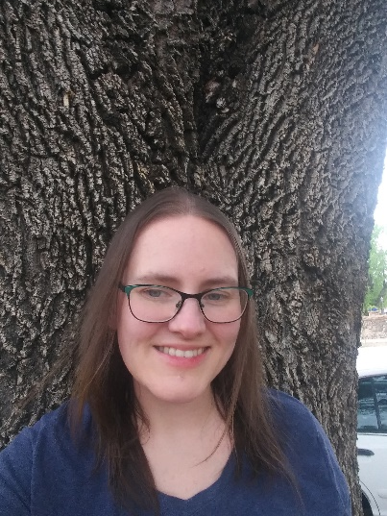
Empowering Success:
Amy’s Journey to Employment
Notes:
Amy has been a stay-at-home mom for the past eleven years. She loved raising her kids and taking care of her family. Unfortunately, Amy found herself in a situation that required her to go back to work. Her goal was to work Part-Time as a Para-Professional or a teacher’s aide in her children’s school. She worked hard with her JPS to develop her resume and prepare to go to work. Three months after she started in our VR program Amy had an interview scheduled for exactly what she was wanting. She was so excited. JPS worked with her on preparing for the interview and Amy did amazing. She was offered the job. She told me she loved working with the kids and really liked her job. Toward the end of the school year she had some bumps in the road and was concerned about her future. I counseled Amy on on some strategies to handle her problems and stress and reached out to her JPS so she could speak with her too. After a week I reached back out to Amy and things were going much better and she felt much more secure and happy with her position and is looking forward to her future.

Slide 34
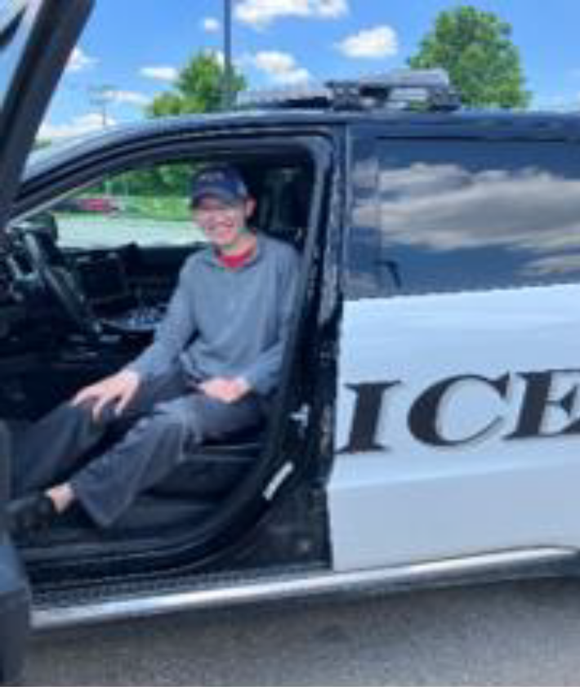
Charting Success:
Ryan’s Pre-ETS Journey
Notes:
Providing students an opportunity to learn about a job and engage with local employers is only one aspect of a Job Shadow. Ryan has a learning and development disability. He is social and thrives in environments where he can not only learn new job skills but also engage with people. Exploring jobs one day, we talked about professions we most admire, and Ryan immediately mentioned police officer. I contacted Riley County Police Department, and a job shadow was set. Providing a tour of operations, dispatch, administration, and supplies, each RCPD staff member made a point to introduce themselves to Ryan, shake hands and explain their jobs. helped Ryan identify tasks and skills he could provide in the department and most importantly, they made Ryan feel like he was a part of their team. Pre-ETS Specialists have many roles and many opportunities to make a difference in our youth and help them realize their unique differences are welcome in our communities. Spending the afternoon with Ryan and seeing him learn, grow, and be included in a profession he admires has been one of my most rewarding experiences as a Pre-ETS Specialist.

Slide 35
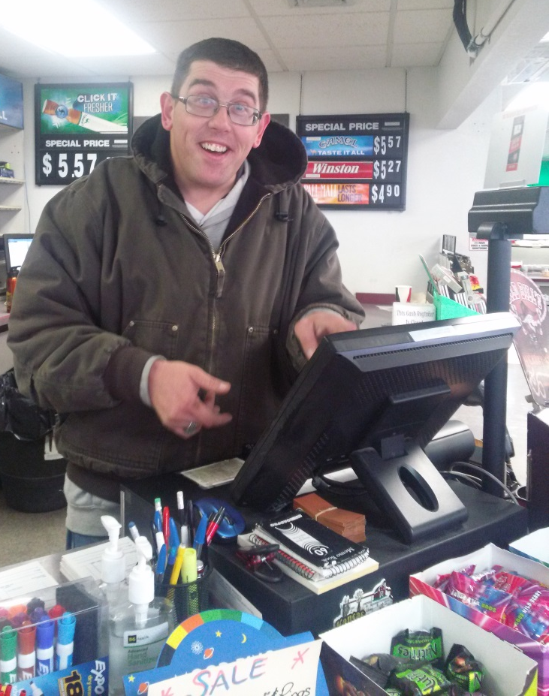
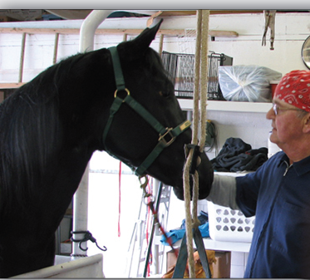
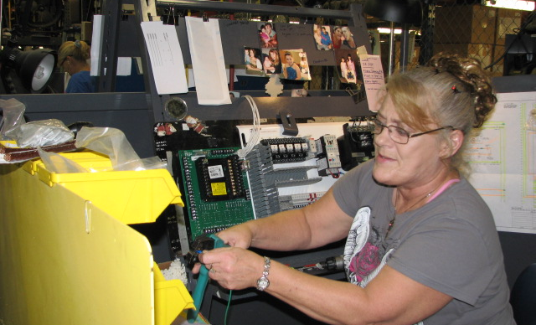
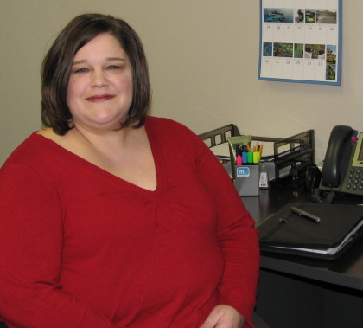
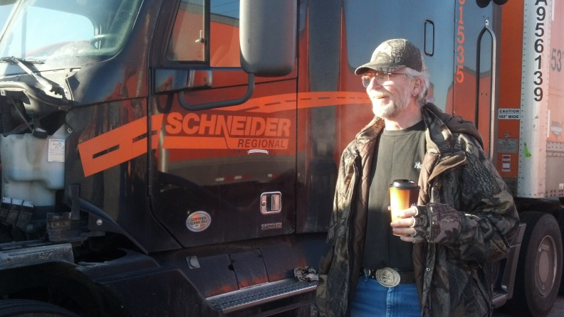
Questions?

Slide 36
Kansas Rehabilitation Services
  Working in partnership with Kansans with disabilities to achieve their goals for employment, independence and self-sufficiency
  Daniel Decker, Director
  555 S. Kansas Ave., 3rd Floor
  Topeka, KS 66603
  785-368-7471
Photos featured in this presentation may not be copied, reproduced
or posted on any electronic media. All rights are reserved by DCF/KRS.

