Slide 1
RETAINWORKS
Facilitated by the Care Collaborative for Western Kansas
Care Collaborative
Sustainability: Primary Value Drivers
RETAINWORKS is funded by the U.S. Department of Labor and the Social Security Administration under a grant award of $21,600,000 to the Kansas Department of Commerce that will be incrementally provided. 100% of grant funding is from U.S. Federal funds.
This document does not necessarily reflect the views or policies of the U.S. Department of Labor or the Social Security Administration, nor does mention of trade names, commercial products, or organizations imply endorsement by the U.S. Government.

Slide 2
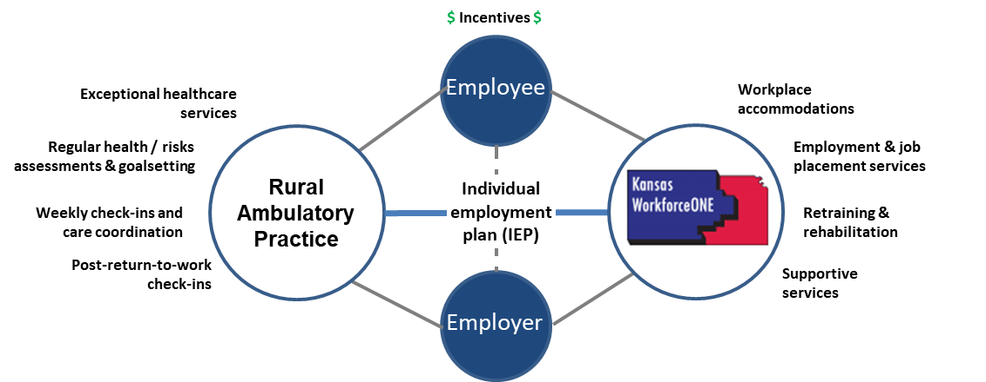
Value Driver: Connection

Slide 3
Value Driver : Nurse Navigation and
Case Management
Coordinating
  Patient
  Provider
  Workforce Center

Slide 4
Value Driver : Workforce Center
Timely supportive services
  Bills
  DME
Employer coordination

