Slide 1


Workers
Compensation
101
Ryan Boswell
Ombudsman, Mediator
Division of Workers Compensation

Slide 2

WORKERS
COMPENSATION
is an insurance plan provided by employers to provide employee benefits for job related injuries, disability or death.
Notes:
I am going to start with a quick definition of Workers Compensation. (Read Screen).
So, what do I mean by “employee benefits?”
Employee Benefits typically include medical treatment for an injury or illness and income benefits to replace part of the wages lost due to a disability.

Slide 3
Why do we have Workers Compensation?
Exclusive Remedy
No-Fault System
Notes:
Why do we have Workers Compensation?
Most people understand workers compensation protects the worker, but who else? The employer. Workers Compensation is a defense against lawsuits. The statutes protect employers from lawsuits by employees to recover damages for work-related injuries.
Imagine that someone falls, has a spinal injury and is unable to work. Without workers compensation they could sue the business for millions of dollars. Could your small or medium-size business take a hit like that?
Work comp coverage is referred to as the "exclusive remedy“. The Exclusive Remedy means the Work Comp Act is the only source of legal process and replaces common law, protecting employers from large tort awards. In exchange for this protection, employees typically receive benefits even if the worker caused their own injury. Workers Compensation is a no-fault system, meaning we don’t need to assign fault for benefits to be permitted.

Slide 4
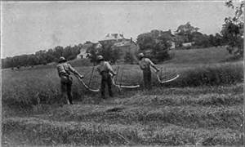
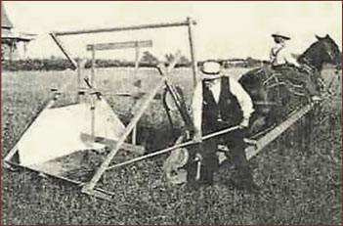
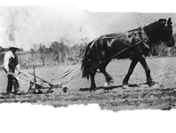
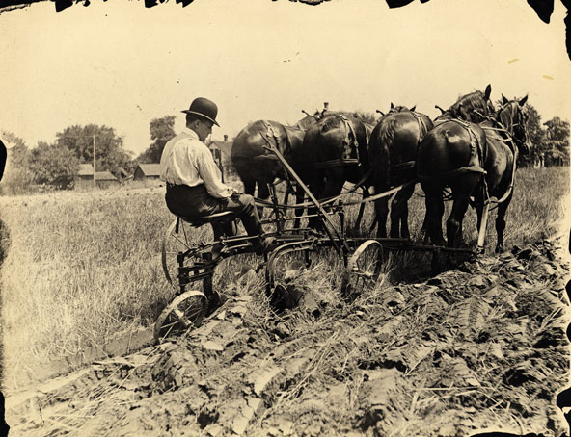
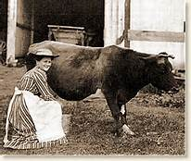
Back Breaking Work
Notes:
Think back…many of your past relatives may have been farmers, even Kansas farmers. Imagine plowing 100 acres with your horse and plow. It was literally back-breaking work. What would happen if you got hurt? One answer was take a swig of Granny’s rheumatism medicine and get back to work. Typically though, your family, neighbors and friends would all pitch in to help. There was a sense of moral obligation to the group or community. I help you out now and later your family will help me and my family. It’s a community working together. Then the industrial revolution began.

Slide 5
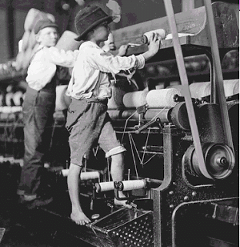
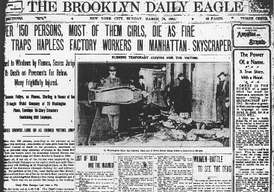
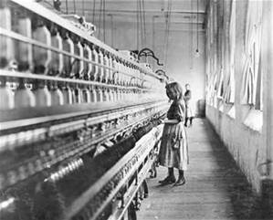
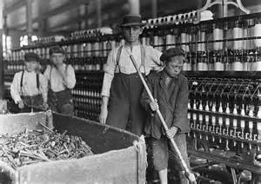
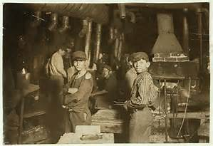
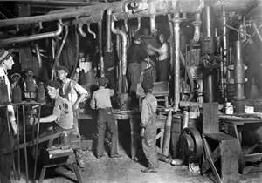
Notes:
With industrialization people moved to the cities to work in factories and away from rural communities. Often, the families had male wage earners. But many families also required others including children to work to makes ends meet. So now, what happens if those who are bringing in the wages get hurt? It became very different from the community spirit of the agricultural society. You don’t have family and friends that are able to pitch in like they did on the farm. They can’t go to work for you at the factory.
One example often provided is the Triangle Shirtwaist Fire of 1911, in New York. It was one of the deadliest industrial fires in US history… a shirt factory in a 10-story building, where 146 people died, almost all women and recent immigrants, with the youngest 2 victims being 14 years old. A fire started on the 8th floor, doors and stairwells were locked or blocked, which was common practice then to stop employees from sneaking out. And of course, no alarm system. With the lives of so many wage earners lost, what were these families to do? So the government had to step in and create Workers Compensation.

Slide 6

“It’s a Pirate’s Life For Me!
The Benefits Are Great.”
Notes:
Workers compensation is not a new idea. The history of compensation for bodily injury begins shortly after the advent of written history itself. Ancient Sumeria (modern day Iraq) had the Code of Ur-Nammu which dated to approximately 2050 B.C. The Code of Ur-Nammu provided monetary compensation for specific injury to workers' body parts, including fractures. Ancient Greek, Roman, Arab and Chinese laws had records of compensation schedules for the loss of a body part in the course of work. In the late 1600s, Piracy was a famously dangerous occupation. Pirates were among the first recipients of compensation for an on-the-job injury. Similar to today’s compensation schedules, benefits differed based on injury. For example, the loss of an eye or finger would merit about 50 weeks’ worth of wages, and losing the right arm netted 300 weeks. Although there was no recorded compensation for death, injured crew members could stay on board and perform less strenuous tasks. Thus, creating the first “return-to-work program.” So the idea of worker’s compensation has been around for a long time.

Slide 7

Notes:
In more modern times, Germany’s Otto von Bismarck started the Workers' Accident Insurance in 1884 creating the first modern system of workers' compensation. He argued that the program created security and certainty for employers and employees.
The Workers' Compensation Act was proposed in England’s Parliament in 1893 and was largely equivalent to the 1884 Prussian law in establishing a "no-fault" doctrine of compensation. Unlike the German model, it did not fully rely on state administration. Instead the "Friendly Societies" which had organized various forms of private disability insurance for workers for many years were relied upon to provide the insurance itself.
The first comprehensive workers' compensation law in the US was passed in Wisconsin in 1911. Kansas was second by just 2 weeks. Nine other states passed regulations that year. Thirty-six other states had some form of workers compensation before the decade was out. The final state to pass workers' compensation legislation was Mississippi in 1948.

Slide 8
Grand Bargain
Specific Benefits
No Fault
Safety Net
No Law Suit
Limits Benefits
Good for Commerce
Notes:
Workers compensation is the Grand Bargain. Both employers and employees give up certain advantages in return for other advantages. Employers trade liability, regardless of fault, for protection from large tort awards. While employees surrender the right to sue, they gain swift medical treatment and limited financial benefits. Fault is not an issue. The employee, employer or an external issue could have caused the injury and the employee will still receive benefits. This creates a safety net for injured employees. By the employer allowing these benefits, lawsuits are eliminated. Eliminating the possibility of business-crushing multimillion-dollar lawsuits is very good for commerce. At first, this was only for specific professions that were extremely dangerous such as mining, but now it covers most employees.

Slide 9
No Fault
Doesn’t mean the employee can deliberately cause an injury or recklessly violate workplace safety rules or regulations
The employee still must use reasonable protection against an accident or injury
Culture of safety by the employer
Notes:
The employer must promote a culture of safety. Failing to do so can mean employees are awarded benefits even if they don’t use a safety device. Example: Seat belts

Slide 10
3 METHODS OF COVERAGE KSA 44-532(b)
Insuring with an insurance carrier authorized in the state of Kansas
Self-insurance
Maintaining a membership in a qualified group funded workers compensation pool (info at www.insurance.Kansas.gov, Kansas Insurance Dept)
Notes:
Employers can obtain workers compensation insurance by 3 different methods (read slide)
Typically self-insurance is for large corporations that have been established for at least 5 years, or is purchasing a company that has been in business for at least 10 years.
Pooled groups are typically new businesses or high-risk businesses that cannot obtain insurance through an authorized insurance carrier. Information on group-funded pools is available through the Kansas Insurance Department.

Slide 11
X8
E1
M3
E1
P3
T1
Sole Proprietor, Partnerships
$20,000 or less in gross annual payroll
Agricultural Pursuits
Real Estate Agents
Members of a Limited Liability Company (LLC)
Sub-Contractors/Independent Contractors
Notes:
Not all employers have to carry workers compensation insurance. Some employers are exempt. Such as (read screen).

Slide 12
Elections
Certain employers or individuals can elect to come under or elect themselves out of the Workers Compensation Act
Examples:
  Owner of 10% or more corporate stock
  < $20K employer elects to cover workers
  Exempt person to come under The Act
  To cover volunteers
Notes:
(read screen)

Slide 13
Injury is defined in K.S.A. 44-508(f)
as a lesion or change in the physical structure of the body causing damage or harm.
Accident
Repetitive Trauma
Occupational
Disease
Injury
Notes:
Workers Compensation requires an injury. Injury is defined in KSA 44-508(f). It is a lesion or change in the physical structure of the body causing damage or harm. Injuries are grouped into 3 categories: accident, repetitive trauma or occupational disease. Let’s talk a little about each of these.

Slide 14

Accident
K.S.A. 44-508(d)
Unexpected
Specific date
Specific place
Notes:
The definition of an accident can be found in K.S.A 44-508(d). An accident is unexpected and typically is unfortunate in nature. An accident has a set place, date and time where it happened, and produces symptoms. Falling off a ladder would be considered an accident. Standing up…right after your coworker opens the file drawer above your head…would be an accident.

Slide 15

Repetitive Trauma
K.S.A. 44-508(f)
Repetitive use, cumulative traumas or micro traumas
Demonstrative by diagnostic
  or clinical tests
No specific date or time for injury
  The date advised by physician that the condition is work related
Notes:
The definition of repetitive trauma can be found in K.S.A 44-508(f). A repetitive trauma is repetitive or cumulative. There is no set date or time. It happens over an expanded time period. Think of a hairdresser continuously using scissors, data entry operator typing, butchers/meat processors using knives to cut and chop. Carpal tunnel and tendonitis are examples of repetitive trauma. What would be some other repetitive traumas?

Slide 16
Occupational Disease
K.S.A. 44-5a01
Disease arising out of and in the course of the employment and within one year of the last injurious exposure
The occupation would have a particular or peculiar hazard distinctive to that employment
The hazard of the disease associated with the employment is in excess of that of the general population
Notes:
The definition of an occupational disease can be found in K.S.A. 44-5a01. This is a disease caused by the occupation. The disease has to be associated with the employment and the employee must be at a higher risk than would be the general public that does not work there. Various lung diseases like asbestosis, silicosis, black lung; skin diseases from regular exposure to chemicals or other irritants are examples of Occupational Disease.

Slide 17
Prevailing Factor – K.S.A. 44-508(f)
Arises out of and in the course of employment
The primary factor in relation to any other factor
If due to a preexisting condition, then the incident is not compensable
Notes:
For workers compensation, a work-related incident must be the prevailing factor that caused the injury. The work-related incident must have caused a physical change in the body and not simply caused a prior injury to become symptomatic. For example, we have an aging and overweight workforce. Both these factors may lead to arthritis in the knee. Someone could have this condition without knowing it nor being diagnosed. Now, while at work, the worker twists a knee and requires surgery. Is twisting the knee the prevailing factor for the surgery or was age or weight the prevailing factor? To be covered under Workers Compensation the twisting of the knee would have to be the prevailing factor. The injured worker must prove the work incident caused the injury. Having credible medical records is a must to help determine the prevailing factor.

Slide 18
Substance Impairment
An employer is not liable for workers compensation benefits if an employee is impaired and the impairment contributed to the injury.
Notes:
Pay close attention here to the words ‘impairment contributed’. For example, if Joe is drunk at work, climbs up the scaffolding and falls because of poor footing due to his drinking, then the impairment of alcohol contributed to his fall injuries. Now, if Joe is drunk at work and standing by the scaffolding when a brick falls on his head from above, did his impairment contribute?
If a test for drugs or alcohol should be positive, then it is presumed that the impairment contributed to the injury. But presumptions can be overcome.

Slide 19
Substance Impairment
An employee’s refusal to submit to a chemical test at the request of the employer shall result in the forfeiture of benefits under the Workers Compensation Act if the employer has sufficient cause to suspect the use of alcohol/drugs by the claimant or if the employer’s policy clearly authorizes post injury testing.
Notes:
(read screen) An employee is considered to be impaired from alcohol if the blood alcohol concentration at the time of injury is .04 or higher. The law, KSA 44-501(b)(1)(C), has listed concentrations for other substances such as marijuana, cocaine and opiates. The employer’s drug policy should be strictly and uniformly followed. If a test is given, the employer must have a split sample taken. One sample is for the employee to have tested, if the first test is positive.

Slide 20
Notice of Injury
Injuries must be reported to the employer
  calendar days from the date of the accident
  calendar days from the date when the employee seeks medical treatment
  calendar days from the employee’s last day of work
  days from disablement from occupational disease
20
20
10
90
Notes:
Employees have very specific time frames to report an injury. Since April 2013, employees have 20 days from the date of accident. This would be for an injury that had a certain date associated with it, such as someone falling and breaking their leg.
Next is 20 days from the date of medical treatment. This would be for an injury that doesn’t have a date associated with it. – repetitive trauma. An example would be carpal tunnel syndrome, where the injury occurred over a long period of time.
And finally 10 days from the employee’s last date of employment. There is a shorter period of time for notification of injury to help control any type of revenge filing against the company.
This was changed in April, 2013. Prior to April, 2013 employees had 10 days from the incident or 75 days with good cause. That is 2.5 months. Some of you may be thinking 20 days seems like a long time, too. So this is an example, you strained your back while carrying a box of supplies. Your back is sore, but doesn’t seem to need immediate medical attention. First thought, go home and ice it or put some heat on it. Next morning still sore, but you think once you get moving it will work itself out. Still hurts for the next few days, you think it just needs time. Now it has been a couple weeks with no improvement and you go to the doctor and learn you need surgery. So the idea is to give employees time to determine if this needs to be reported.

Slide 21
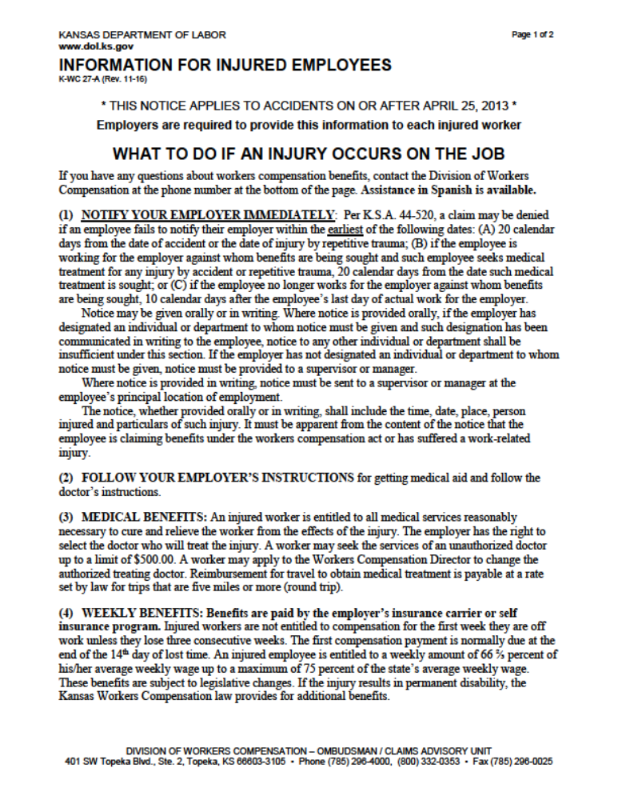
Employer Must
Once an employer is notified of an injury, the employer must provide K-WC 27-A (English) or K-WC-270A (Spanish) to the employee, or dependent if death occurred.
Notes:
(read screen) The K-WC 27A form is available in English and Spanish (K-WC 270A) and available to download from our website. On the bottom of the 2nd page the employer must write in their WC insurance carrier’s information so the employee has this information.

Slide 22
Employer Must
Send employee for medical evaluation / treatment
The employer should respond quickly to have the greatest chance for a successful outcome
Notes:
Once notified of injury the employer should send the employee for medical treatment – ER/urgent care clinic or schedule appt with assistance from wc carrier (read screen).

Slide 23
DO NOT
Employers
pay for
any workers compensation expenses out of pocket unless they are a self-insured employer
Notes:
Deductible is paid to the carrier after the carrier pays the medical provider.

Slide 24
Claim
Employer/insurance carrier has the right to designate the treating physician
Injured worker may seek services of an unauthorized physician up to $500 in fees
  Notify Insurance Adjuster
  Cannot be used for functional impairment rating
Notes:
When seeking medical treatment the employer or insurance carrier has the right to determine where the employee goes for treatment. However, the injured worker can elect to go somewhere else for treatment up to $500 in fees. The worker should notify the insurance adjuster for payment to be made. This treatment is limited to exam and care and cannot be used for obtaining a functional impairment rating. If an employer fails or refuses to file a claim, the worker can seek medical care and the employer is liable for the costs.

Slide 25
Benefits Include
Employer provides
  Medical treatment, including medicines
  Temporary partial wage replacement
  Medical mileage for more than 5 miles round trip, or transportation services
In addition, if injury leaves a permanent impairment, the employer will provide
  Permanent impairment award
Notes:
If the injury is compensable then the employer provides
1) Medical treatment to cure or relieve the employee from the effects of the injury, including medications and equipment,
2) Partial wage replacement if the employee is off work or working with reduced income, and
3) if the injury is permanent in nature, the employer is responsible for an award (settlement) of additional benefits.

Slide 26
Medical Records
The patient’s privilege of preventing the furnishing of medical records by a health care provider is waived when seeking worker compensation benefits
Unreasonable refusal by an injured worker to cooperate in providing the employer/carrier medical information may result in compensation being denied or terminated
Notes:
HIPPA not applicable to workers compensation claims

Slide 27
Maximum Benefits as of
July 1, 2023
Medical treatment (includes Rx) - no limit
Medical mileage > 5 miles round trip at $0.655 per mile
Maximum weekly benefits - $804
Temporary total disability (TTD) - $130,000
Permanent partial disability (PPD) - $130,000
Permanent total disability (PTD) - $155,000
Notes:
Maximum benefits are revised every fiscal year. The current benefits were revised as of July 1, 2023, and are (read frame).

Slide 28
Maximum Fatality Benefits as of July 1, 2018
Death with spouse/wholly dependent children: $300,000 – paid 50/50
$60,000 immediately, balance paid weekly
Death with no spouse/children but other wholly dependent: $100,000
Death with partial dependents: Percentage of 3 x annual earnings up to $100,000, not < $25,000
Notes:
In a death claim, there is a provision that allows for an immediate payment of $60,000 to the surviving spouse/dependent children, with the remainder to be paid over time at the weekly compensation rate, but not less than a minimum, which is 50% of the state’s AWW. Children receive payments until age 18, regardless of max. Also, children who are students or disabled will receive benefits through age 23, not to exceed the max. All related medical expenses are covered. Limits of age, death and marriage do apply.

Slide 29
Maximum Fatality Benefits as of July 1, 2018
Death with no dependents: $100,000 minus employer life insurance > $50,000
Burial: $10,000
Conservator: $2,500
Table of Maximum Benefits Available at www.dol.ks.gov

Slide 30
Categories of Disability Benefits
Temporary Total Disability (TTD)
Temporary Partial Disability (TPD)
Permanent Partial Disability (PPD)
  Scheduled
  Non-Scheduled/Whole Body
Permanent Total Disability (PTD)
Notes:
The different categories of Worker Compensation Benefits are:

Slide 31
Temporary Total Disability (TTD)
Due if injured employee is unable to engage in substantial & gainful employment
Waiting period is 7 calendar days
  If disabled for 3 consecutive weeks the employee is paid for the waiting period
66.67% of employee’s average gross weekly wage, not less than $25 & not more than maximum of $130,000
Notes:
Temporary Total Disability is the most common. It exists when the employee is unable to report to work because of the injury. Benefits are paid for the duration of the TTD. (read slide)
Medical benefits are still collected during the 7 day waiting period. Employees may not collect TTD and unemployment benefits for the same week(s).

Slide 32
Temporary Partial Disability (TPD)
Worker returns to work at a wage less than that at the time of the injury
7-day waiting period applies
Must be temporary
Maximums apply
Notes:
Exists when an employee returns to work at a wage less than the time of injury. Compensation is weekly and continues until the wage loss has ended or the max is met.

Slide 33
Notice
Warning: Acceptance of employment with a different employer that requires the performance of activities you have stated you cannot perform because of the injury for which you are receiving temporary disability benefits could constitute fraud and could result in loss of future benefits and restitution of prior workers compensation awards and benefits paid.
Notes:
This notice MUST accompany all first TTD checks to the claimant

Slide 34
Permanent Partial Disability (PPD)
Complete or partial loss of or loss of use of a
body part(s)
  Scheduled
  Non-Scheduled/Whole Body

Slide 35
Permanent Partial Disability (PPD)
Scheduled Disability
  e.g. leg 200 weeks, thumb 60 weeks
Number of weeks paid is calculated by multiplying the maximum available weeks, less any weeks of temporary benefits, times the percentage of functional impairment.

Slide 36
Functional Impairment
  Injuries after January 1, 2015, ratings are based on the 6th Edition of the AMA Guides
  Injuries before January 1, 2015, ratings are based on the 4th Edition of the AMA Guides

Slide 37
Permanent Partial Disability (PPD)
Non-Scheduled (General) Disability
  Greater of the percentage of functional impairment OR the employee’s reduced ability to perform and average weekly wage
  Employees earning 90% of the pre-injury wage are limited to functional impairment
  Maximum number of weeks is 415
    Excess of 15 weeks of TTD is deducted from max
Notes:
Non-scheduled or General is when an injury is partial in character and permanent in quality and is not covered by the schedule, for example injury to the back, head, both legs, multiple body parts. Compensation for such nonscheduled/whole body disability is based on the greater of the percentage of functional impairment OR employee’s reduced ability to perform and average weekly wage the employee is capable of earning after the injury. Employees earning 90% of the pre-injury wage are limited to functional impairment. The Maximum number of weeks allowed is 415. If an injured worker has received more than 15 weeks of TTD the excess weeks are deducted. For example, if the injured worker had 20 weeks of TTD then you would subtract 15 from 20, which is 5. Then 415 - 5 = 410 weeks. If the worker had 15 weeks or less you would not deduct the TTD weeks.

Slide 38
Permanent Total Disability (PTD)
Exists when the injured worker has been rendered completely and permanently incapable of engaging in any type of substantial or gainful employment
  e.g., loss of both eyes, paralyzed

Slide 39
Permanent Total Disability (PTD)
Benefits are 66.67% of the employee’s average gross weekly wage paid for the duration of the disability
  Not less than $25
  Total compensation up to maximum of $155,000
  NO more than 1 PTD in a lifetime

Slide 40
Ombudsman Section
Assist injured workers, employers, insurance carriers, agents,
attorneys, medical providers, etc.
throughout the workers
compensation process.
785-296-4000 option 2
KDOL.wc@ks.gov

Slide 41
Industrial Safety and Health
Workplace safety and health
assistance is available at
785-296-4386
KDOL.indsafetyhealth@ks.gov
https://www.dol.ks.gov/ish

Slide 42
E
E
E
S
S
U
S
U
U
T
T
T
Q
Q
Q
I
I
I
O
O
O
N
N
N
S
S
S

Slide 43
Arigato
Gracias
Obrigado
Takk
Salamat
Hvala
Thank You
Danke
Asko
10Q
Toda
Falemnderit
Merci
Thanks
Grazie
Mahalo
Köszönöm
THX

Slide 44
Contact Information
Department of Labor
785-296-4000 or 800-332-0353
Ombudsman Unit, Option 2
Ryan Boswell
Ext. 7361
www.dol.ks.gov

Slide 45


Connect With Us
Website: dol.ks.gov
Twitter: @KansasDOL
Facebook: facebook.com/KansasDOL
LinkedIn: linkedin.com/company/KDOL
Instagram: ks_dol

