Slide 1

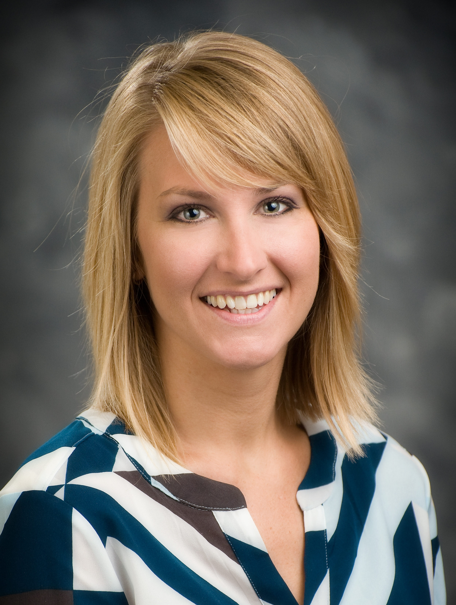
RENEA WILSON
Renea began her work at Stormont Vail Health as a nurse in 2005, later becoming a charge nurse in 2008. In 2011, she took the role of Manager, Emergency Department, and for the last three and a half years has served as the department’s director. She received her Master’s in Nursing and Organizational Leadership from the University of Kansas, Kansas City, Kansas, in 2015.
Renea works collaboratively with other departments and leaders throughout the organization to ensure a consistent patient experience. Their focus is the relationship between building strong programs in quality, safety, patient experience, and team member engagement. She leads organizational efforts to achieve outstanding patient experience scores and a positive community impression. She champions service standards to departmental leadership and team members throughout Stormont Vail.

Slide 2
Patient Experience
Notes:
.

Slide 3
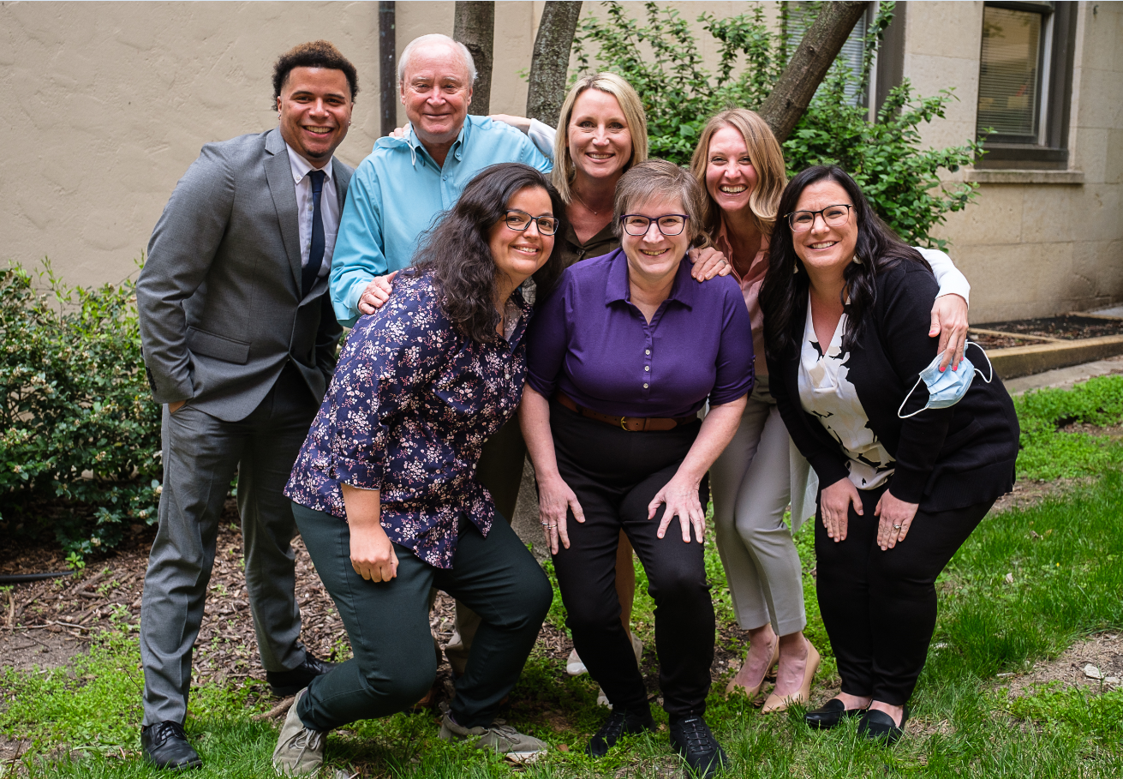
Meet the PX Team

Slide 4
Leadership with committed time and focused to shape, guide and execute experience strategy.
Patient Experience Definition
Reinforce a strong, vibrant and positive organizational culture.
Implement a defined process for continuous patient and family engagement and community partnership.
Engage in the voices of staff, clinicians, and healthcare professionals to drive comprehensive and lasting solutions.
Ensure an active community to both health equity and access to care.
Expand focus on health outcomes beyond treating illness to promoting health, wellness and well-being.
Acknowledge the healthcare experience reaches beyond clinical interactions to all touch points across the continuum of care.
  Eight Guiding Principles

Slide 5
PATIENT EXPERIENCE IS DEFINED AS:
The sum of all INTERACTIONS, shaped by an
organizations CULTURE, that influence
patient PERCEPTIONS,
across the CONTINUUM of care
The Beryl Institute
Patient Experience

Slide 6

Reinforce a strong, vibrant and positive organizational culture.
Implement a defined process for continuous patient and family engagement and community partnership.
Experience

Slide 7



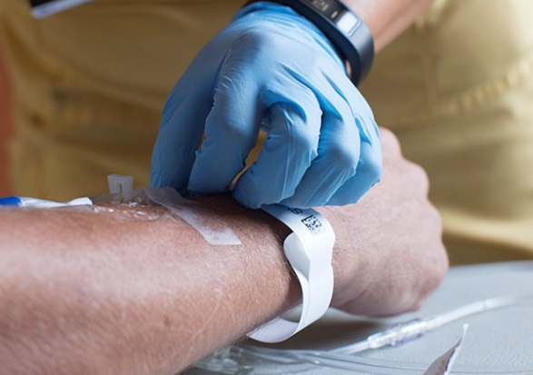
Ensure an active community to both health equity and
access to care.
Acknowledge the healthcare experience reaches beyond clinical interactions to all touch points across the continuum of care.
Engage in the voices of staff, clinicians, and healthcare professionals to drive comprehensive and lasting solutions
Small
Moments
Expand focus on health outcomes beyond treating illness to promoting health, wellness and well-being.
Tenets of Small Moments

Slide 8
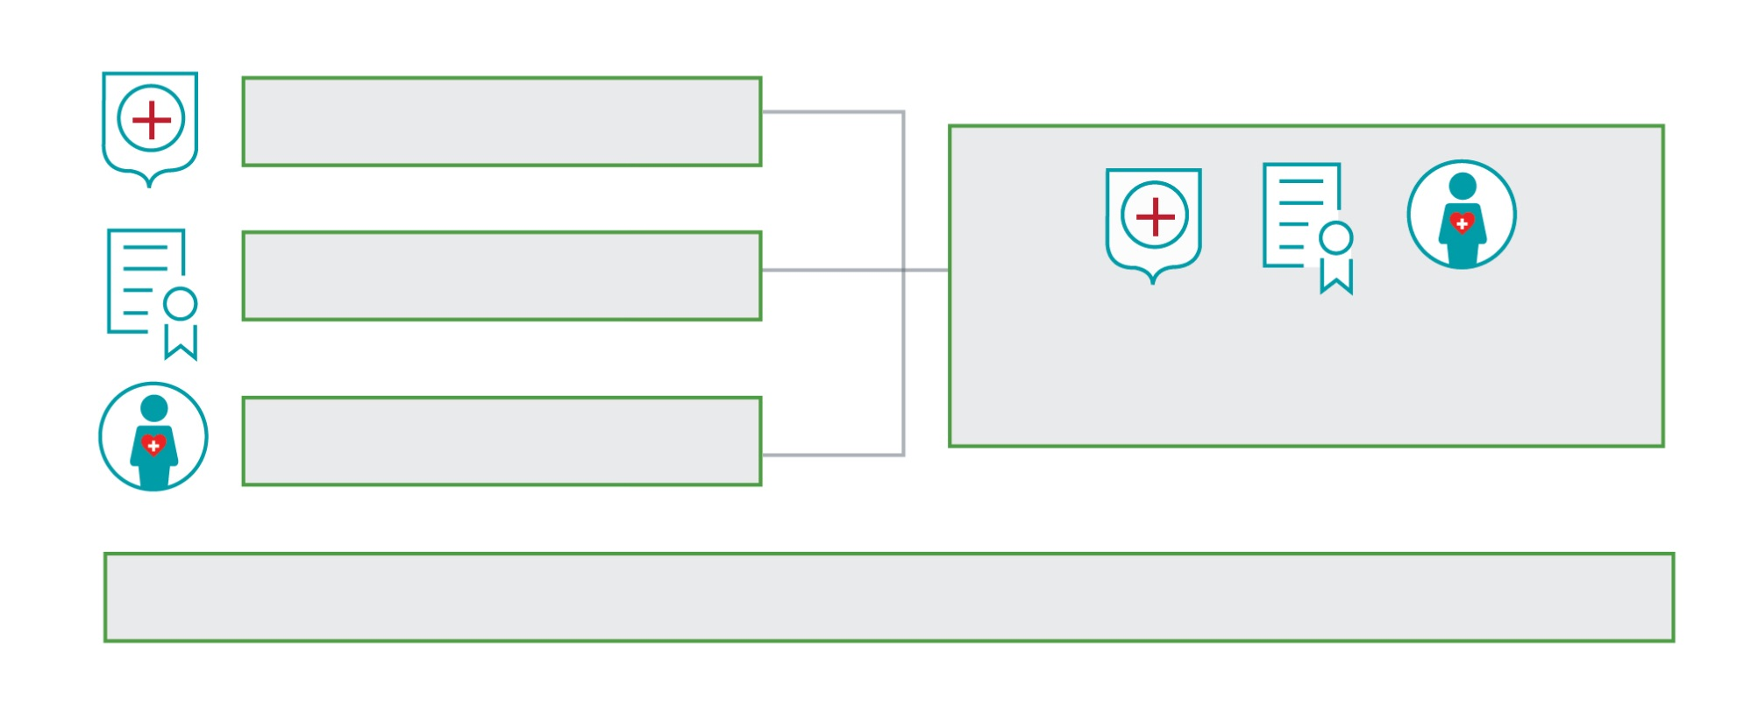







Safe
High Quality
Patient Experience
Patient-Centered
Engaged, Resilient Care Teams
TeleHealth
Virtual
Visits
Physician
Acute
Post Acute
Home
Hospice
CONTINUUM OF CARE

Slide 9
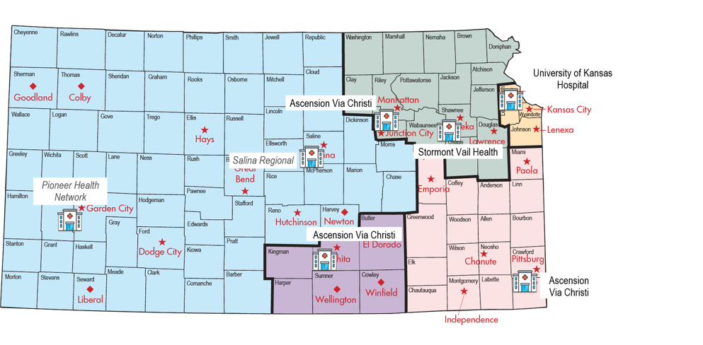





We Together

Slide 10
__
THANK YOU
Notes:
Questions or Thank You Slide

